Slide 1
An Exploration of S-3D video QoE: the binocular depth issue
EXPLORATION OF QUALITY OF EXPERIENCE OF STEREOSCOPIC IMAGES: BINOCULAR DEPTH
W. Chen, J. Fournier, M. Barkowsky, P. Le Callet
VPQM 2012
Quality of experience model for 3DTV
W. Chen, J. Fournier, M. Barkowsky, P. Le Callet
in Proceedings of SPIE Stereoscopic Displays and Applications, 2012

Slide 2
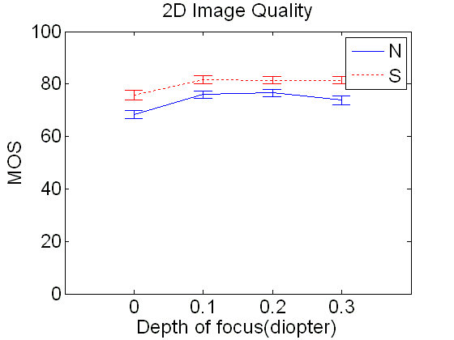
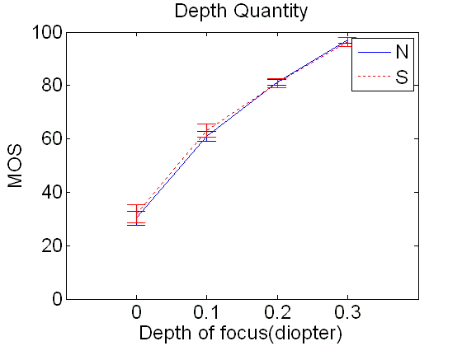
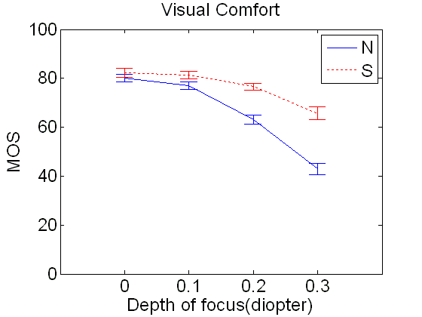
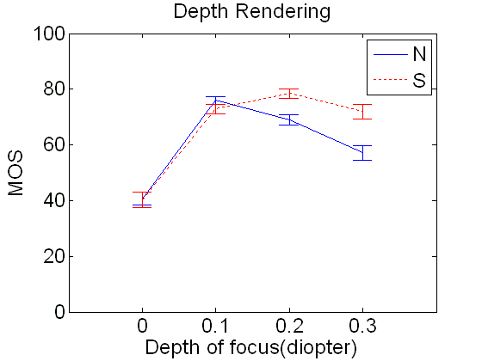
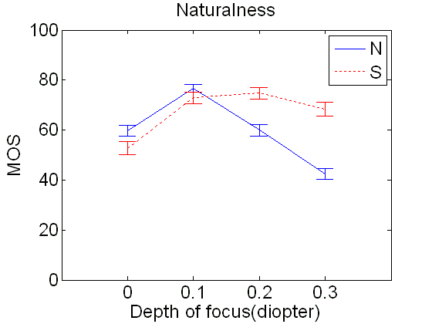
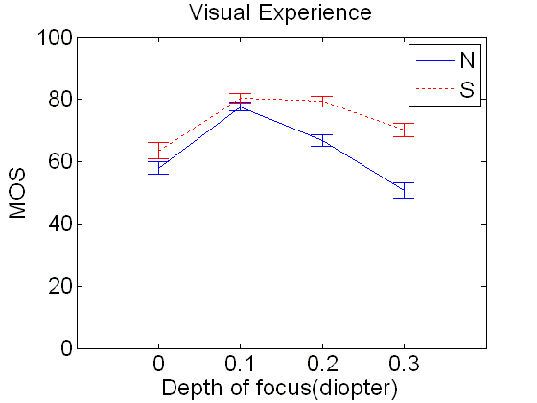
Main results Considering QoE indicators and scene contents
Increasing the binocular depth increase the perceived depth quantity
Increasing binocular depth decrease the visual comfort.
Mean Opinion Score
Visual experience optimization depending on binocular depth
MOS (with their 95% confidence intervals) vs. variation of DoF for different QoE indicators (Natural scene in solid line and Synthetic scene in dotted line)

