Slide 1
VQEG HDR- group
Phil Corriveau, Patrick Le Callet
VQEG Singapore meeting
December 2012
One mission:
The aim of the VQEG HDR project is to develop methods for assessing the quality of HDR video.

Slide 2
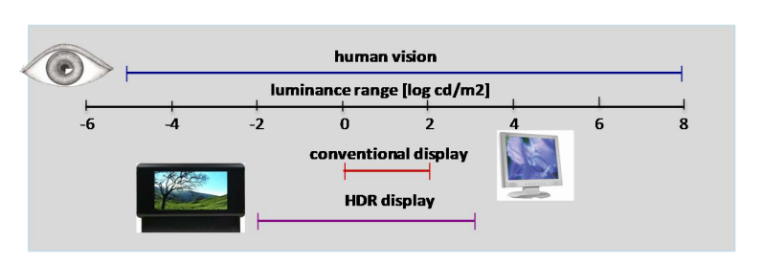
High Dynamic Range
HDR technologies aim at filling the gap between capture and display technologies and the abilities of the human visual system. This will provide a more realistic visual experience compared to current Low Dynamic Range (LDR) imaging
HDR represents the real physical luminance values resulting in
much higher contrast ratios (typical HDR scenes can be more than 10⁶:1)
More finer details and image information incorporated
More compelling and pleasing pictures

Slide 3
HDR and visual quality: new issues
Image capture: Since almost no native HDR sensor exists, the capture step is multi-phased. Natural HDR imagery and video currently cannot be acquired. Consequently HDR content is built up by fusing multiple LDR images
=> Many quality issues can arise from such processing(geometric distortions, ghosting, noises, etc.).
+ usual content delivery issues
Need for efficient compression techniques to store HDR data (will lead to lower QoE!)

Slide 4
Two immediate items
Methodologies:
HDR Displays for HDR testing
Visual experience assessment …beyond Video Quality
Metrics for TMO (Tone Mapping Operator)
LDR metrics !
=> any ‘VQEG’ FR metric is a candidate

Slide 5
Methodology for subjective assessment
Displays
Indentify and qualify displays for HDR testing
Visual experience
The example of 3D
=> Define Items for HDR
Visual experience
2D Image quality
Depth quantity
Visual comfort
Depth rendering
Naturalness

Slide 6
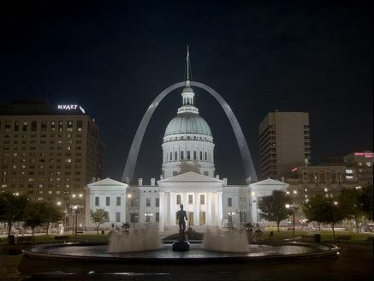
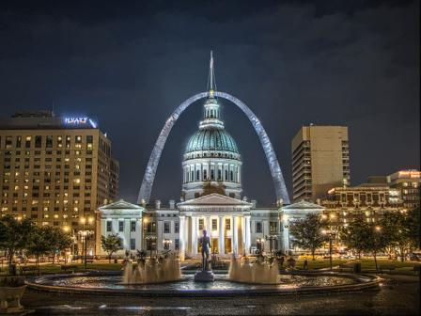
Metrics for TMO
HDR and LDR technologies will have to coexist for some time. HDR to LDR operations (tone mapping) and LDR to HDR operations (inverse tone-mapping) will need to be used. These operations can cause distortion on the original content and even change the original artistic intention.
simple contrast reduction
with local tone mapper
6

Slide 7
Metrics for TMO (2)
Proposal:
Test ‘VQEG’ FR metrics adding TMO (and iTMO) in some HRCs
IRCCyN can produce HRCs
Investigate possible adaptation of the metrics (depends on available ground truth): needs discussions !
Inputs of the metric ?
Agreement between metrics ?
Which model could be available ?
7

