Slide 1
Overview of EBU and EPFL subjective tests on High Dynamic Range video
Ludovic Malfait
Senior Engineer – Communication Group CTO Office
September 15, 2015

Slide 2
EBU and EPFL subjective tests
This presentation summarizes the results of the subjective tests conducted by EBU (European Broadcast Union) and EPFL (Ecole Polytechnique Fédérale de Lausanne)
Further details are available in the following publications:
P. Hanhart, P. Korshunov, T. Ebrahimi, Y. Thomas, H. Hoffmann, “Subjective Quality Evaluation of High Dynamic Range Video and Display for Future TV”, SMPTE Motion Imaging Journal, vol. 124, num. 4, p. 1-6, 2015 http://infoscience.epfl.ch/record/208948
P. Hanhart, P. Korshunov, T. Ebrahimi, Y. Thomas, H. Hoffmann, “Subjective Quality Evaluation of High Dynamic Range Video and Display for Future TV”, International Broadcasting Convention (IBC), Amsterdam, Sept. 2014 http://infoscience.epfl.ch/record/200194
P. Hanhart, P. Korshunov, T. Ebrahimi, “Subjective Evaluation of Higher Dynamic Range Video”, Applications of Digital Image Processing Xxxxvii, Vol. 9217, 2014 http://infoscience.epfl.ch/record/200538
Dolby provided HDR video material and a 42” HDR Reference Monitor (Pulsar)

Slide 3
Need for appropriate subjective test methodologies
There is no recommended methodologies for the assessment of High Dynamic Range video
Some of the existing methods involving single stimulus presentation, such as the Absolute Category Rating (ACR) method with naïve subjects, may not be sensitive enough to compare different grades of dynamic range
In 2014, EBU and EPFL carried out double stimulus subjective tests (Pair Comparison and Comparison Category Rating) with identical contents and display

Slide 4
Test conditions
Labs used six common 20-sec HDR video clips. EPFL used two additional clips.
Four conditions representing real use cases:
4000 nit clips were captured with an Arri Alexa camera and manually graded by professional colorists
100, 400 and 1000 nit clips were tone-mapped from the 4000 nit version
Tone-mapping performed by a tone-mapping algorithm (Dolby’s proprietary algorithm)
4000 nit | Max luminance delivered by the test display
1000 nit | Max luminance that can be observed in today’s consumer TV
400 nit | Max luminance found in high-quality LCD with LED backlight consumer TV
100 nit | Max luminance of standardized monitors for color grading and broadcasting calibration

Slide 5
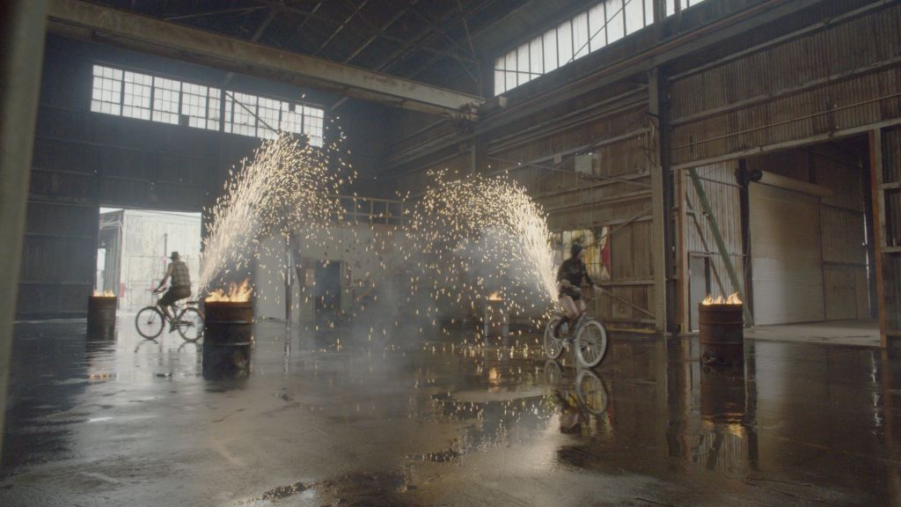
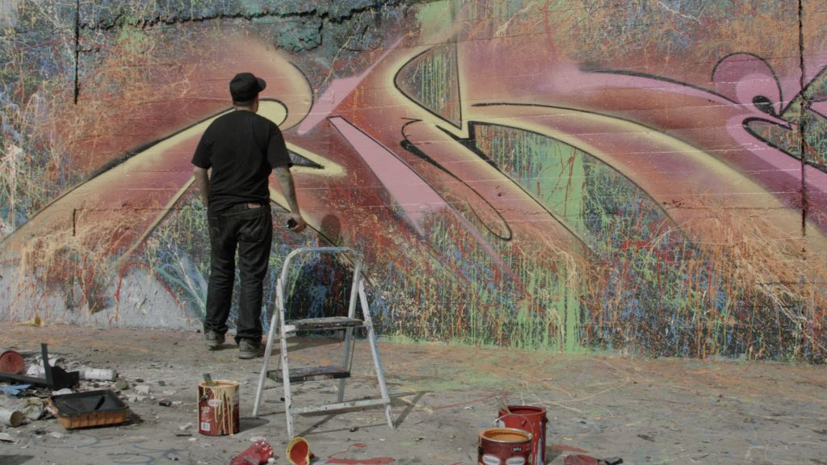
Common test material

Slide 6
Labs setup
Two viewing distances
3H (1.5 m): recommended viewing distance for subjective tests
2.7 m: typical distance from display in a typical home environment
Ambient light
EBU: 10 nits for all subject panels but one. 24 nits for one group.
EPFL: 20 nits
Display
42” HDR Reference Monitor (Pulsar)

Slide 7
Subjects
EBU used experts
EPFL used naïve subjects
All subjects were tested for color vision (Ishihara and Snellen vision tests)
Subjects wearing contact lenses or glasses were advised to wear them during the test
Subject training:
Each subject received verbal instructions
Each subjects participated in preliminary trials to get acquainted with the assessment procedure
Material used during the preliminary trials differed from the material used for the test

Slide 8
Methodology
Double Stimulus, pair presentation with rating provided as forced-choice and as Comparison Category Rating preference scale
Partial pair comparison design - 4000 nit hidden reference presented for every pair comparison (random position)
Subjects were asked to rate the overall quality of pairs considering aspects such as:
color rendition,
quality of the reproduction of skin tones,
details of shadows in the scene,
contrast and the details of highlights,
presentation of light sources appearing in the scene

Slide 9
Ratings
EPFL
EBU

Slide 10
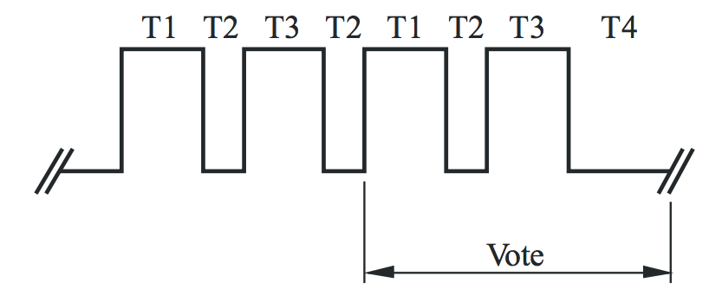
Differences in material presentation
EBU:
Sequential presentation (A/B/A/B)
3-second mid-gray screen between each clip presentation (T2)
5-second mid-grey screen ending each sequence (T4)
50 minutes test time
EPFL:
Side-by-side presentation on a single 1080p display => cropped video sequences (950x1080)
Single presentation
17 minutes test time
Side-by-side presentation resulted in a smaller horizontal Field Of View (FOV)

Slide 11
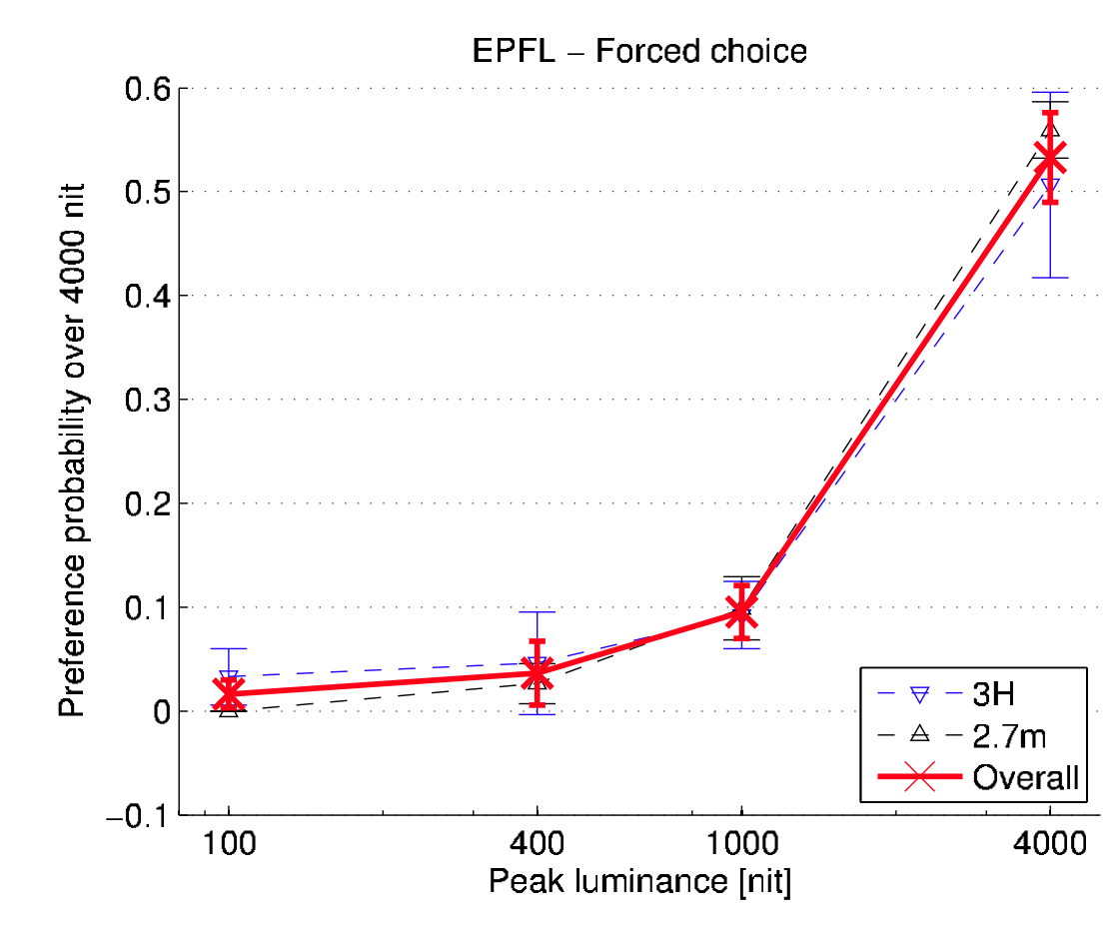
Results – Overall forced choice responses
Overall preference increases as luminance increases
Significant preference for 4000 nit version
Side-by-side presentation provides more reliable results (tighter confidence intervals)

Slide 12
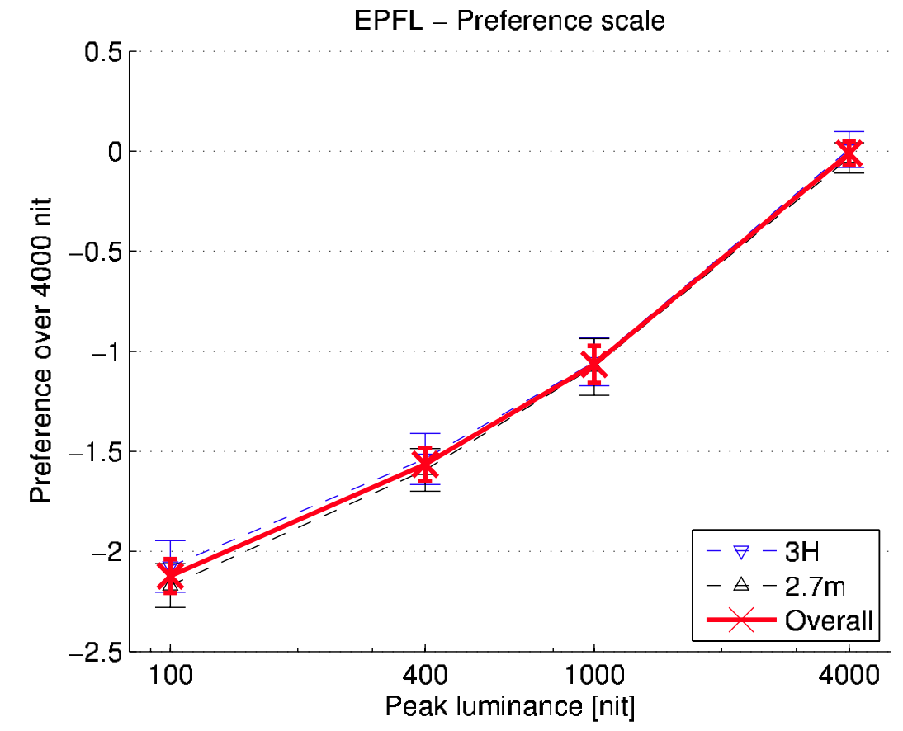
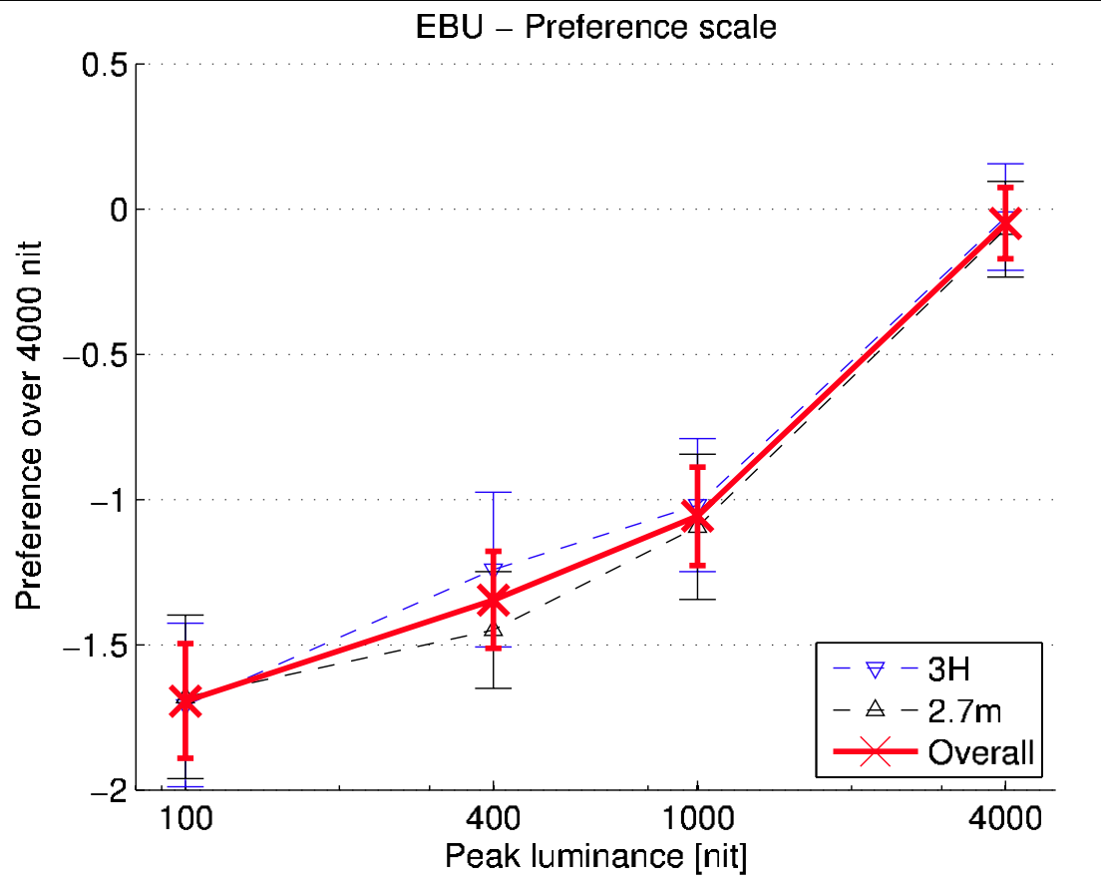
Results – Preference scale responses
Aligned with forced-choice responses
No significant differences between viewing distances
CCR rating provides greater discrimination between conditions

Slide 13
Full paired comparison conducted by EPFL
EPFL also conducted a test will all possible pairs of different conditions as well as the 4000-4000 nits pair (56 pairs in total)
Subjects indicated their preference on a three point discrete scale:
Statistic model, Thurstone Case V, applied on the preference scores to convert ratings from a ternary scale to a continuous-scale quality scores
Left | The same | Right

Slide 14
EPFL full paired comparison – Overall results
Similar to the partial comparison design, the estimated scores increase as the peak luminance increases

Slide 15
Conclusions
Both force-choice and preference ratings indicate an increased preference as the peak luminance increases
Independence of the viewing distance; this does not mean that participants had the same experience in both configurations
Memory effects:
Sequential presentation requires large cognitive load on the viewer due to Visual Short-Term Memory (VSTM) limits
Side-by-side may be affected by iconic visual memory
Split screen set up for side-by-side presents some disadvantages:
Reduced FOV; FOV is important for HDR testing because of the glare effects due to the tails of the point spread function of the human eye’s optics
Local contrast limits of the display
=> For side-by-side, two separate displays should be used

