Slide 1
HEVC/H.265 Performance
Andrew Catellier
NTIA/ITS.T
Boulder, CO

Slide 2
H.265
New!
Standardized!

Slide 3
We did a test
25 viewers
Compared MPEG2, AVC, HEVC

Slide 4
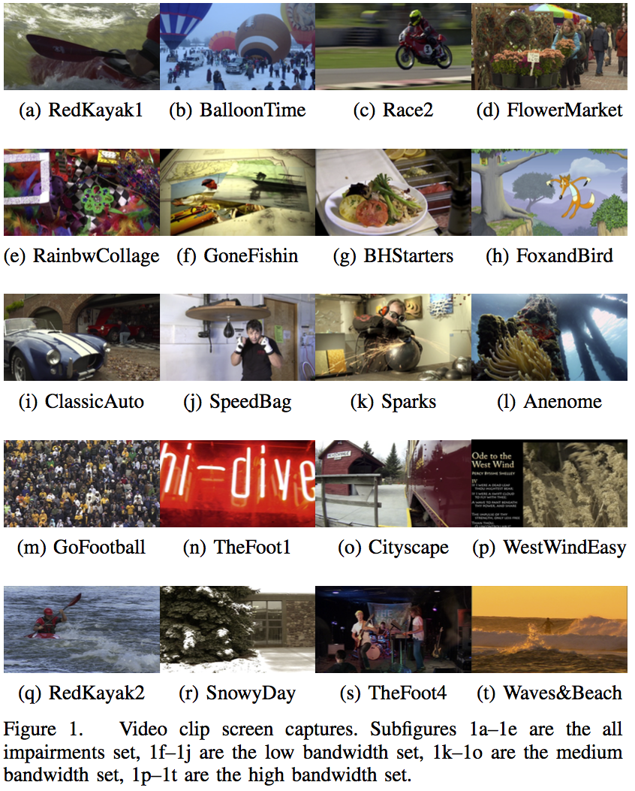
Scene List

Slide 5
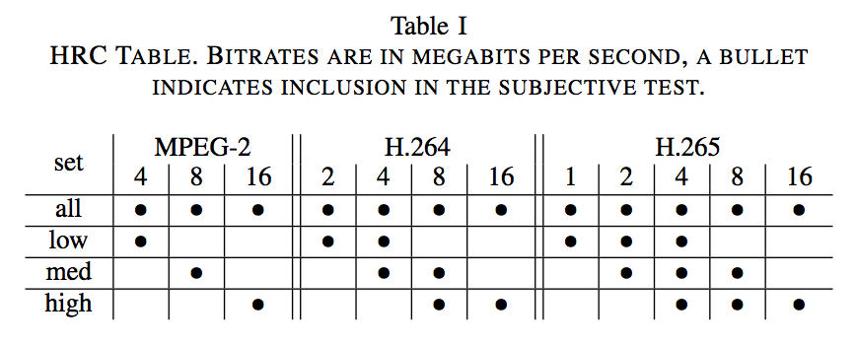
Test design

Slide 6
Test Setup

Slide 7
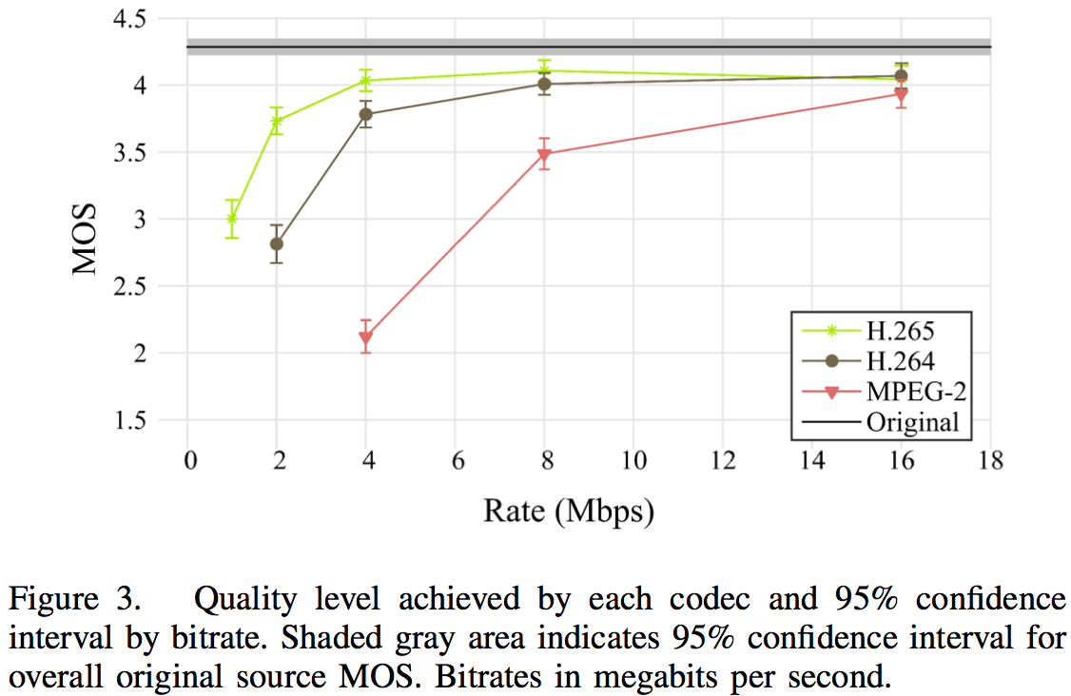
Results

Slide 8
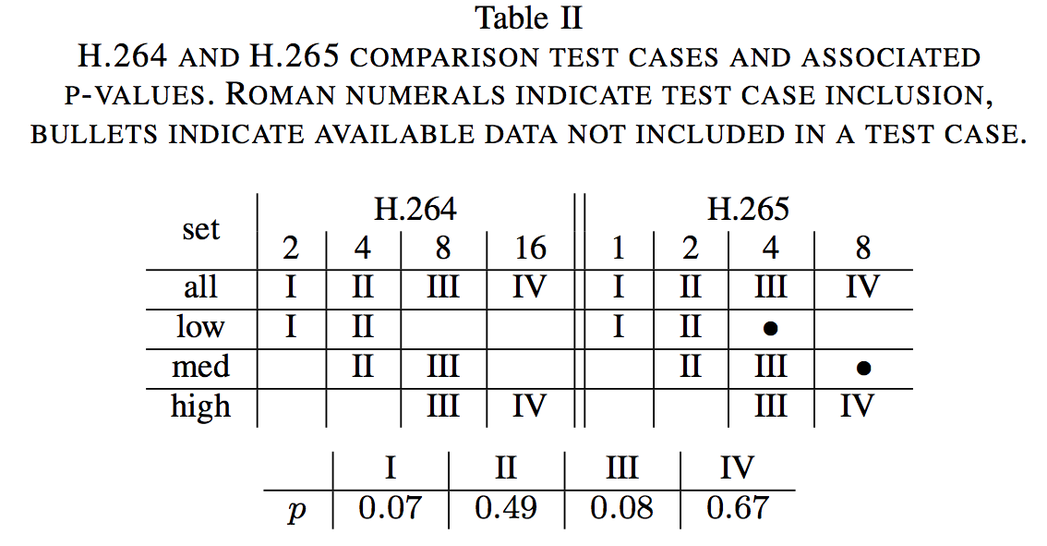
Results

Slide 9
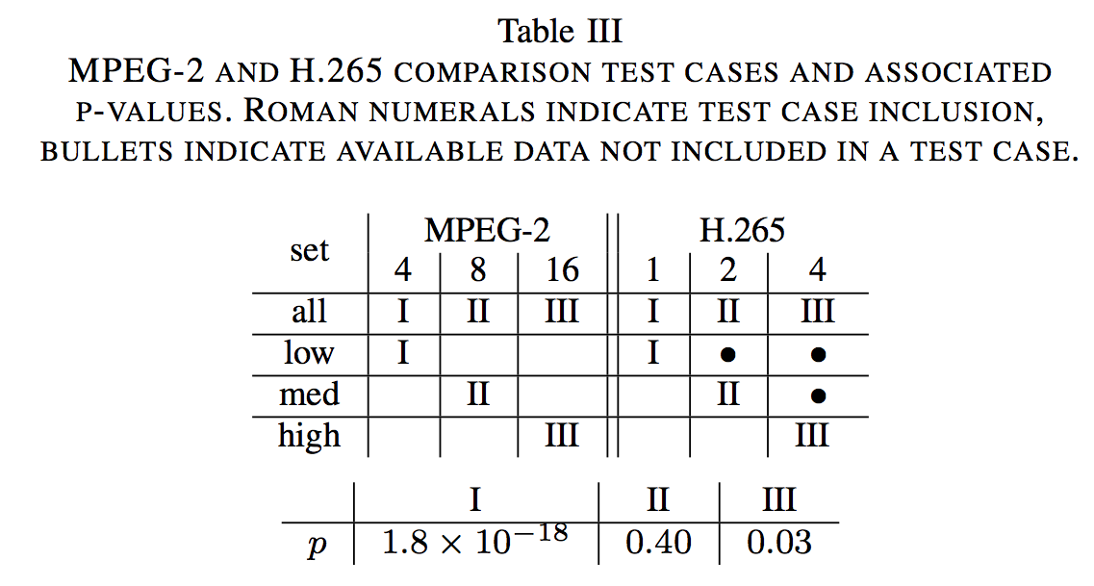
Results

Slide 10
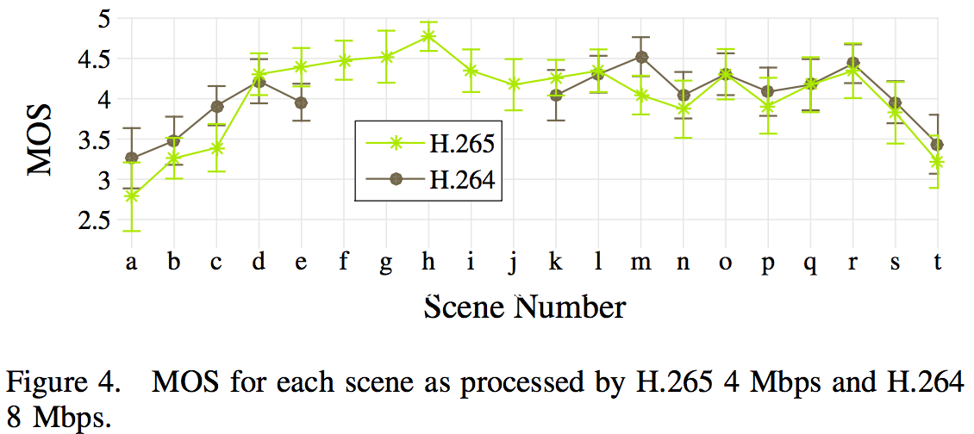
Results

Slide 11
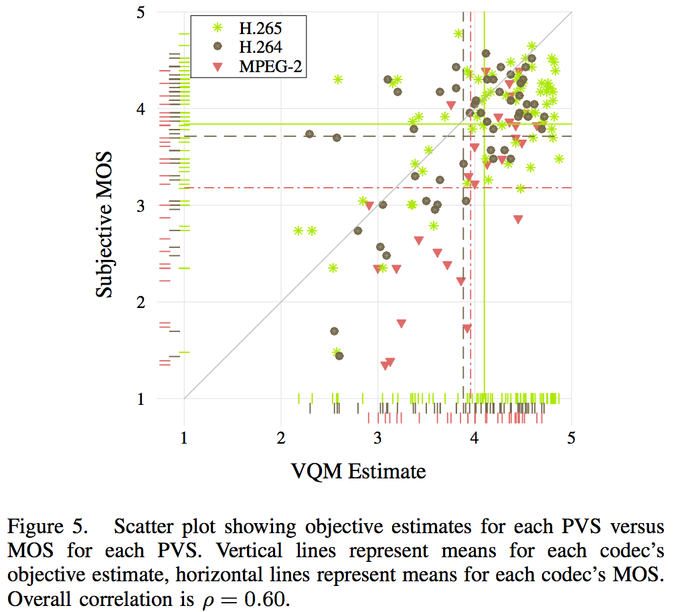
Results

Slide 12
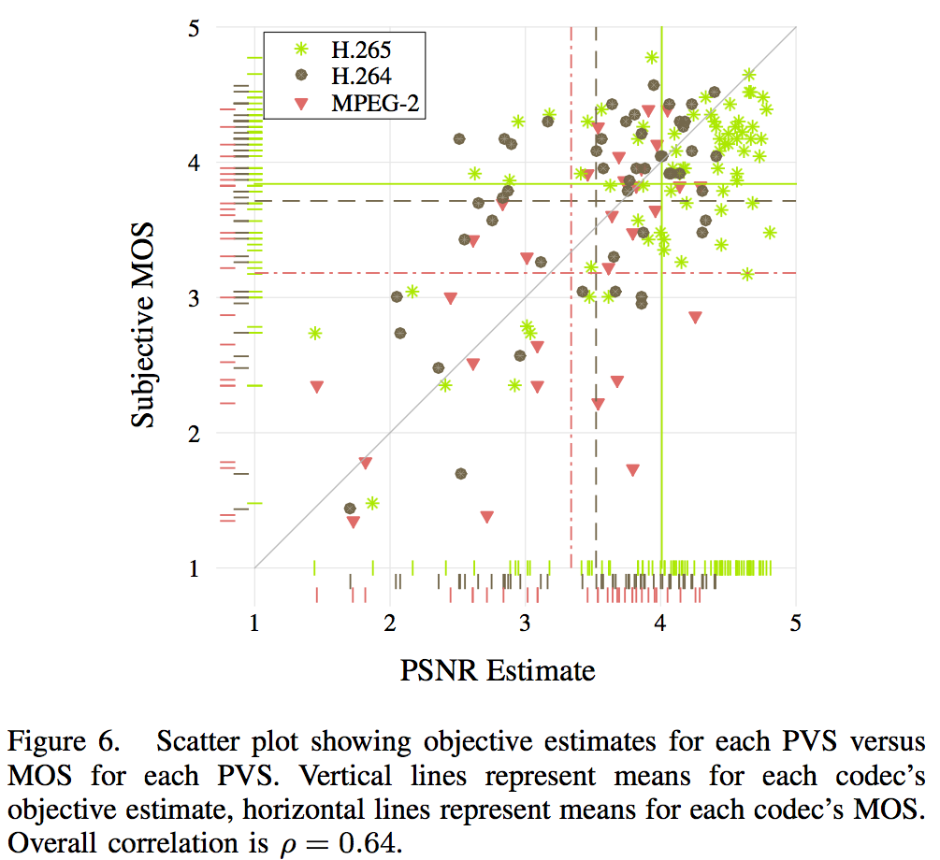
Results

Slide 13
Fin

