Slide 1
JEG-Hybrid
Database
Bartosz Moś, Lucjan Janowski, Marcus Barkowsky

Slide 2
Main Concept
We want to store every data which is we have
The current approach:
Server with a database
A web interface which allow to create, edit and display entries

Slide 3
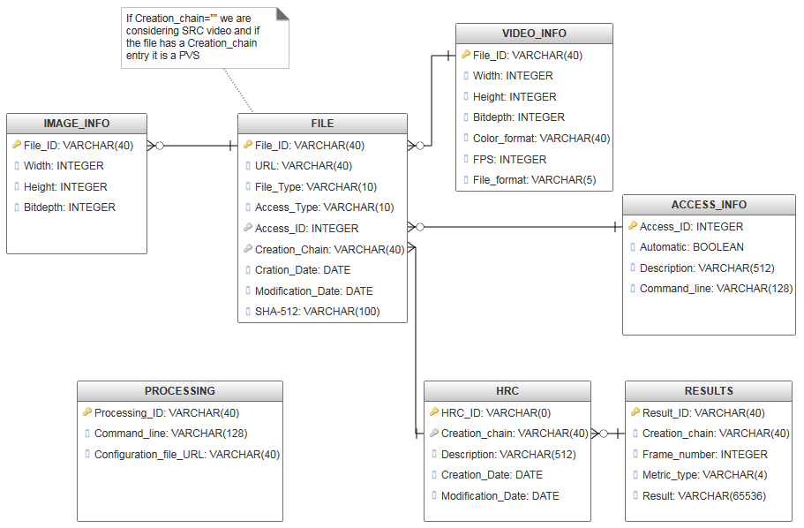
Database Model
1
1 1
1
n
1

Slide 4
Use Cases
Adding a metric
Adding a sequences
Testing a metric
Share subjective test results
Search for particular distortion
Repeating a specific processing chain

Slide 5
Adding a Metric
Sequences
Find sequences with specific distortion
Calculate
Out of the system
Upload
Metric description
Link sequence/frame ID with the value
Each sequence/frame has ID
Values uploading

Slide 6
Adding a Sequence and subjective results
Sequences
Information about frames
Processing chain
Description
Relation to other sequences
Access information
Opinion Scores

Slide 7
Testing a metric
Finding
Find sequences with specific distortion
Calculate
Each sequence/frame has ID
Values for known metrics
Compare with the known metrics
Link sequence/frame ID with the value
Out of the system

Slide 8
Additional Aspects
Authentication of users
Security

