Slide 1
Use cases for 5G networks: video in industrial applications
Kjell Brunnström
RISE ICT Acreo

Slide 2
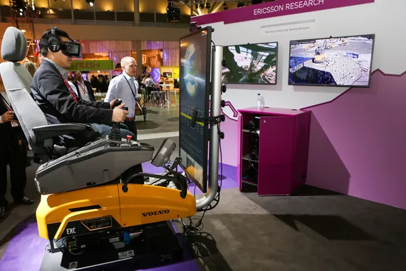
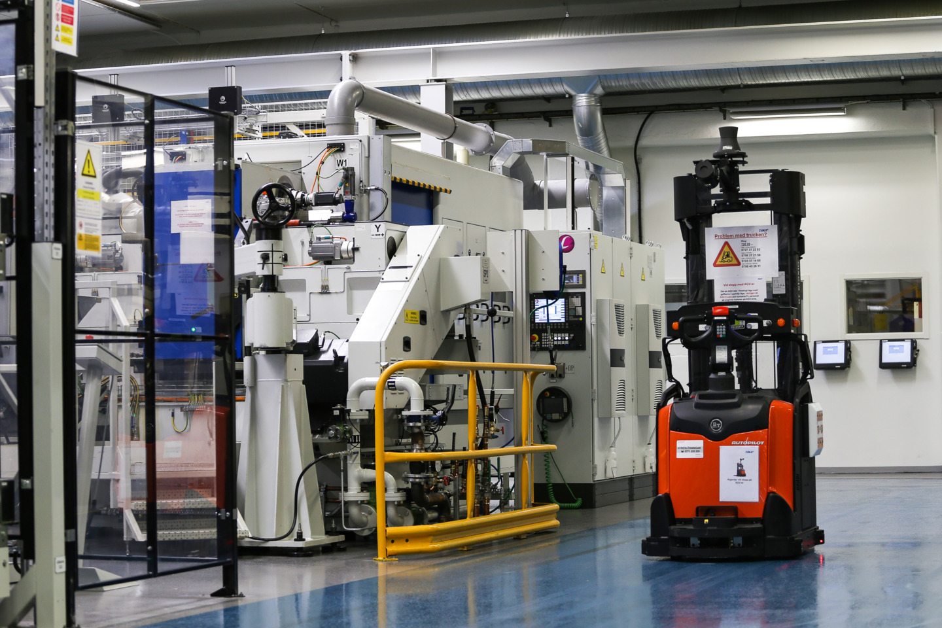
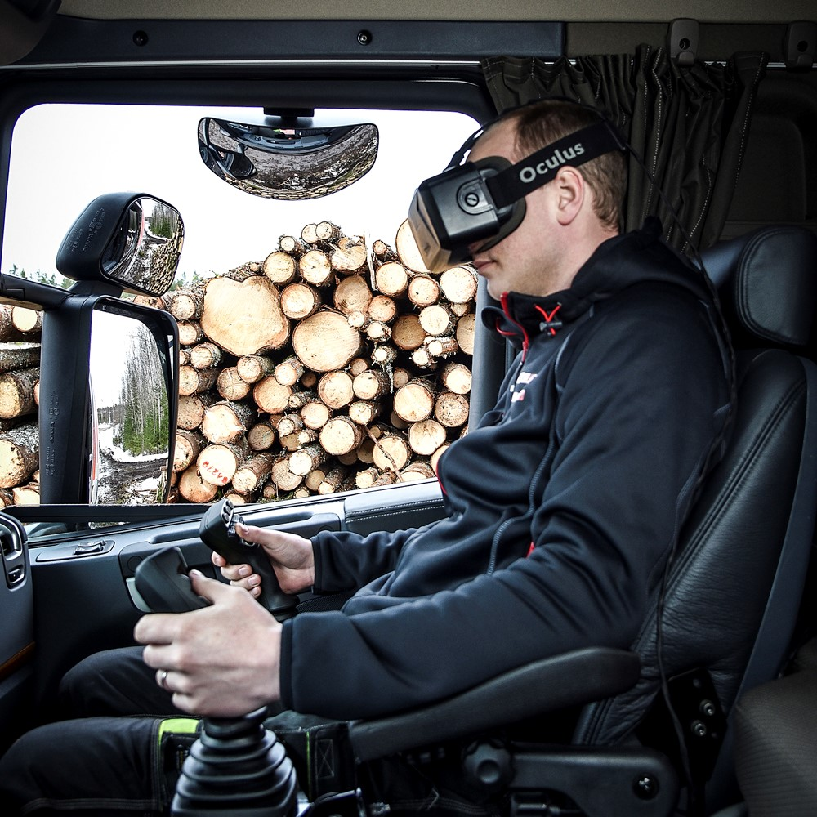
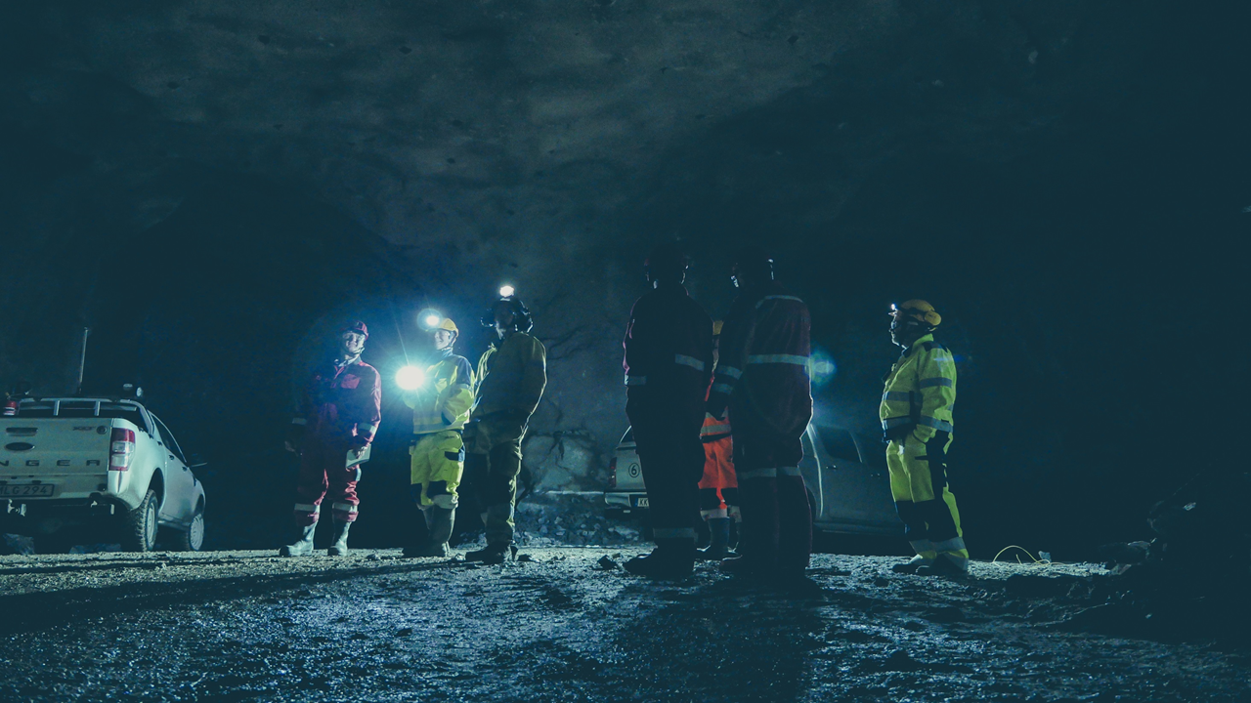
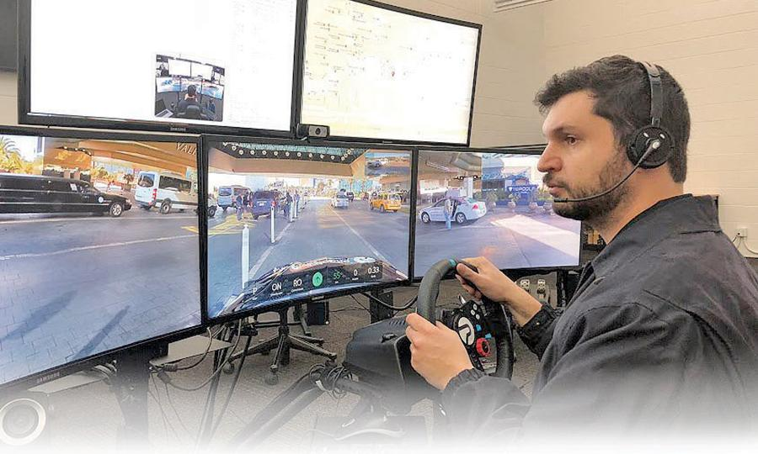
5G will enable
Smart factories – time critical communication
Remote control machines and vehicles
Connected mines – safety and production

Slide 3
5G KPI
High-level:
QoE requirements for VR video for remote control of machinery and other industrial applications
Network level:
Medium level KPIs and QoS based on machine learning
Low-level:
Low level KPIs e.g. latency, bitrate, codecs, jitter

Slide 4
Thank you!
Kjell Brunnström
kjell.brunnstrom@ri.se
RISE Acreo

