Slide 1
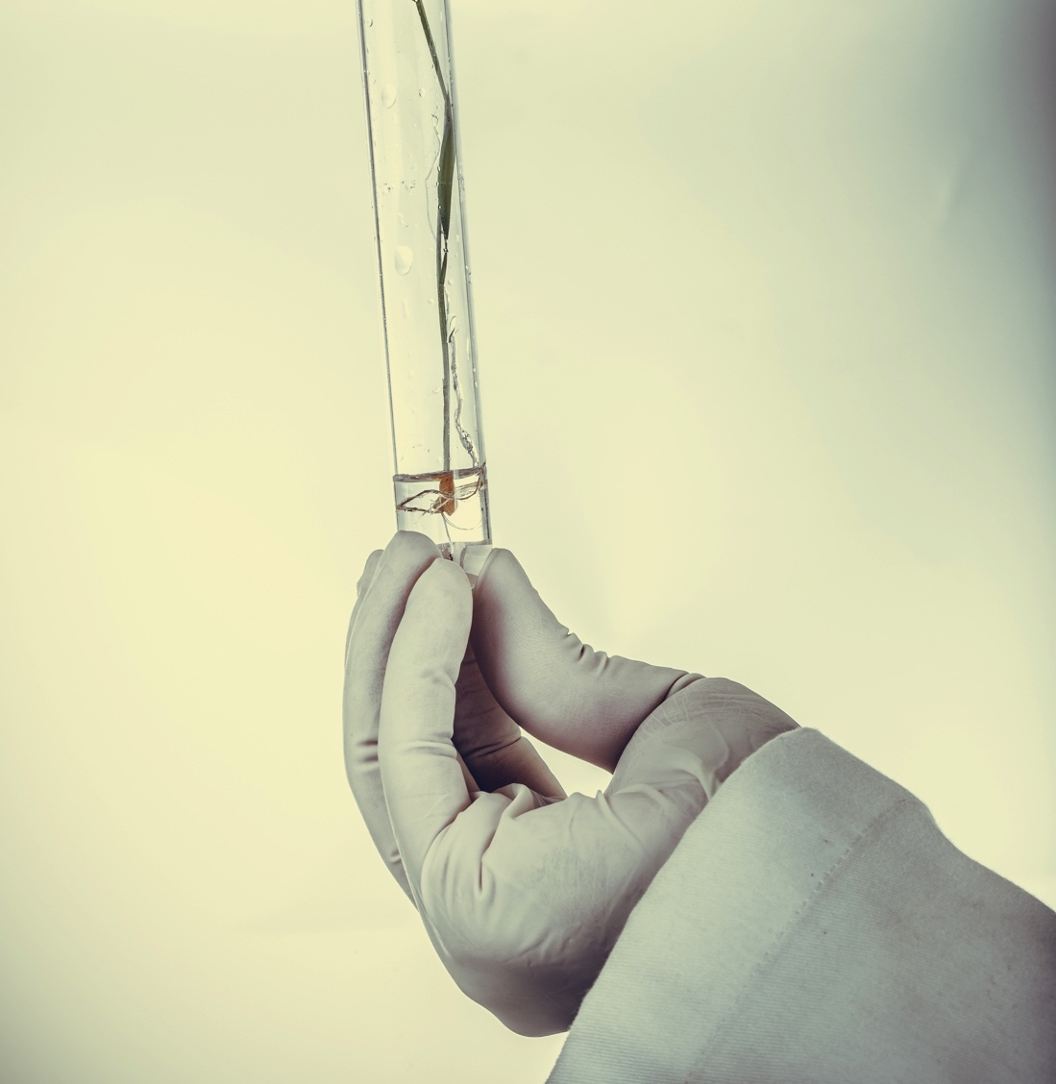


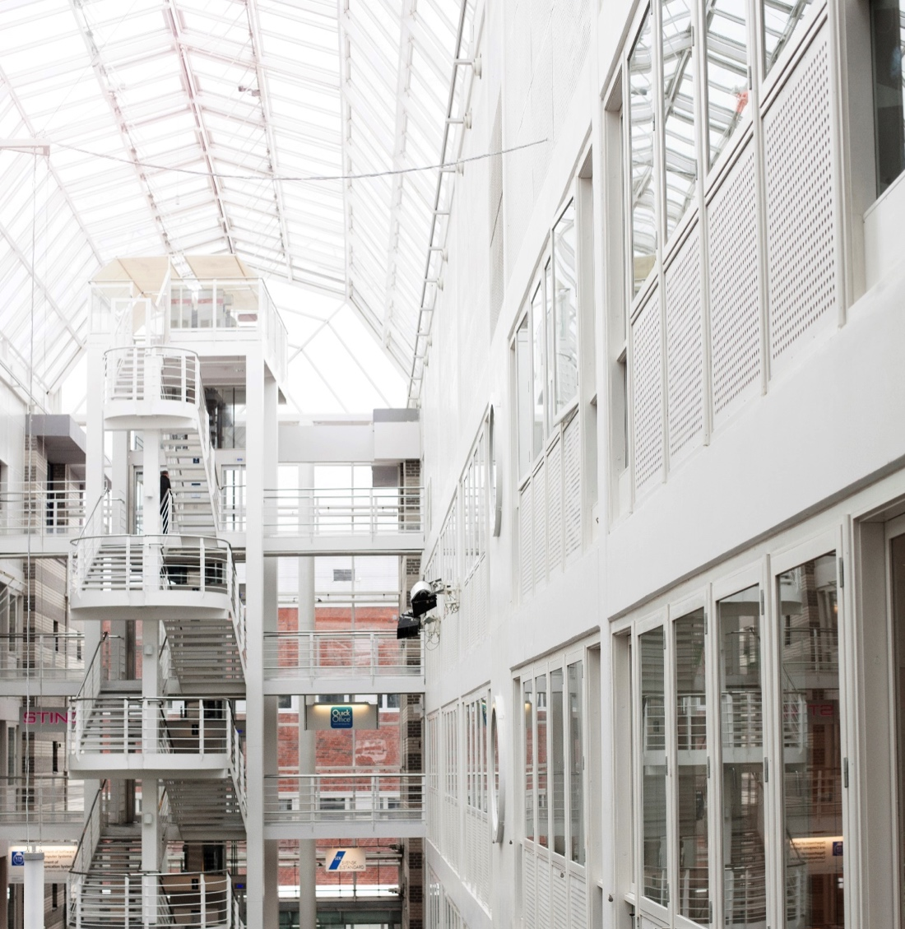
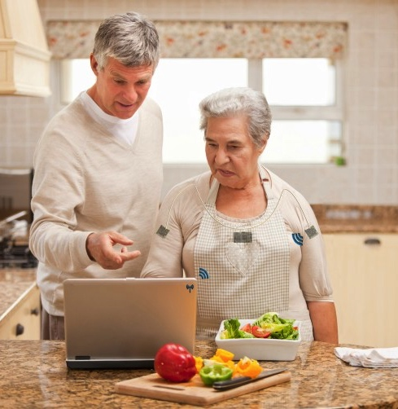
Qualinet
Kjell Brunnström
ICT
Acreo

Slide 2
Qualinet (www.qualinet.eu)
European organization targeting QoE
Started as a cost action (EU-funding model)
Continuing in a similar way as VQEG
Currently one f2f-meeting per year co-located with QoMEX
Latest meeting: before QoMEX 2019 - June 4, 2019 - Berlin

Slide 3
Qualinet – main acheivements
QoMEX conference
Definition of QoE
  Qualinet White Paper on Definitions of Quality of Experience (2012). European Network on Quality of Experience in Multimedia Systems and Services (COST Action IC 1003), Patrick Le Callet, Sebastian Möller and Andrew Perkis, eds., Lausanne, Switzerland, Version 1.2, March 2013.
Qualinet Databases (now reachable from VQEG homepage)
  http://dbq.multimediatech.cz/
  Database of available subjective quality experiments with data (246 registered datasets)
Best Practices for QoE Crowdtesting: QoE Assessment with Crowdsourcing
Implementation of a scientific journal ”Quality and User Experience”

Slide 4
Qualinet – Task Forces
TF1: Managing Web and Cloud QoE
  Raimund Schatz (The Telecommunications Research Center Vienna), Lea Skorin-Kapov (University of Zagreb), Tobias Hoßfeld (Universität Duisburg-Essen)
TF2: Gaming
  Sebastian Egger (Austrian Institute of Technology), Sebastian Möller (TU Berlin)
TF3: QoE in Medical Imaging and Healthcare
  Sebastian Egger (Austrian Institute of Technology), Sebastian Möller (TU Berlin)
TF4: QUALINET Databases - Dissemination and Standardization
  Karel Fliegel, Czech Technical University in Prague, Lukas Krasula, ARM
TF5: Crowdsourcing
  Tobias Hoßfeld, Universität Duisburg-Essen, Babak Naderi, TU Berlin

Slide 5
Qualinet – Task Forces
TF 6: VQEG
  Kjell Brunnström, RISE, Lukáš Krasula, ARM, Alexander Raake, University Ilmenau, Christian Timmerer, UNIKLU
TF7: Immersive Media Experiences (IMEx)
  Andrew Perkis, NTNU, Marianna Obrist, University of Sussex, Christian Timmerer, UNIKLU, Irene Viola, EPFL
  Current initiative to write white paper on the definition on QoE for immersice media
TF8: Submission of proposal for new COST Action
  Touradj Ebrahimi, EPFL, Andrew Perkis, NTNU

Slide 6
Thank YOU!
Kjell Brunnström
Kjell.brunnstrom@ri.se
ICT
Acreo

