Slide 1

5G Key Performance Indicators
VQEG Online Plenary Meeting
2021-06

Slide 2
5G-KPI
Mission and Goals
Mission:
Study the relationship between the Key Performance Indicators of new communication networks (namely 5G, but extensible to others) and the QoE of the video services on top of them.
Goals:
Define relevant use cases, such as video for industrial applications, or mobility scenarios.
Study global QoE aspects for video in mobility and industrial scenarios.
Identify the relevant network KPIs(e.g. bitrate, latency, …) and application-level video KPIs (e.g. picture quality, A/V sync, …).
Build open datasets for algorithm testing and training.
Group organization
Chair: Pablo Pérez
Vice-Chair: Kjell Brunsström

Slide 3
5G-KPI
Progress Report: Logistics
Reflector: 5g@vqeg.org
Monthly meetings on 2nd Thursday each month , 15.30-16.30 CET/CEST (European DST).
  MS Teams hosted by Nokia
Document store.
  Within MS Teams / Sharepoint storage
Request access to pablo.perez@nokia-bell-labs.com

Slide 4
5G-KPI
Progress Report: Topics
Contribution to ITU-T Study Group 12 (Q13)
  GSTR-5GQoE: Technical Report about QoE in 5G video services
    Instead of G.QoE-5G
    Target: October 2021
  General QoE requirements and factors for some use cases
    Tele-Operated Driving
    Wireless Content Production
    Mixed Reality Offloading
    First Responder Networks
Contribution to 5G Automotive Association (5GAA)
  Done: High-level contribution on general QoE requirements for remote driving
  Mid-term: subjective tests for ToD video quality
Long-term: Methodology to create (simple) DIY opinion models

Slide 5


ITU-T GSTR-5GQoE
QoE on 5G Services

Slide 6
ITU-T GSTR-5GQoE
Contribution
Initially proposed as contribution to work item ITU-T G.QoE-5G
Discussed in SG12 meeting
  As we were not recommending anything, it was decided to reformat as Technical Report (non-normative)
  VQEG 5G-KPI is the only contributor
Plan:
  Mid-August: Draft
  Mid-August to Mid-September: Revision
  Beginning October: Revised version
  SG12 Meeting (October 12 – 21): Consent
List of Authors (so far)
Pablo Pérez (Nokia)
Jaime Ruiz (Nokia)
Diego González-Morín (Nokia)
Femi Adeyemi-Ejeye (U. Surrey)
Kjell Brunnström (RISE)
Narciso García (UPM)
Jesús Gutiérrez (UPM)
Maria Martini (Kingston U.)
Ian Wadgin (BBC)

Slide 7
ITU-T GSTR-5GQoE
Rationale
LTE brought the generalization of consumer video on handheld devices
5G brings new industrial and professional use cases (“verticals”)
Going from wired to wireless
Non-public networks (QoS control)
Different QoE expectations
  Streaming or videotelephony QoE models do not apply!
Wireless is new to the use case
  Current QoE expectations may not apply either!
No critical mass in video QoE community

Slide 8
ITU-T GSTR-5GQoE
Scope
Which services we address
For each service
IP wireless communication.
Multimedia (mostly video) transmission.
Require support from network
  Not over-the-top.
Requirements for latency or expectation on timely delivery.
Vertical or niche applications
  No dedicated ITU-T QoS/QoE Recommendation
Main features, reference architecture.
Relevant QoE indicators to be considered
Reference service KPIs
Key factors to evaluate QoE
Use Cases
Tele-Operated Driving
Wireless Content Production
Mixed Reality Offloading
First Responder Networks

Slide 9
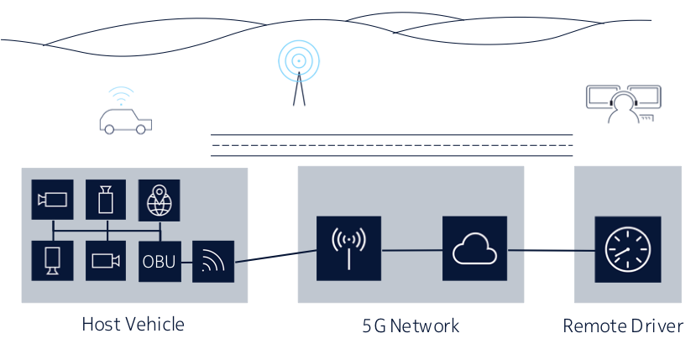
Tele-Operated Driving
Use case description
ToD Type (Role of operator) | Act of Driving
 | Strategic (itinerary) | Dynamic Driving Task (DDT)
 |  | Tactical (trajectory) | Operational (Steering)
0 (No Role) | In-vehicle | In-vehicle | In-vehicle
1 (Dispatcher) | ToD | In-vehicle | In-vehicle
2 (Indirect Controller) | ToD | ToD | In-vehicle
3 (Direct Controller) | ToD | ToD | ToD
Reference Architecture
4 cameras
Sensors (radar, lidar, GPS…)
Steering wheel
Throttle/brake
Screens / VR
Target: ToD types 2/3

Slide 10
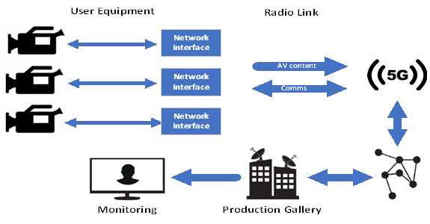
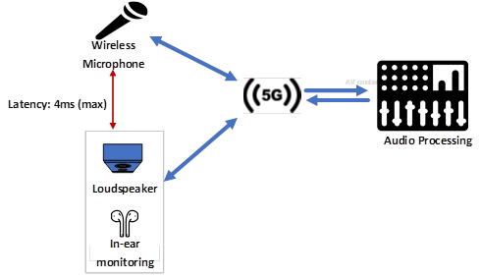
Wireless Content Production
Use case(s) description
News Gathering
Live audiovisual production
Live Audio in Production
Coverage of any kind of live event
Planned or unplanned
Single (multiple) camera
Continuity & quality
Remote live TV production
Multi-camera, heterogeneous
Production quality
Video quality & synchronization
Artist-production loop
Existing wireless systems → 5G
Local only
Low latency & reliability

Slide 11
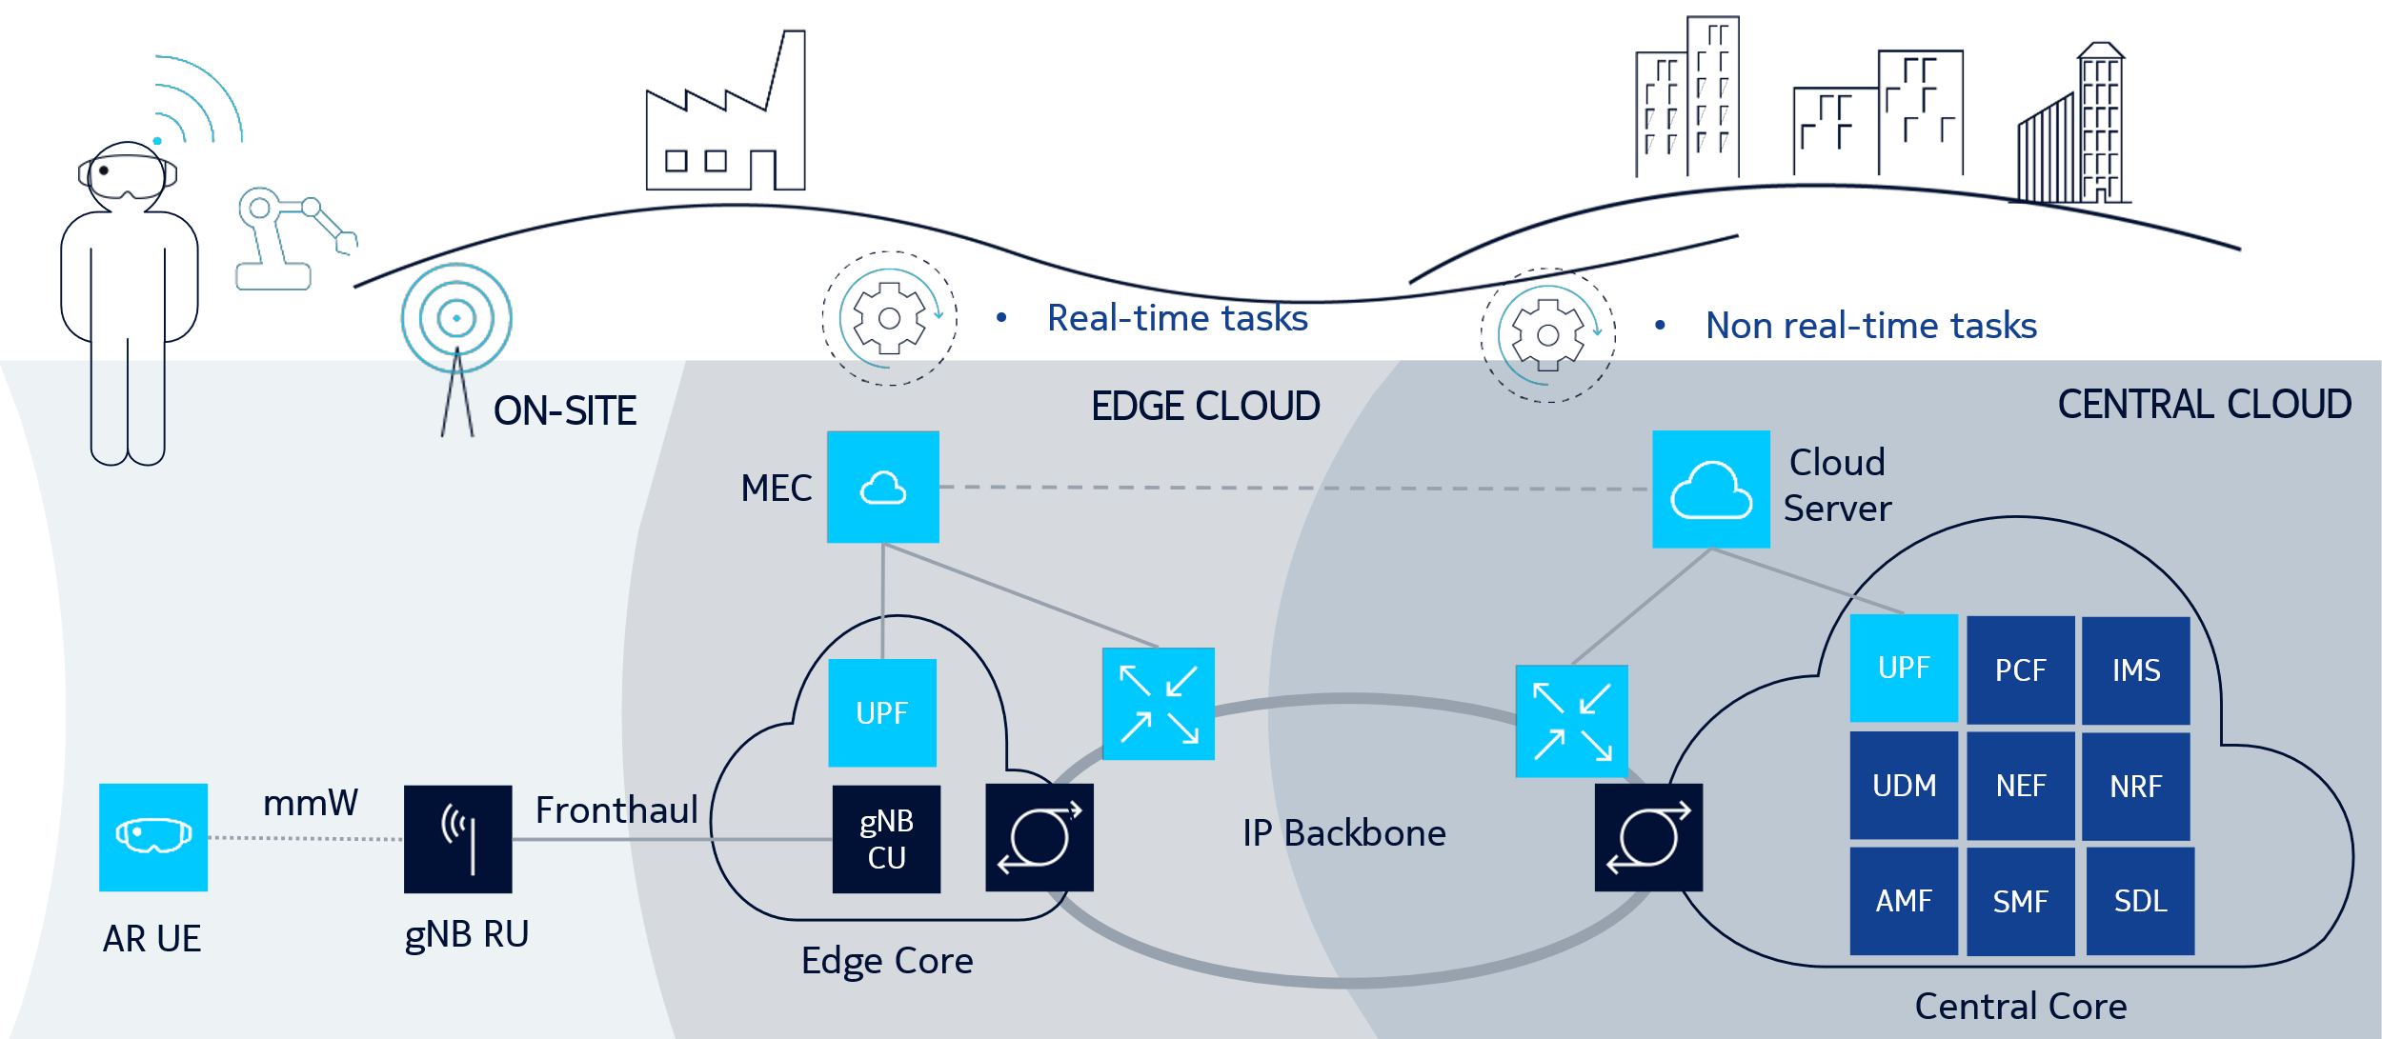
Mixed Reality Offloading
Use case description
Full offloading: the sensor feed (RGB and depth) is streamed to the MEC and processed. The new ultra high-definition frame is rendered, sent and displayed on the device.
Algorithm offloading scenario: a machine-learning-based heavy-duty algorithm is offloaded from the device. Part of the sensor feed is streamed to the MEC and processed, and the result is sent back.

Slide 12







First Responder Networks
Use case description
In emergency situation:
Coordinate on-site teams
Obtain information from CCTVs, etc.
Communicate with central stations
Reserved network resources
Mission-Critical Push-to-Talk (MCPTT)
  Specific spectrum, standard solution
  Use reliable multicast over RAN
Private Network

Slide 13
5G Services
Summary of service reference KPIs
Use Case | Uplink Throughput | Downlink Throughput | Latency
ToD Type 2 | 4-36 Mbps | 25 kbps | 300-400 ms
ToD Type 3 | 4-36 Mbps | 400 kbps | 100-300 ms
News | 15-50 Mbps | 100 kbps | 1 second
LAVP | 100-200 Mbps | 20 Mbps | 100 ms
LAiP | 0.1 - 5 Mbps | 0.1 - 5 Mbps | 4 ms
MR (Full) | 180 (1250) Mbps* | 1.0 (2.8) Gbps* | 5 ms
MR (Algo) | 180 (750) Mbps* | 18 (250) Mbps* | 10 ms
1st Responder | TBA | TBA | TBA
*Mean (peak)

Slide 14
5G Services
Summary of QoE Factors
UC | QoE definition | KPIs | Technical Factors | Task/User
ToD | Safety | Visual Q Latency Reliability | Vehicle speed Camera position Maneuver type Cockpit type | ToD Operator Safe driving
WCP | Production Quality (under mobility) | Visual Q Latency Synchro | Number / type of devices Available BW | Content Producer
MR | Immersion / Presence / Embodiment | Visual Q FPS Latency | HMD Offloading architecture | (Depending on application)
1st Resp |  |  |  | 1st Responder

Slide 15


Contribution to

Slide 16
Contribution to 5GAA [DRAFT] TR XW5-200145
“Tele-operated Driving (ToD): System Requirements and Architecture”
Contribution to 5GAA TR done on March 2021
  From Nokia
  Reviewed by VQEG-5GKPI
General considerations of video coding quality for ToD systems
  Number of cameras
  Position of the cameras (temporal complexity)
  Driving speed (temporal complexity)
  Type of environment (spatial complexity)
  Specific task / maneuver

Slide 17
Contribution to 5GAA / ToD Work Plan
Phase 1: perceptual degradation of ToD video coding
Source content:
  To be recorded by Nokia.
  Car in test circuit (simulating a suburban location), at several speeds (professional driver).
  4 camera positions, 1080p, high quality
HRCs
  Video coding using low-delay configuration
Objective evaluation: PSNR, SSIM, VMAF, VQM…
Subjective evaluation: ITU-T P.913
  Details to be decided
Date to be decided (start on 3Q2021)
Target: perceptual rate-distortion analysis of different camera positions and speeds

Slide 18
Contribution to 5GAA / ToD Work Plan
Phase 2: mapping perceptual quality to ToD QoE
Building a ToD cockpit (screens or equivalent only)
Show a combination of the videos in the cockpit to potential ToD operators / drivers
Ask for QoE
  Is it safe to drive at this speed with this video?
Target: find which is the minimum / good visual quality for ToD

Slide 19

DIY Opinion Model

Slide 20
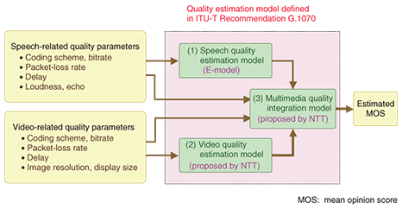
Opinion models
A standard tool to estimate average QoE for a network & use case
Use case QoE model
System configuration
User QoE (MOS)
5 | Excellent
4 | Good
3 | Fair
2 | Poor
1 | Bad
Network KPIs

Slide 21

Standard Opinion Models
ITU-T G.107x
G series: Transmission systems and media, digital systems and networks
G.100-G.199: International telephone connections and circuits
  G.107: The E-model: a computational model for use in transmission planning
G.1000-G.1999: Multimedia Quality of Service and performance – Generic and user-related aspects
  G.1070: Opinion model for video-telephony applications
  G.1071: Opinion model for network planning of video and audio streaming applications
  G.1072: Opinion model predicting gaming quality of experience for cloud gaming services

Slide 22
Simplification
Keep first-order elements and simple models
Resolution
Bitrate
Codec
Network Planning Assumptions
Video Coding Quality
I_{V}
Fusion
R
Map to MOS
Q
Coding delay
Network buffer
RTT
End-to-end Latency
I_{D}

Slide 23
Creating your own opinion model
Mid to long-term work
Complex models are recommendable, but they are expensive to produce
Proposal: design a generic framework:
  Impairment model: linear, MOS-to-R, etc.
  Aggregation model: additive, multiplicative, min/max, other
  List of relevant impairments and their first-level impairment models (or how to develop them)
  Methodology for calibration / training
  Methodology for formal evaluation (“how to run a model competition”)
Each use case should use the framework to create their own (simple) opinion model
  Useful when there is no ITU-T recommended model (yet)

Slide 24
Creating your own opinion model
Open issues
Can it generalize across use cases (good enough)?
How is it done by ITU-T when designing the framework for a new opinion model?
Should we call more experts?
More will come when we start working on it

