Slide 1
Crowdsourcing Pixel Quality Study Using Non-neutral Photos
Mikołaj Leszczuk, Lucjan Janowski, Michał Wierzchoń, Bogdan Ćmiel

Slide 2
Introduction
Nowadays the assessment of QoE requiring a multidisciplinary approach
Combining techniques from psychology, human-computer interaction, signal processing, data analytics, and machine learning
Investigating the impact of emotional content on the perceived quality of multimedia in psychophysical QoE experiments
This presentation:
  Not about results on this investigation (these to be reported later)
  But about a (new?) way of collecting crowdsourcing data

Slide 3
Source Reference Circuits (SRCs)
Nencki Affective Picture System (NAPS) picture database used
1,356 high-quality realistic pictures, categorised as: “people”, “faces”, “animals”, “objects” and “landscapes”
Database providing per-picture ratings covering entire range of 3 psychological variables: valence, arousal & approach/avoidance
Using a subset of the NAPS database in the “people” category (250 pictures), being one of the most popular categories used in research
Not removing pictures with potentially graphic, sexual or upsetting content

Slide 4
Hypothetical Reference Circuits (HRCs)
7 quality levels with fixed quality metric levels, as shown in Table
Max quality metric level achieved for SRC image: 10
The values of the other levels empirically selected
Aiming at achieving distribution of quality levels being:
  Widest possible
  Most uniform
Quality | FovVideoVDP Quality Setting
A | 10.000
B | 9.825
C | 9.600
D | 9.350
E | 9.050
F | 8.600
G | 7.750

Slide 5
Example Processed Video Sequence (PVS)
(Or Actually Processed Picture)
Picture: “People 160_h”, Compression: “A”
Picture: “People 160_h”, Compression: “D”
Picture: “People 160_h”, Compression: “G”

Slide 6
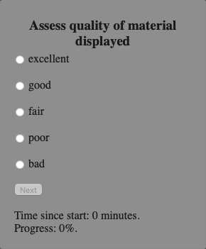
Picture Quality (ACR) as Measured Variable

Slide 7
Crowd-Sourcing Platform Conduct a Psychophysical Experiment
Due to the lack of specialized requirements, the experiment seeming to be tailored for crowdsourcing
So far, platforms commonly used in this type of research including:
  Amazon Mechanical Turk
  MicroWorkers
However, these platforms known for the low quality of collected subjective data
Resulting in the need to reject even half of the answers
Meanwhile, decided to use an alternative solution...

Slide 8

Prolific
”A Higher Standard of Online Research”
Participants recruited and compensated through Prolific
Test group of 115 users participating in experiment
The experiment carried out remotely
The participants compensated (£9=$11/hour) for their time

Slide 9
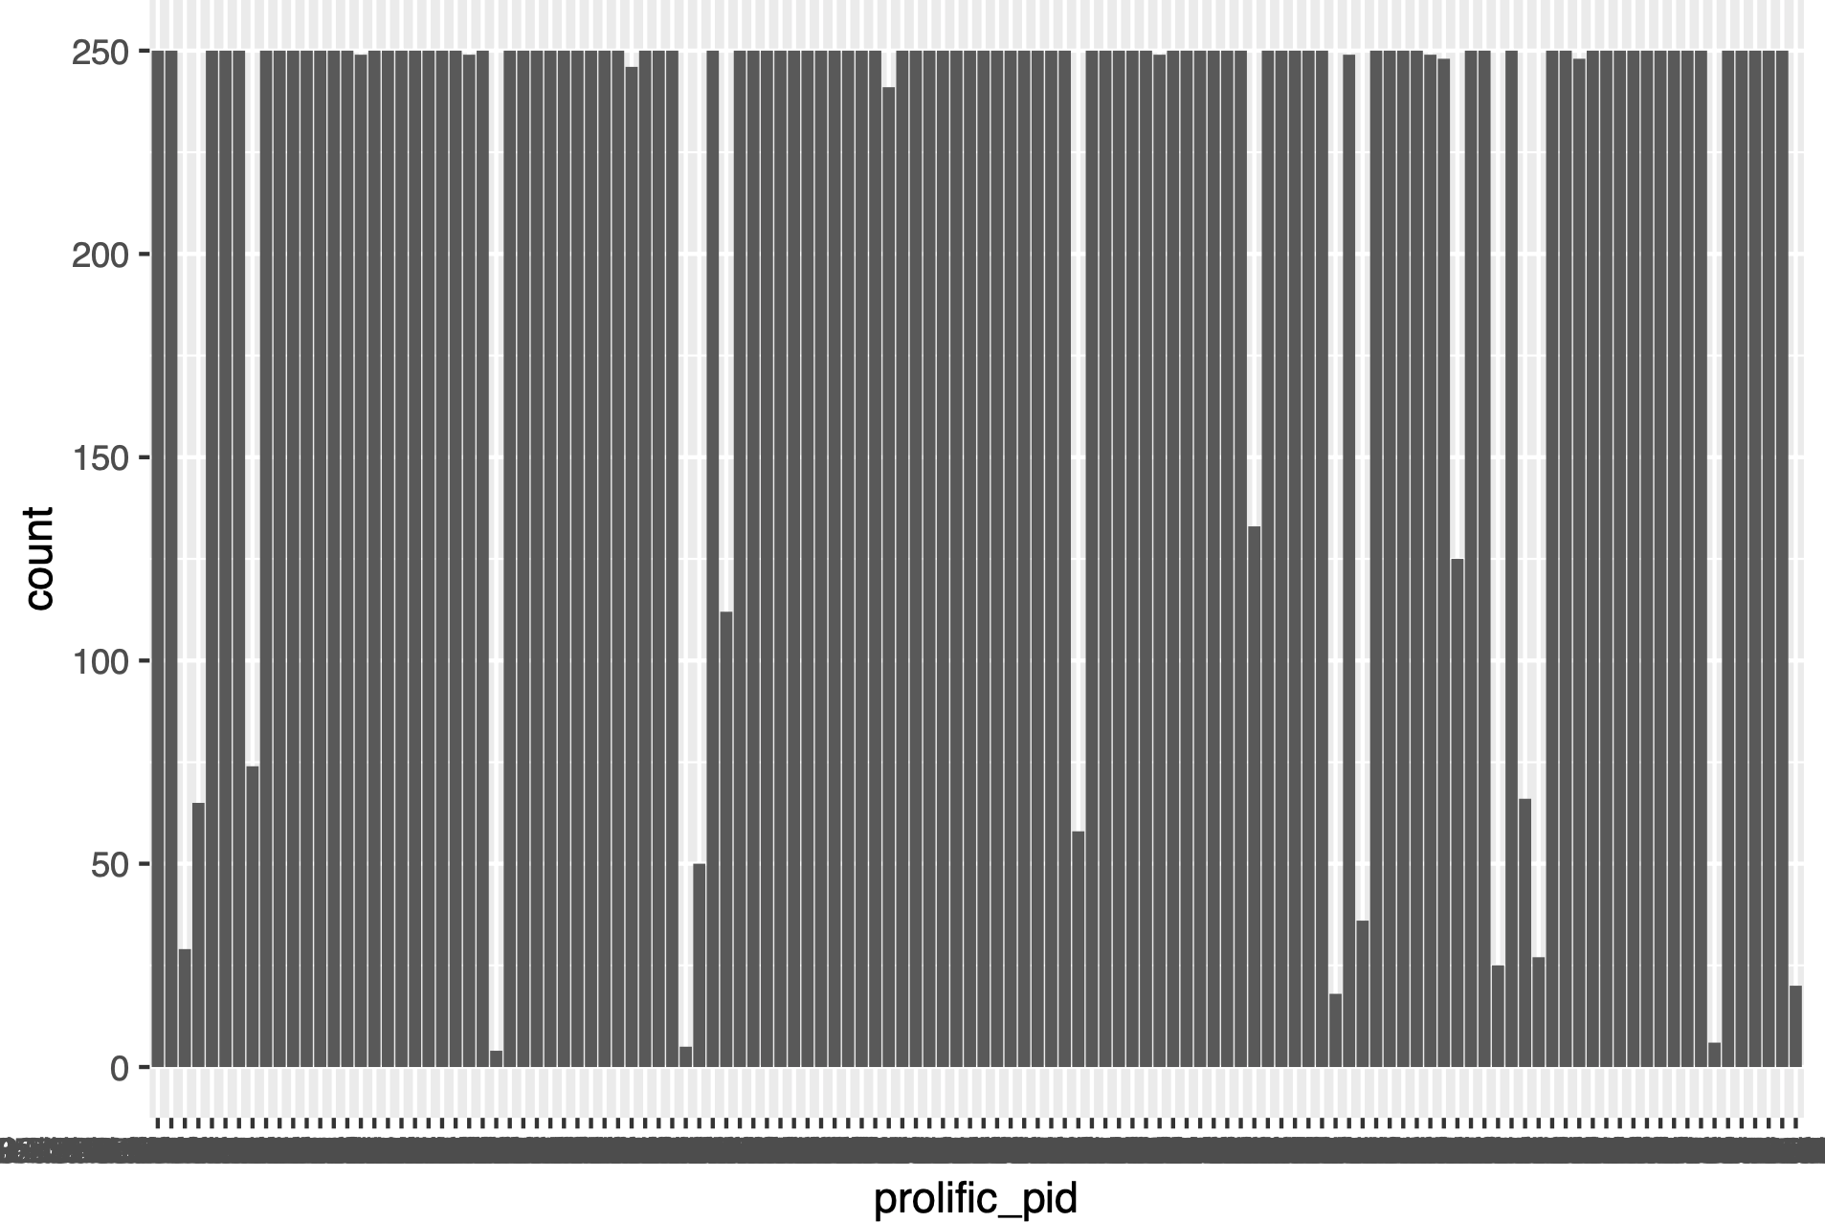
Most Participants Fully Completing the Experiment

Slide 10
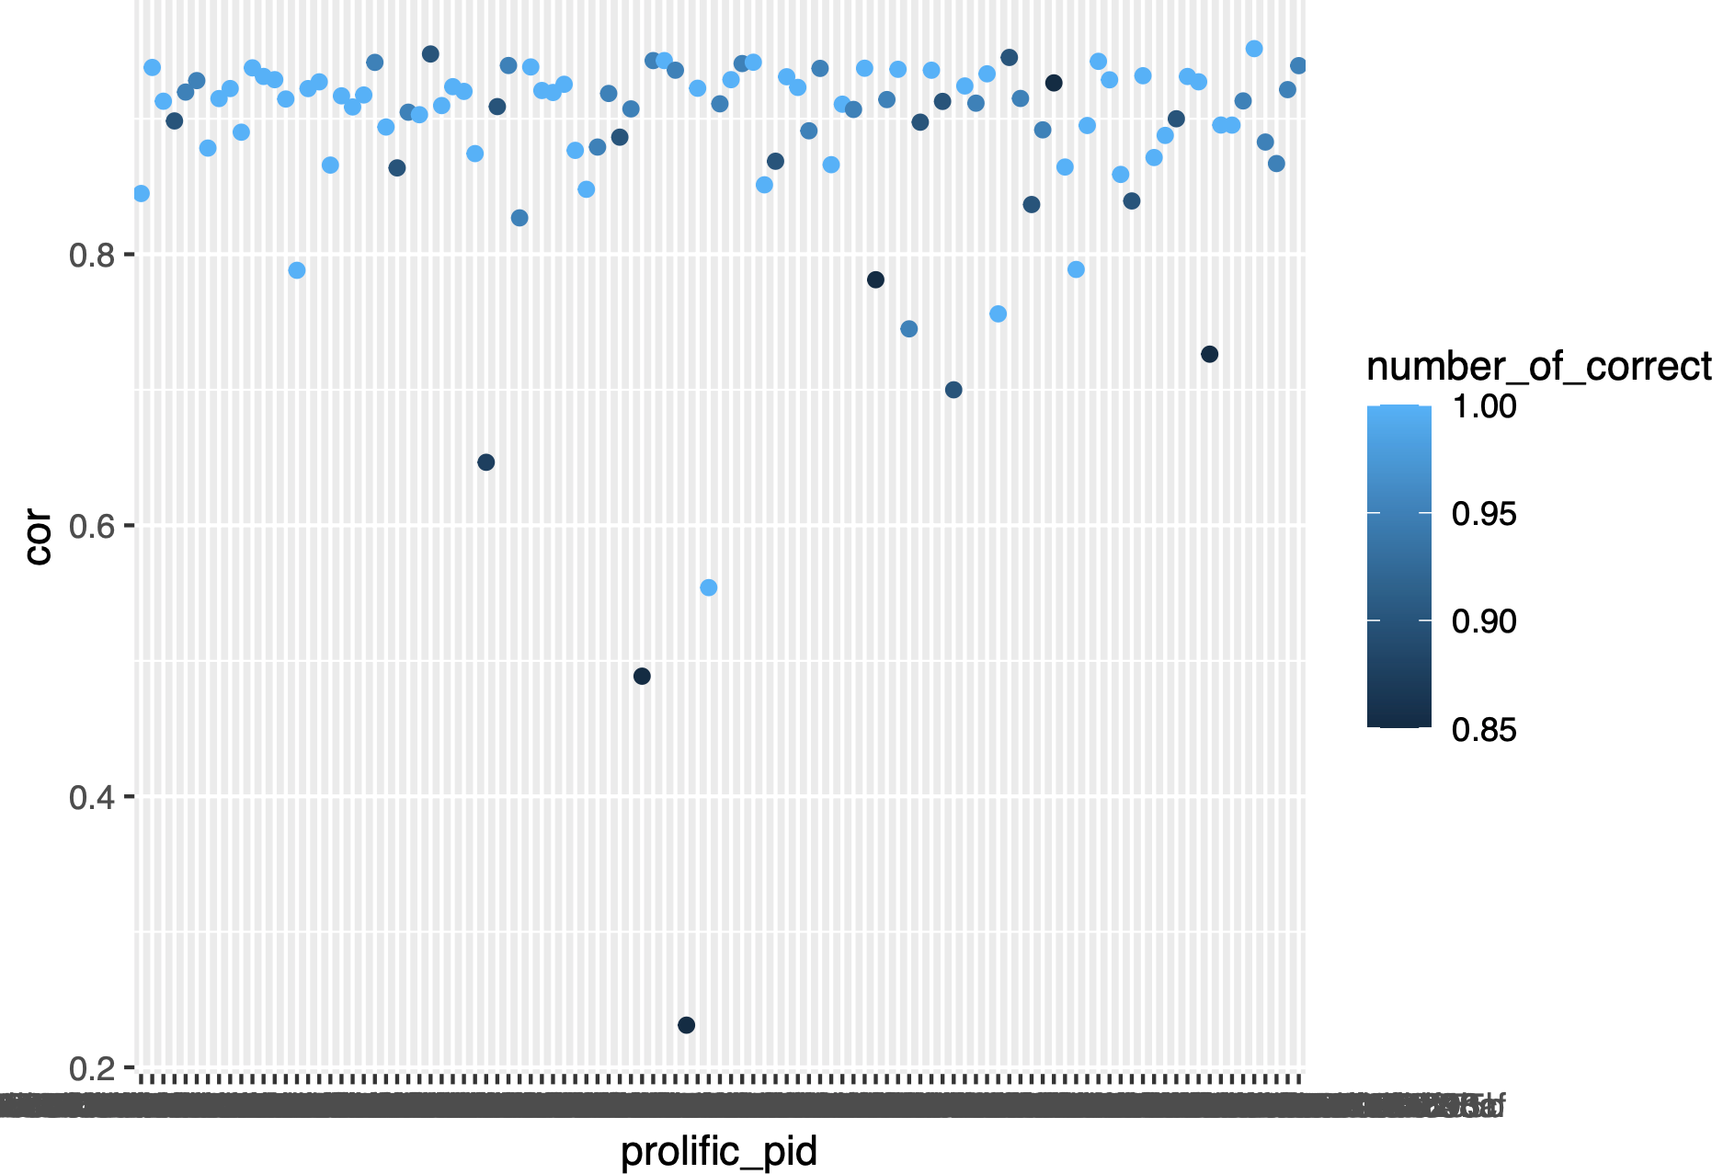
The Vast Majority of Participants Being Not Outliers (ITU-T 0.75 Pearson Correlation Criterion)

Slide 11
Trapping Questions
20 trapping questions asked to filter out inattentive participants
Examples given on the right
Up to 3 errors were allowed (agreed a priori)
Remember that low image quality may make it difficult to answer
All participants positively verified (no more than 3 errors)!
“Did the photo show a market?” (Answer: True)
“Did the photo show a street?” (Answer: True)
“Did the photo show an artist?” (Answer: True)
“Did the photo show a garlic?” (Answer: False)
“Did the photo show pollution?” (Answer: False)

Slide 12
Conclusions
Crowd-sourcing platforms tailored for conducting a psychophysical experiment in case of the lack of specialized requirements
Platforms commonly used in this type of research known for the low quality of collected subjective data
Prolific as an alternative solution, resulting in a higher standard of online research data
Comparison of typical participant salaries:
  Amazon Mechanical Turk: $2-7/hour
  MicroWorkers: $4/hour
  Prolific: $8-15/hour

Slide 13
Thank you
Mikołaj Leszczuk, mikolaj.leszczuk@agh.edu.pl
AGH University of Krakow
Faculty of Computer Science, Electronics and Communications
Institute of Telecommunications

