Slide 1
Human in the Loop Training Procedure of the AIO of a Real Subject
LOHIC FOTIO TIOTSOP
JEG-HyBRID Group
VQEG Meeting: JUN 2023

Slide 2
Artificial Intelligence-Based Observers: AIOs
AIO: deep neural network (DNN) trained to mimic the quality perception of an individual subject
The AIOs output a five-class probability distribution on the ACR scale
Aim and Scope: designing media processing systems that account for the characteristics of the targeted audience

Slide 3
Training AIOs is a Challenging Learning Task
Current subjectively annotated datasets do not even allow an effective training of DNNs for MOS prediction [1]
Available datasets for the training of AIOs are even more limited in size;
Training AIOs is a learning task with noisy labels and limited amount of training samples
[1] J. Kim, H. Zeng, D. Ghadiyaram, S. Lee, L. Zhang and A. C. Bovik, "Deep Convolutional Neural Models for Picture-Quality Prediction: Challenges and Solutions to Data-Driven Image Quality Assessment," in IEEE Signal Processing Magazine, vol. 34, no. 6, pp. 130-141, Nov. 2017, doi: 10.1109/MSP.2017.2736018.

Slide 4
Previous Approach: Two-steps Learning
First step: create a large scale synthetically annotated dataset, and use it to train a DNN (JPEGResNet50) to extract generic perceptual features
Second step: Refine the weights of the trained DNN by performing an additional training on a small scale subjectively annotated dataset
Issues: is such a single small scale subjectively annotated dataset enough?

Slide 5
Putting the Human into a Learning Loop
To train the DNN of a subject and thus an Artificial Intelligence-based Observer (AIO), we propose an iterative procedure. Steps for each learning iteration:
Ask the subject to rate a selected set of images
Train the DNN of the subject on the collected opinion scores
Use the trained DNN to make inference on a large-scale dataset
Select a new set of images to be rated by the subject, i.e., images for which the DNN provided a quality prediction prone to very high uncertainty. Go back to step 1 with the newly selected images

Slide 6
Implementation
We considered five subjects for our experiment
For each subject, the AIO was trained by performing three iterations of the previous 4 points
During each iteration, each subject rated 300 new images
The AIO of each subject has a similar architecture to that of the JPEGResNet50. Hence it is a DNN with 50 hidden layers. The weights obviously differ from subject to subject.

Slide 7
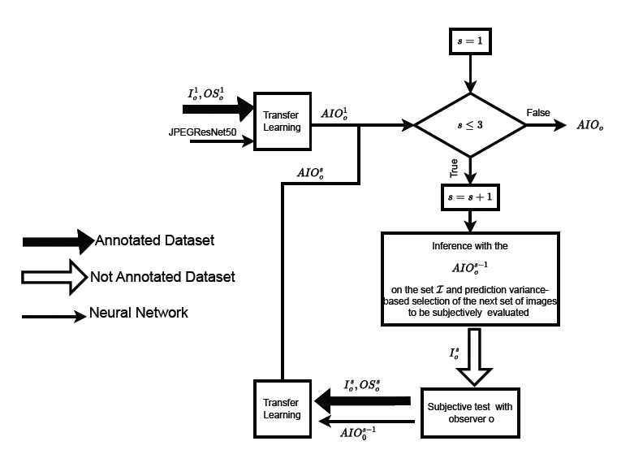
Implementation
Fig. 1. Summary of the implementation of the proposed human-in-the-loop approach to train the AIO of an individual observer $o$.

Slide 8
Real Subjects Performance as a Benchmark
Percentage of stimuli for which each subject repeated his first evaluation after rating twice the same stimulus.
These percentages can be considered a kind of reference performance to benchmark the performance of AIOs on a test set never seen during the training process.

Slide 9
AIOs Performance on a Test Set
AIOs were used to predict the opinion scores of the five real observers on a set of 300 images rated by the observers but not used in the training loop of the AIOs.
Accuracy of each AIO in predicting each real observer

Slide 10
Key Points
The accuracy of the trained AIOs is comparable to the repetition performance of real observers.
In general, each AIO predicts the observer it mimics better than the others AIOs. Thus, each AIO seems to have learned characteristics intrinsic to its observer.
The accuracy of each AIO in predicting the opinion score of the related subject overcomes that of the JPEGResNet50 that was used as starting point.

Slide 11
Future Work
Is the iterative approach convergent ? How to define a suitable convergence criteria?
Can the approach be looked at as a standard way to collect opinion scores for AIOs training?
Avoiding the collection of useless data
Mitigating the effect of subjects’ fatigue
Note: We are currently looking for people willing to enter into the loop. Volunteers will be asked to rate new sets of stimuli until the training loop of their AIO converges.

Slide 12
References
Pavel Majer, Tiotsop, Lohic Fotio and Marcus Barkowsky, "Training the DNN of a Single Observer by Conducting Individualized Subjective Experiments." in Proc. 15th Intl. Conf. on Quality of Multimedia Experience (QoMEX). Ghent, Belgium, Jun 2023
Tiotsop, Lohic Fotio, Antonio Servetti, Marcus Barkowsky, Peter Pocta, Tomas Mizdos, Glenn Van Wallendael, and Enrico Masala. "Predicting individual quality ratings of compressed images through deep CNNs-based artificial observers." Signal Processing: Image Communication 112 (2023): 116917.

