Slide 1

QART (Quality Assessment for Recognition Tasks)
Mikołaj Leszczuk, AGH (Poland)
Joel Dumke, ITS-NTIA (USA)

Slide 2
Presentation plan
QART objectives
Reports/plans/next steps
Action points
Organizations

Slide 3
QART Objectives

Slide 4
QART motivation or why do we have different QoE for entertainment vs. recognition tasks?
240p,
24 BPP,
low bitrate:
1080p HD,
24 BPP,
high bitrate:
1080p HD,
1 BPP,
low bitrate:
MOS: good
LPR: bad
MOS: excellent
LPR: excellent
MOS: bad
LPR: excellent

Slide 5
Organizations
Initial interest
ITS-
NTIA
AGH
IBBT
Real work
ITS-
NTIA
AGH
Current research
VQiPS
IRCCyN

Slide 6
Changes in QART co-chairmanship at ITS-NTIA?
Carolyn Ford ☹
Joel Dumke? ☺

Slide 7
Reports/Plans/Next Steps

Slide 8
And where do we go from here?
QART
Quantifying GUC
Extending P.912 test methods
Measuring camera quality
Investigating video acuity
Investigating H.264 encoders
Checking results’ stability
Reports, plans and proposals of joint research topics within the area of quality assessment for recognition tasks…
Color codes:
No progress
Marginal progress
Moderate progress
Substantial progress

Slide 9
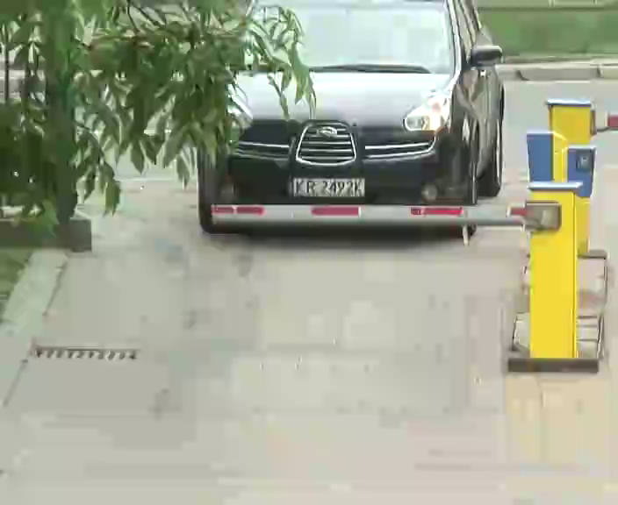
Sequences to Consumer Digital Video Library
Parameters:
  22 sequences
  Professional AXIS CCTV footage
  720p
  30 fps
  10 seconds each
  SRC + ground truth
  PVS + subjective scores
Planned long ago
Still problems: ☹
  Informed consents
  Withdrawals (30->22)
  Licenses, acknowledgements
  Minor video errors
Planned soon after Hillsboro

Slide 10
What is the impact of subliminal cues?
Cellphone
Flashlight
“Spot the difference ☺”! Recognizing objects…
…or just a different layouts of clouds?

Slide 11
Acuity
NTIA has been focused on the same 7-object recognition task for the last three subjective tests
  We are interested in applying our results to other tasks
  We are interested in making recommendations tailored to the difficulty of a particular task
Our approach is to attempt to rank various tasks and the performance of various systems on a single scale
We have begun by investigating visual acuity
  Measured as the smallest reliably recognizable characters on a reduced LogMAR chart
  We hope to see a significant correlation between object recognition and character recognition

Slide 12
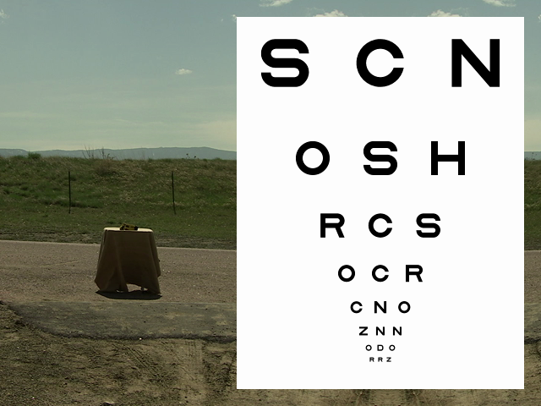
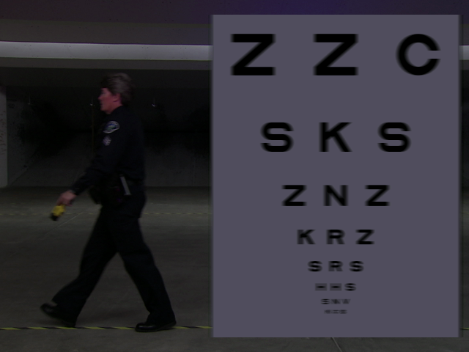
Source Videos for Current Testing

Slide 13
Other Possibilities
We are open to using other metrics
  Other quality metrics, such as VQM, have been suggested
  Pixels-per-foot has been suggested
    This is extensively used by manufacturers
We are about to design our “Phase 3” test
  Will incorporate new tasks of various difficulty
  After subjective testing is complete, it should be relatively easy to determine which metric best correlates to the viewers performance of various tasks.

Slide 14
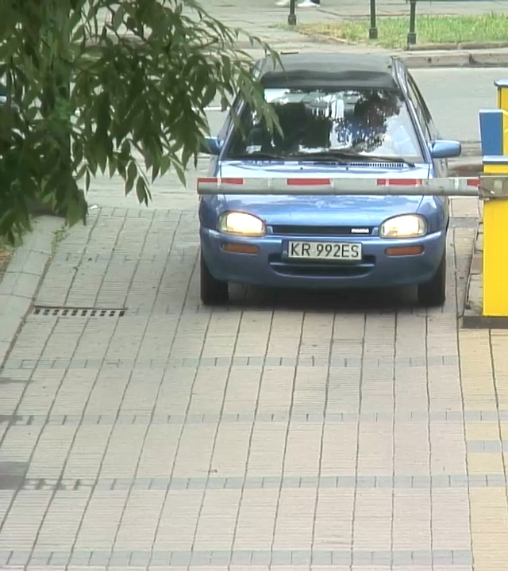
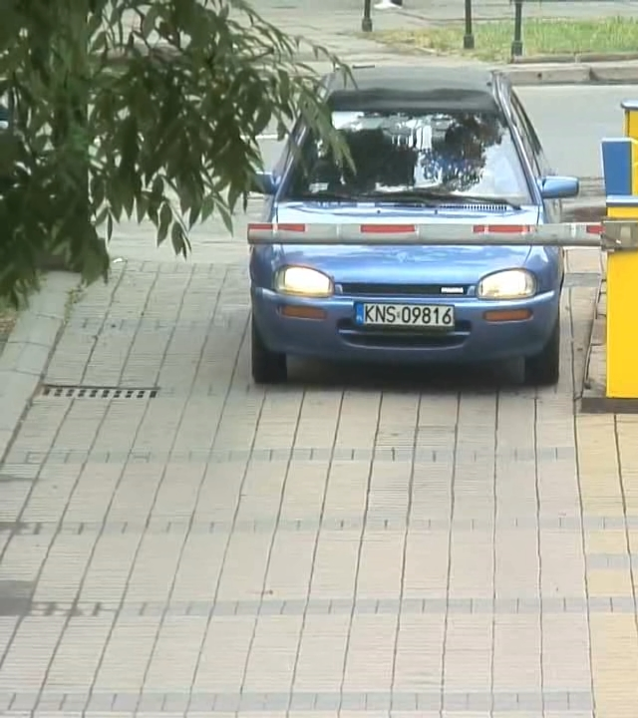
Are CGI (Computer Generated Imagery) SRCs valid?
Shooting various SRCs is very tedious…
…so why not give overlaying realistic CGI a try?

Slide 15
Action Points

Slide 16
Stakeholders – who is in?
ITS-NTIA
???
QART
AGH
Sharing ideas
Joint experiments
Joint papers
Joint VQEG reports
Joint standardization contributions

Slide 17
Discussion
Acknowledgments:
ITS-NTIA: The Public Safety Video Quality (PSVQ) project is undertaken by the Public Safety Communications Research (PSCR) program, sponsored by the U.S. Department of Homeland Security’s Office of Interoperability and Compatibility
AGH: The “Intelligent information system supporting observation, searching and detection for security of citizens in urban environment” (INDECT) project is undertaken by the Seventh Framework Program, sponsored by the European Commission (Grant No. 218086)

