Slide 1
Proposal for subjective test plan of stereoscopic three-dimensional video
June 13 2012
Jun Okamoto (NTT)

Slide 2
Introduction
Stereoscopic three-dimensional (3D) services are rapidly becoming widespread. To provide better 3D services, service providers need an accurate, dependable, and efficient assessment method to evaluate or optimize coding/transmission systems.
We propose the necessary common or subset conditions for service providers in 3D subjective tests. It is the following three points.

Slide 3
Proposal 1
1) Clarify the appropriate assessment method for “video quality”
- VQEG is working to clarify 3D characteristics using the PC method. From a measurement viewpoint, this method is not appropriate for evaluating many conditions for optimizing an encoder/transmission system.
To avoid the heavy burden of evaluating 3D video, we propose to clarify an appropriate method in terms of time and cost for determining “video quality” in the VQEG 3D subjective test.
This clarification is worthwhile from the service provider’s point of view.

Slide 4
Proposal 2 (1/2)
b) Consider stereo acuity of observer
We conducted a screening test of observers with an ophthalmologist before carrying out a 3D subjective.
Initially, 35 observers took the screening test, and 13 passed.
(Age: 20-35)

Slide 5
Proposal 2 (2/2)
b) Consider stereo acuity of observer
Therefore, VQEG should check and report the observers’ information (e.g. stereo acuity) in order to analyze its impact if necessary.
The conceivable parameters are as follows.
- Essential parameters
Stereoscopic visual acuity (fine stereopsis),
binocular stereopsis (simultaneous perception, binocular fusion, coarse
stereopsis),
fusion area examination
-Optional parameters
Strabismus/amblyopia (self-enumeration or examination by an
ophthalmologist),
heterophoria (over 10 prism diopters),
anisometropia (over 2 diopters)

Slide 6
Proposal 3
c) Clarify the quality characteristics between professional monitors and consumer monitors.
3D video service operators do not use consumer monitors to perform a strict subjective test. However, VQEG is attempting to clarify 3D monitor conditions (e.g. cross talk, contrast) using consumer monitors.
We propose that VQEG add the condition to use professional monitors as an examination object and to confirm that there is no difference in quality characteristics between professional and consumer monitors. NTT is capable of conducting the test for this clarification.

Slide 7
Information
URCF (Ultra-Realistic Communications Forum) to which NTT belongs have released some findings of fatigue caused by watching 3DTV based on an experiment using 500 adult participants for one hour.
If you want to know, please access the following reference (in Japanese):
https://www.mmjp.or.jp/ssl.scat.or.jp/urcf/precondition.htm

Slide 8
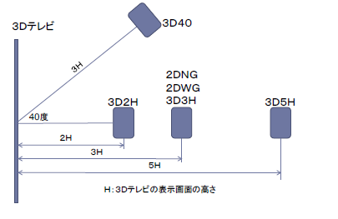
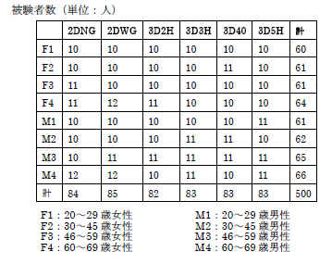
Condition
3DTV
Participants (number of person)
degree
years female
years male
years female
years male
H : Height of display
years female
years male
years female
years male

Slide 9
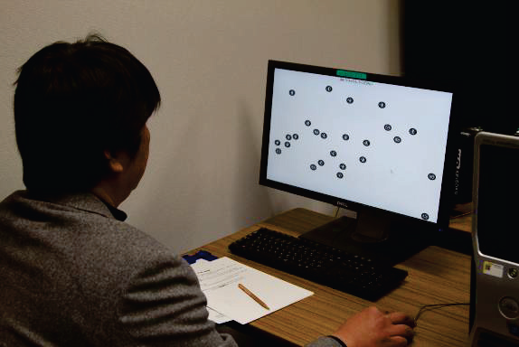
Objective indexes fatigue
◆ Critical Flicker Frequency（CFF）
Critical Flicker Frequency is a psychophysical measure of visual temporal resolution. It represents the minimal number of flashes per second at which an intermittent light stimulus provides a continuous sensation, which may show some subject's visual fatigue and visual sensory sensitivity. Details of the method are described in the following paper:
Mitsuhashi, T., "Evaluation of Stereoscopic Picture Quality with CFF," Ergonomics, Vol. 39, No. 11, 1996.
◆Advanced Trail Making Test（ATMT）
ATMT is a method to evaluate mental fatigue. In this test, circles numbered from 1 to 25 are placed randomly on the display and participants are required to use a computer mouse to click these circles in sequence. See the following reference:
Kajimoto, O.: Development of a Method of Evaluation of Fatigue and its Economic Impacts. In Fatigue Science for Human Health. Edited by: Watanabe, Y., Evengard, B., Natelson, B.H., Jason. L.A., Kuratsune, H. New York:Springer; 2008:33-46.

Slide 10
Subjective indexes fatigue
◆ Simulator Sickness Questionnaire（SSQ）
The Simulator Sickness Questionnaire (SSQ) has been used in many studies to measure the level of visually-induced motion sickness. The SSQ contains 16 questionnaire items with a four-point scale. See the following reference:
Kennedy, R.S. et al., “Simulation Sickness Questionnaire: An Enhanced Method for Quantifying Simulator Sickness,” The International Journal of Aviation Psychology, Vol. 3, No. 3, pp. 203-220 (1993).
◆ Visual Analogue Scale（VAS）
The Visual Analogue Scale measures subjective symptoms of fatigue where participants indicate the degree of fatigue on a simple visual analogue scale. "Guideline of Clinical Evaluation of Anti-fatigue" cited this method as one of the standard evaluation methods of fatigue.
http://hirougakkai.com/VAS.pdf (In Japanese)
Best sensation with no fatigue
Worst sensation with fatigue

Slide 11
Results 1
The results of the objective indexes indicated that there was no difference between watching 3DTV and traditional TV (i.e., watching 2D contest without glasses) in degree of decline of visual and cognitive functions due to fatigue.

Slide 12
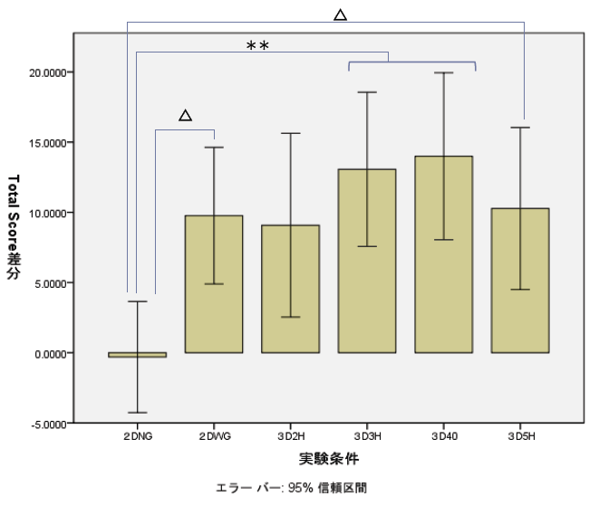
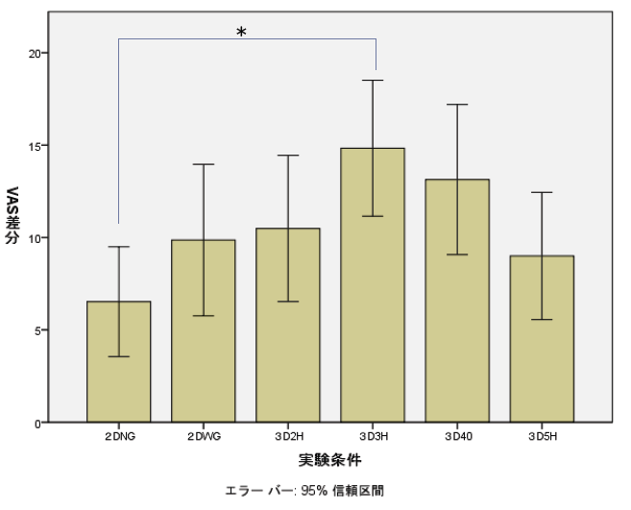
Results 2
・Subjective indexes indicated that there were some differences between watching 3DTV and traditional TV in the sensation of fatigue.
・However, these differences may not be attributed to watching 3D content, but to wearing the 3D shutter glasses.
20
15
10
5
0
-5
20
15
10
5
0
Difference of SSQ total score
Difference of VAS score
2DNG 2DWG 3D2H 3D3H 3D4H 3D5H
2DNG 2DWG 3D2H 3D3H 3D4H 3D5H
Error bar:95% confidential interval
Error bar:95% confidential interval

Slide 13
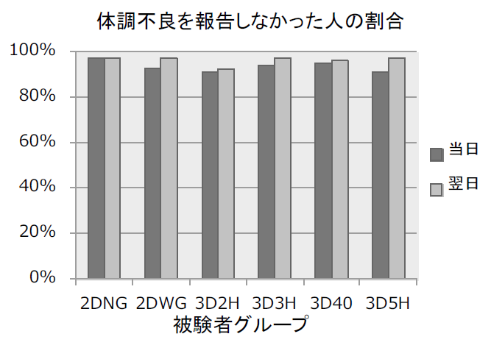
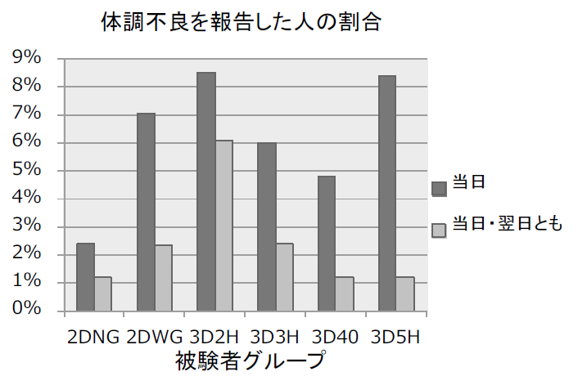
Results 3
Although there was no difference in the sensation of fatigue between the different conditions when evaluated immediately after watching 3DTV, the results suggest that the sensation of fatigue may be persistent if 3DTV is watched at a distance closer than the standard viewing position (i.e., three times the screen’s height)
The ratio for person with no feeling of unwellness
The ratio for person with the feeling of unwellness
current day
next day
current day
next day

