Slide 1




Image Quality for Recognition tasks in the Automotive Environment
Anthony Winterlich
Vladimir Zlokolica
Edward Jones
Martin Glavin
Connaught Automotive Research Group
Electrical & Electronic Engineering
National University of Ireland, Galway

Slide 2
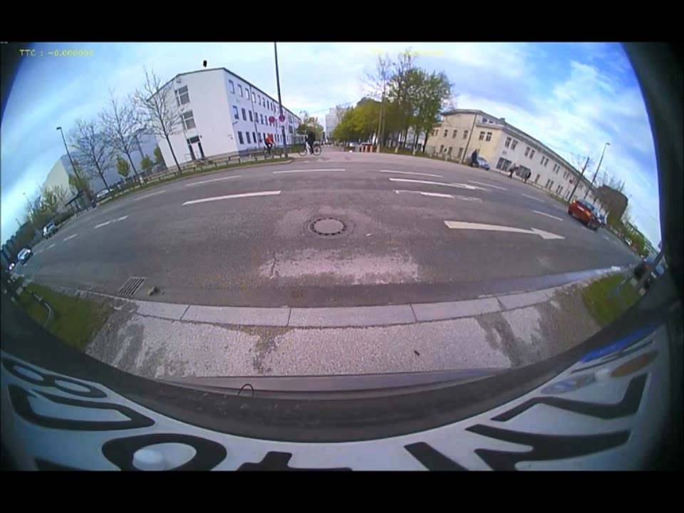
Current Applications for object detection

Slide 3
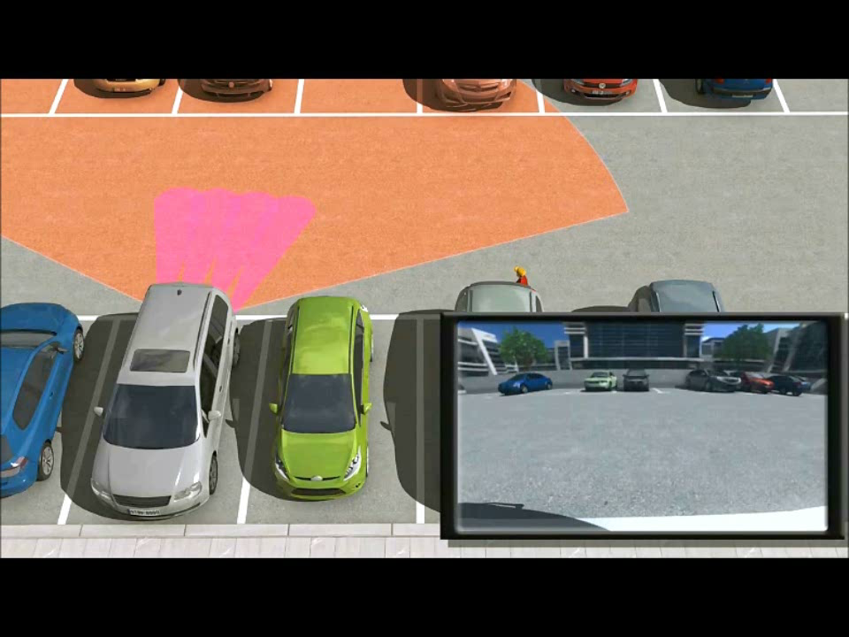
Current Applications for object detection

Slide 4
Object Detection & 3D depth modelling
    Feature Detection
    Motion Vector Field

Slide 5
Object Detection & 3D depth modelling
    HDR/Contrast
    Noise
    Sharpness

Slide 6
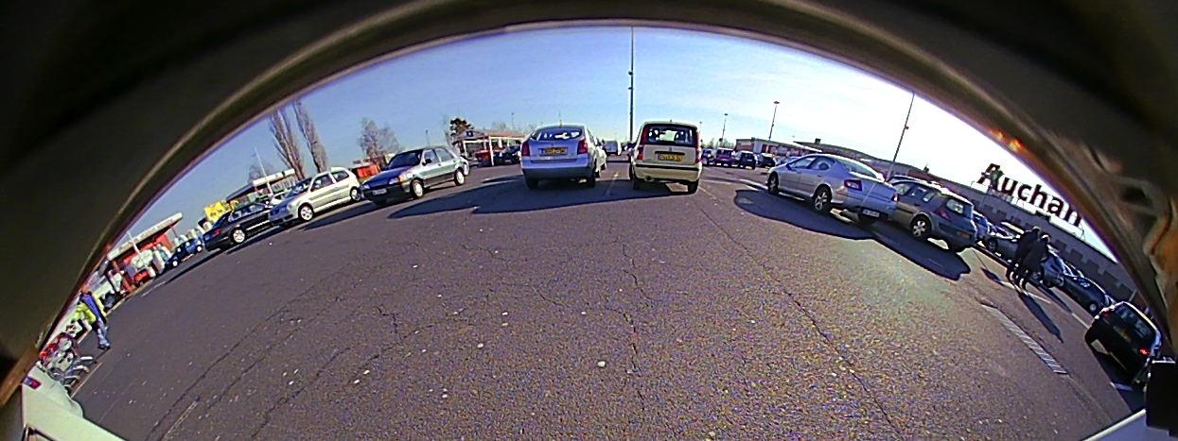
Radial distortion
Notes:
Show video!

Slide 7
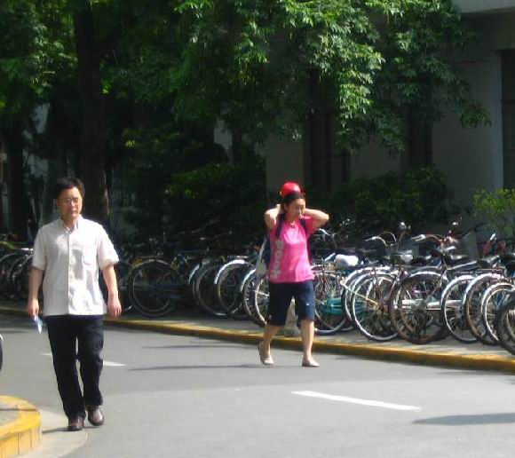
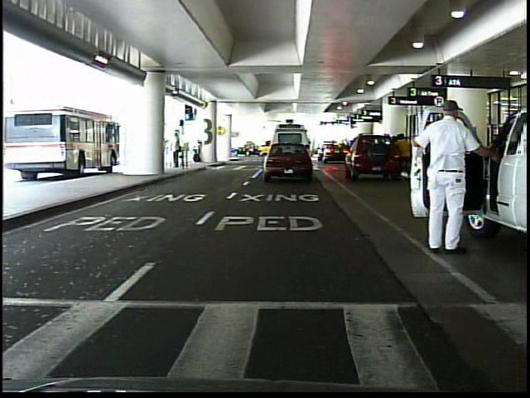
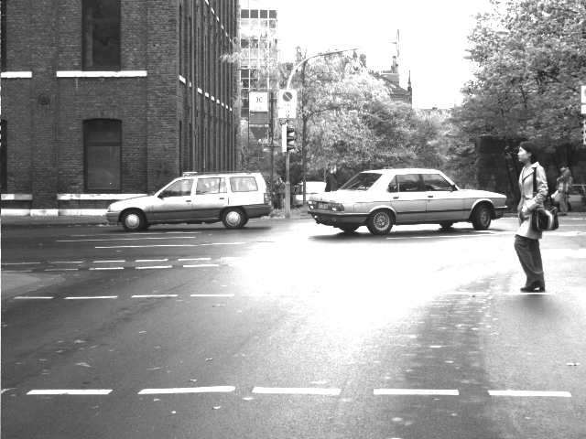
Objective Image Quality Metrics
Daimler Mono Ped. Detection Benchmark dataset
CVC Dataset:
Computer Vision Center,
Autonomous University of Barcelona
PennFudan Dataset
PNG format
PGM format
PNG format
580x516 = 876KB
640x480 VGA = 300KB
640x480 x3 = 900KB

Slide 8
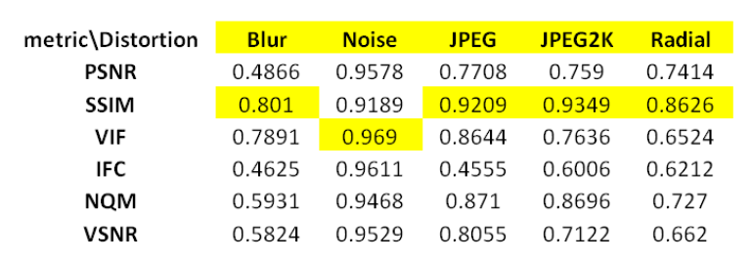
Objective Image Quality Metrics
The Pearson correlation coefficients of metric score to detection rates
SSIM performs reasonably well across all distortion types

Slide 10
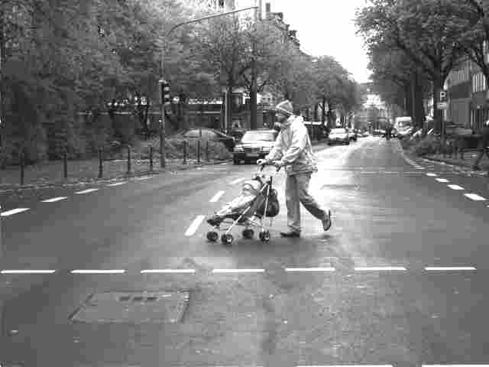
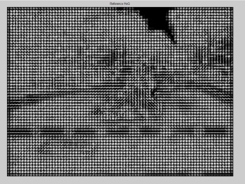


Reference image
HOG features of reference
compression
noise

Slide 11
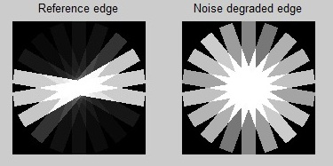
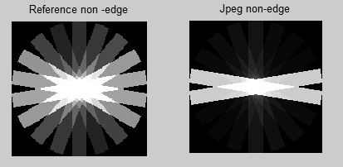
An Oriented Gradient based Image Quality Metric for Pedestrian Detection Performance Evaluation
A “lost edge” due to noise corruption.
An incorrectly detected edge due to a loss of high frequency components.

Slide 12
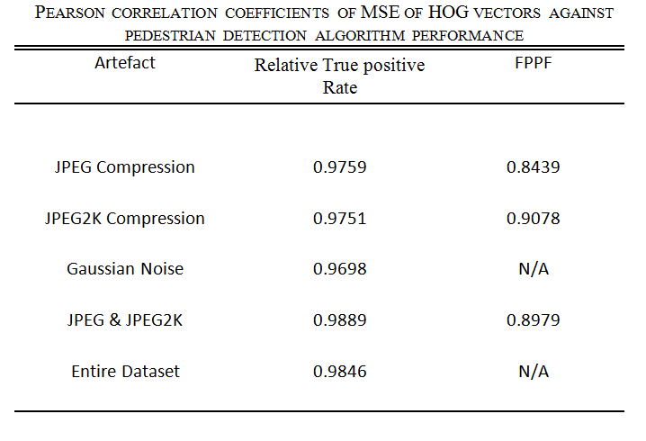

Slide 13
Research Goal
    Image Quality Metric for motion tracking/feature detection for automotive images.

Slide 14
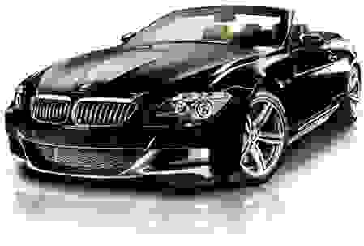
Thank You!

