Slide 1
Using Steady-State Visual Evoked Potentials for Electroencephalography-Based Image Quality Assessment
Sebastian Bosse
Notes:
Good afternoon! My name is Sebastian Bosse. I am with HHI Fraunhofer in Berlin and would like to tell you a little about an interesting study we did recently in order to learn something about the assessment of perceived image quality.
Let me start by shortly revisiting conventional approaches to image quality assessment.

Slide 2
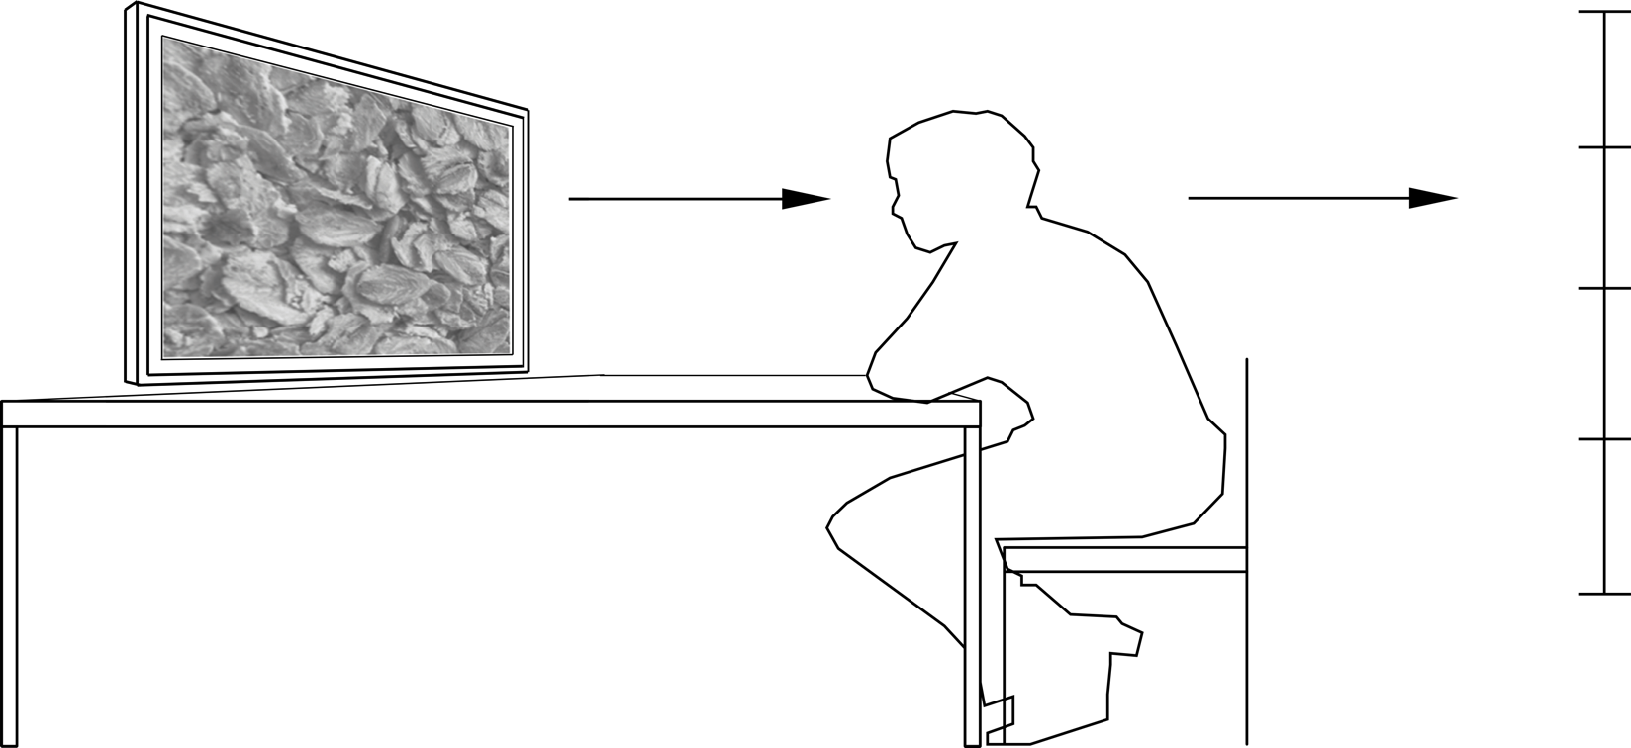
Traditional Image Quality Assessment
Imperceptible
Perceptible,
but not annoying
Slightly annoying
Annoying
Very annoying
Notes:
Usually, perceived image or video quality is evaluated in psychophysical experiments. In those sessions, a subject is presented the different conditions, e.g. different images or videos subject to different kinds or magnitudes of distortions.
Then the subject is asked for a behavioral response to the stimuli, concretly the subject is asked to report his or her decision about the perceived quality.
The ITU suggests in the Recommendations BT.500 and P.910 to repeat each condition for each subject and, obviously, to ask more than one subject, better around 15 or more. All the individual ratings are then compiled to the famous Mean Opinion Score.
These sessions are very exhausting for the subjects and thus limited in time. Given the limited time, the number of conditions is limited as well, even more, since each condition has to be presentet several times to each subject.
Rating scale assessments in general also suffer from systematic biases. We know that parameters, such as the design of the rating scale or the density of the conditions have influence on the subjects response.
Psychological scales do not conform the laws of fundamental measurements as we know from physics.

Slide 3
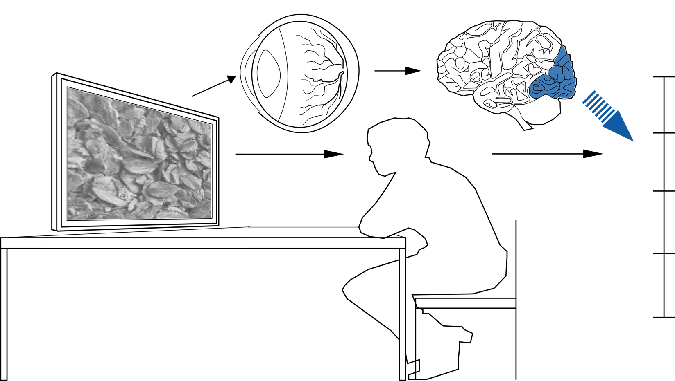
A (too) Simple Intuition for the Decision
Process
Imperceptible
Perceptible,
but not annoying
Slightly annoying
Annoying
Very annoying
Notes:
Here we have a intuitive model of the processing in behaviora quality assessment : the visual information enters the optical system of the eye, hits the retina and is processed in the brain. Here, in the brain, we have sensory processing in the visual cortex, marked as the blue shaded part of the brain and cognitive and behavioral processing, indicated my the blue arrow, leading to an overt response, that the subject is asked for.
We don’t know much about the cognitive and behavioral processing underlying the resulting category rating, but we are assuming that these are the source of psychological biases and fatigue.

Slide 4
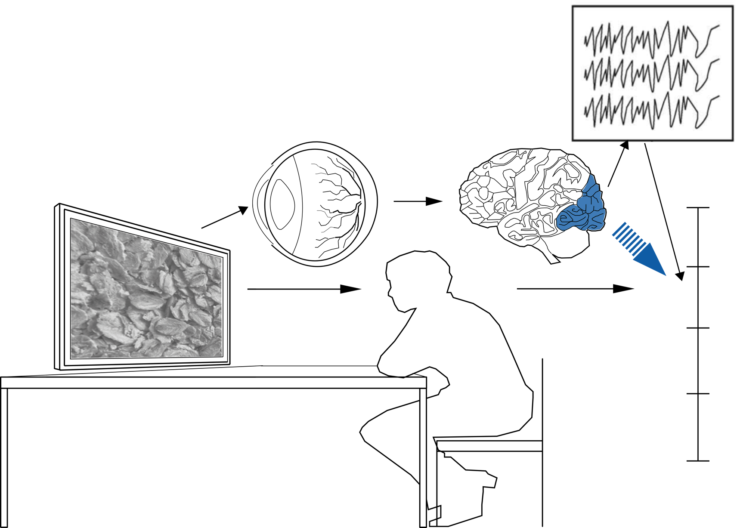
Neuro-Physiological Approach
Imperceptible
Perceptible,
but not annoying
Slightly annoying
Annoying
Very annoying
Notes:
So, we wondered if it was possible to access the perceived quality of images a little more objectively and more directly, by accessing the relevant sensory signal before some black block of cognitie and behavioral processing - For example during early vision processing located in the visual cortex.
Luckily, neuro-pyschologists know a phenomenon called steady state visually evoked potentionals, which I will talk of a little later.
So, we did two experiments: During the first one, we assessed the visual quality traditaionally in order to obtain MOS values of some stimuli; during the second one, we adapted the stimulus presenation and looked for SSVEP-responses in the neural signal.

Slide 5

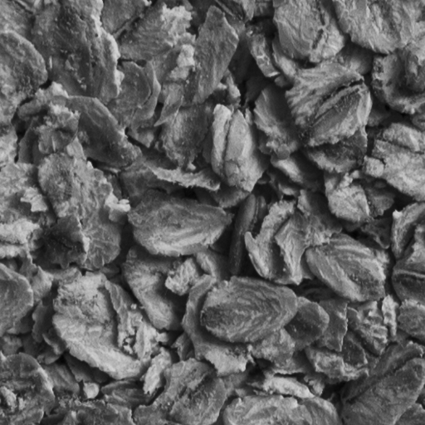

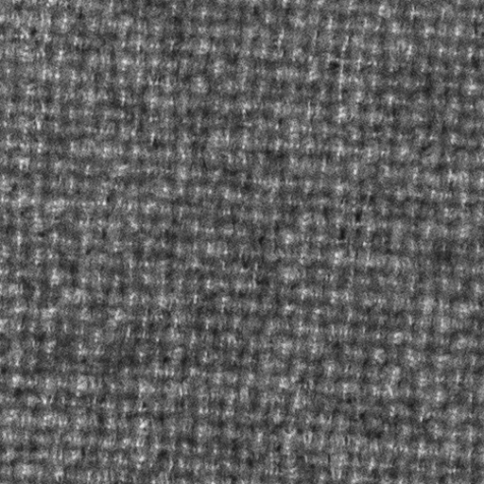
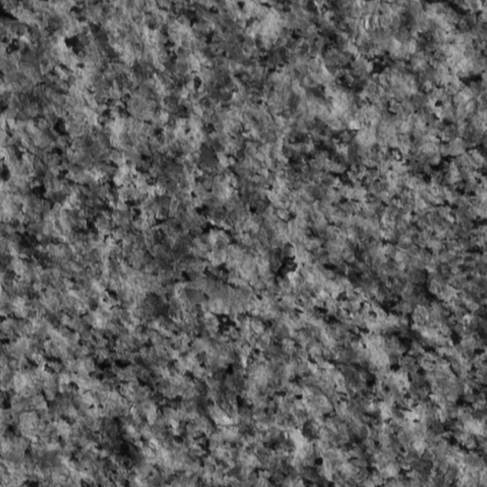
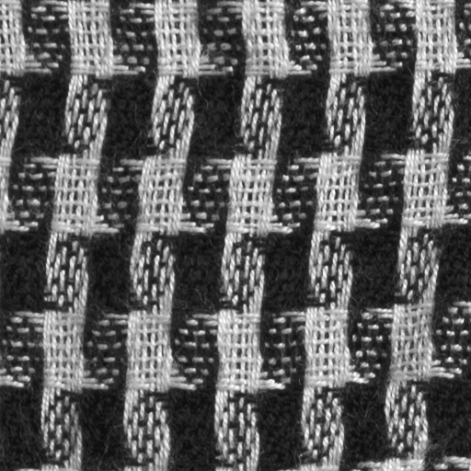
Used Textures
Notes:
Let me talks about the stimulus material, we used in the study.
The stimuli used in the study were based on these textures. We used textures in order to make the stimulus roughly spatially stationary and the EEG-recordings less prone to artifacts stemming from eye movements.

Slide 6


Example of Distorted Texture
Notes:
Those images were distorted by coding them using the reference software HM of the emerging High Efficiency Video Coding standard.
The visual loss in quality (as seen here in the slide from the left to the right) is due to the quantization of the transform coefficients. This is controlled by the Quantization Parameter (QP)

Slide 7
Behavioral Results
Notes:
As indicated before, in a first session, we assessed the perceived quality of the distorted images traditionally as recommended by BT.500 and P.910.
We used a 9-point scale, were
9 indicated ‘Imperceptible’
7 ‘perceptible, but not annoying’
5 ‘slighly annoying’
3 ‘annoying’
And 1 ‘very annoying’
For each texture we had 6 levels of distortion, resulting in 42 conditions in total, when considering the reference as well.
The ratings of the 16 subjects in the study were to combined to the MOS values..
The curve shows the MOS in dependence of the QP for the different textures.
Note, that a MOS=8 can be interpreted as the detection threshold.

Slide 8
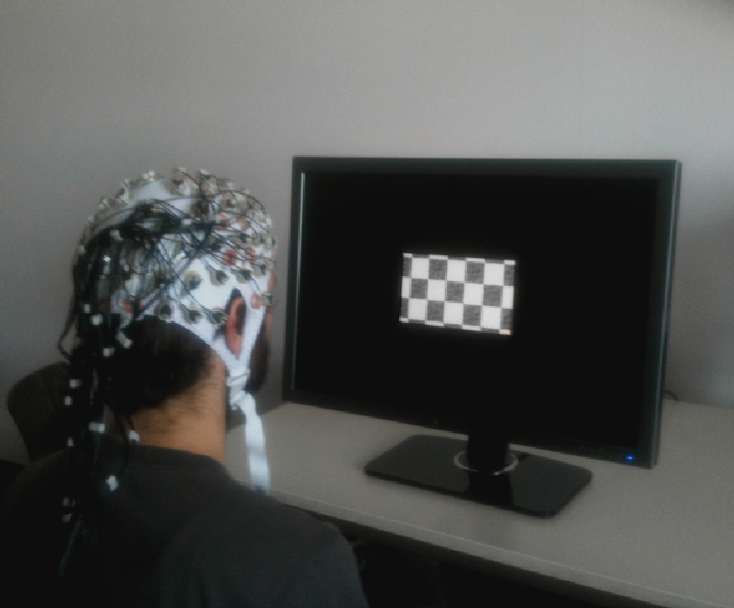
EEG-Setup
Notes:
Before I dive into talking about the EEG part of the study, here is an image that may give you some impression about the general EEG setup
So, in a EEG study, addressing vision, the subject sits In from of a display, is asked to look at the stimulus while his or her EEG signal is measured by electrodes placed on the scalp.

Slide 9
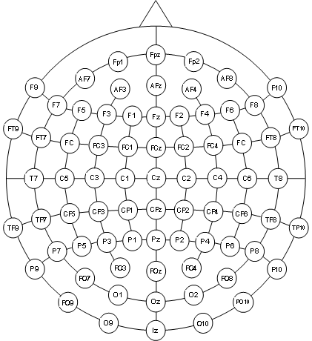
Steady-State Visually Evoked Potentials
Evoked Potentials: stereotypic changes of electrical activity evoked by sensory stimuli
Notes:
When we talk about the EEG signal, we mostly talk about Evoked Potential. Evoked Potentials are stereotypic changes of the electrical activity measured on the scalp. Usually, evoked potentials are time locked to the stimulus presentation.
A prototypical topology of electrodes for EEG studies is shown here on the right hand side, where the small triangle on the top represents the position of the nose and the circle indicate the electrode positions.

Slide 10
Steady-State Visual Evoked Potentials
Evoked Potentials: stereotypic changes of electrical activity evoked by sensory stimuli
Steady-State Visual Evoked Potentials (SSVEP): responses to a stimuli presented at a fixed rate
SSVEP: objective measurement of processing in early visual pathway
Rich description of brain dynamics
Provides data for quantitative modeling
Notes:
In our study, we addressed a special kind of Evoked Potential, called Steady-State Visually Evoked Potentials.
Those Evoked Potentials are responses to a visual stimulus subject to a periodic change and are most prominent in the visual cortex. The rough position of the visual cortex in sensor space is indicated here by the gray shading.
You can feel it at your own head: it is the area around the small projection that you can palpate on the back of your head.
SSEP provide an objective measurement of processing in the early visual pathway and a rich description of brain dynamics. They have a long history in neuro-psychology, where it is used for measuring simple things such as contrast sensitivity, but also more complex sensory processing such as motion perception and even face detection.
Being responses to periodic stimuli, SSVEP are described by amplitude and phase. Responses are elicited at the stimulation frequency and, due to the non-linearity of the humans visual system at its harmonics. We will come to this, when we take a look at our recorded signals.

Slide 11
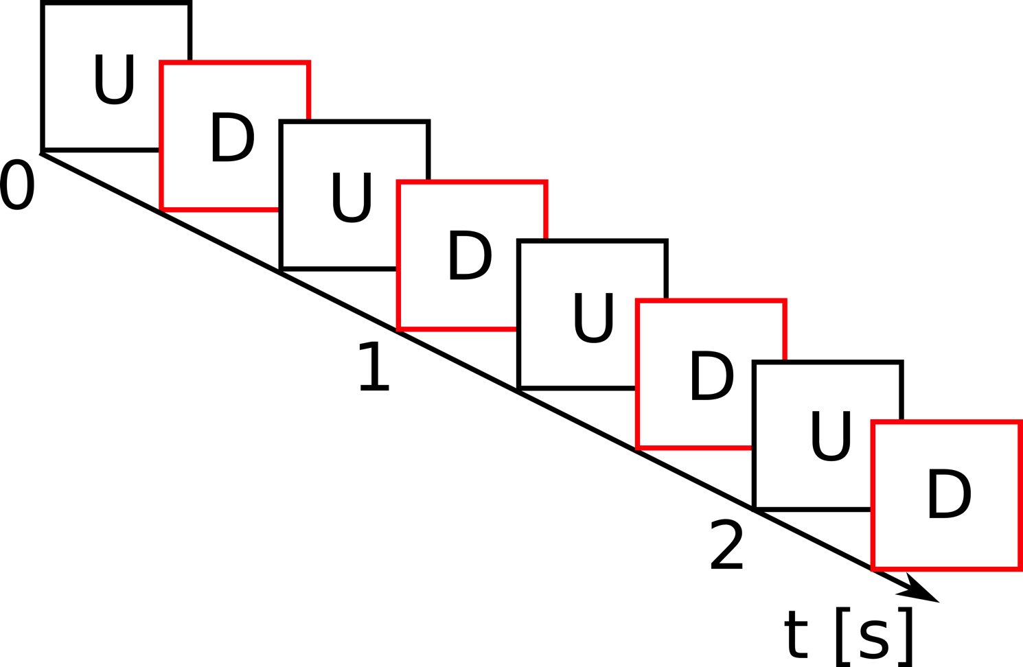
Stimulus for EEG-Measurement
Notes:
Let me explain how we adapted our stimulus presentation, in order to elicit SSVEP.
For each condition, an undistorted and a distorted version of a specific texture are presented to the subject in a periodical change at a rate of 3Hz. In a classical SSVEP-terminology, this would be 1.5Hz stimuliation frequency, as we have 1.5 full periods per second. The periodic change was repeated 4 times for each condition in each trial.`

Slide 12
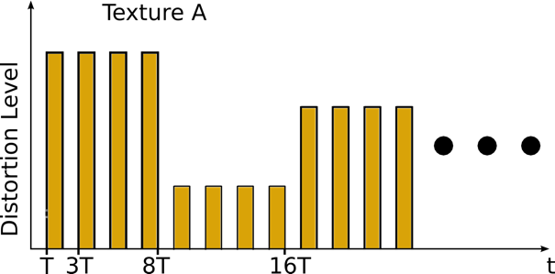
Stimulus for EEG-Measurement
Notes:
In order to avoid adaptaion and memery effects, for each texture, the presentations for different distortion levels are just concatenated in random order for each trial. For the same reason, the order of the texture has been radnomized as well.
In this experiment we had 51 trials for each condition, that where presented to the subjects in 3 blocks. Between the blocks, subjects had a rest.

Slide 13
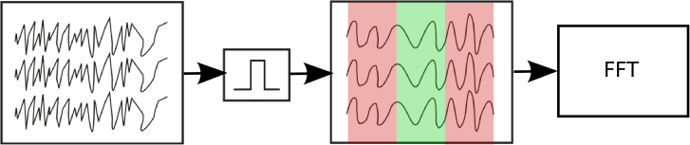
Processing of EEG-Signal
Notes:
I would like to point out that the results I present here used only a very simple, very basic signal processing:
We take the raw EEG signals, apply a bandpass , to get rid of artifacts such as drift and line noise. Then we chop the signal into chunks according to the temporal duration of the specific condition.
After that, we apply the FFT on the chunks in order to extract an useful representation of the SSVEP.

Slide 14
SSVEP Extraction
Less distorted
Notes:
So let me give an example:
The bandpass-filtered EEG-signals measured during the presentation of an alternation of a slightly distorted image and an undistorted image is shown on the top left of the slide.
#####
Here are 2 more graphic examples for the SSVEP extraction, in the upper row for a lesser distorted image, in the lower row for a stronger distorted image.
On the left we have the bandpass filtered EEG signal. On the right the Amplitude of its Fourier spectrum obtained after applying the fft.
As we can see, the the spectrum peaks at the harmonics of the stimulus response of 3Hz. This is pretty obivous for the 1st and 2nd harmonic, so at 3 and 6 Hz. For higher harmonics it becomes less evident due to EEG background noise in the alpha band between 8-13 Hz.

Slide 15
SSVEP Extraction
Less distorted
FFT
Notes:
This signal is transformed into the frequency domain to obtain the amplitude spectrum.
##
Here are 2 more graphic examples for the SSVEP extraction, in the upper row for a lesser distorted image, in the lower row for a stronger distorted image.
On the left we have the bandpass filtered EEG signal. On the right the Amplitude of its Fourier spectrum obtained after applying the fft.
As we can see, the the spectrum peaks at the harmonics of the stimulus response of 3Hz. This is pretty obivous for the 1st and 2nd harmonic, so at 3 and 6 Hz. For higher harmonics it becomes less evident due to EEG background noise in the alpha band between 8-13 Hz.

Slide 16
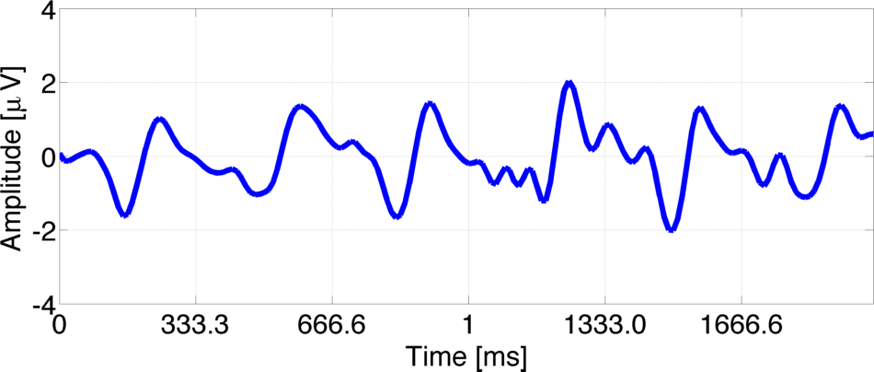
SSVEP Extraction
Less distorted
FFT
Stronger distorted
FFT
Notes:
Let’s compare that signal with a signal measured during the presentation of a stronger distorted image.
As you can see, we obtain a stronger modulation with the stimulation frequency for higher distortion levels.

Slide 17
SSVEP Extraction
Less distorted
FFT
Stronger distorted
FFT
Notes:
This can be nicely described in the fourier domain:
The spectrum peaks at the harmonics of the stimulus frequency of 1.5Hz.
I have to admit that this plot as a little confusing. Please not that the scale are not the same.
This is very obvious for the first two even harmonics, at 3Hz and 6Hz. The same behavior is visble, but less strong for the odd harmonics.
For higher harmonics it becomes less evident due to EEG background noise in the alpha band between 8-13 Hz.
##########
The results I will show you in the next slides are obtained using the amplitude peak at 6 Hz.

Slide 18
Topographies of Spectral Amplitudes
1.5 Hz
6 Hz
Notes:
Another view on the recordings is given by considering the channel positions.
In the top row of this slide, we see the topographies of the spectral amplitude for 1.5Hz, in the bottom row we see the topographies for 6Hz. In both rows, the distortion level is increasing from left to right.
We can see the activity to be increased for higher distortion level. Also, the activity is mainly increased on electrodes positioned over the visual cortex.
Overall activity is slightly increased as well, this is probably due to volume conduction through the brain tissue.

Slide 19
Topographies of Correlations
1.5 Hz
3 Hz
4.5 Hz
6 Hz
Notes:
This becomes a little clearer, when we take a look at the correlations of reported MOS-values with the average ampltude spectras measured at specific frequencies. The little crosses indicate a significant correlation with p<0.05 and the color indicates the absolute value of the correlation, with white being 1 and black being 0.
As we have higher activity on the even harmonics, the volume conduction has stronger influence as well and we get significant correlations at unexpected positions, for the even harmonics.

Slide 20
Topographies of Correlations
1.5 Hz
3 Hz
4.5 Hz
6 Hz
2 Hz
4 Hz
5 Hz
Notes:
More for testing our neuro-physiological assumptions, here I plot the correlations obtained on off-harmonic frequencies (2,4, ad 5 Hz). As we can see, we can see nothing and we don’t have siginificance nor correlation with the reported MOS-values.

Slide 21
Relating Neural and Behavioral Data
Notes:
So, what we are interested in in the end is a mapping between the measured EEG-signals and the reported MOS-values.
In this plot, On the x-axis we see the MOS values, on the y-axis we see the average amplitude. This plot are obtained by just using amplitude at 6 Hz measured the Po8-electrode.
We can see a fairly consisted relation between neural and behavioral responses.

Slide 22
Discussion
Perceived image quality can be measured using EEG
Measurements are possible already at early sensory processing stages in the visual cortex
Channels can be selected based on the statistical structure of the recorded data and an assumption about the spectral distribution of signals and noise
Components can fail for some subjects
Notes:
Let me wrap up, what I showed you and what we learned.
We can measure perceived image quality using eeg and those measurements are possible at very early processing stages in the visual cortex.
For this specific dataset, on average we achieve a high correlation between neural signal and reported repsonses.
This indicates an overall feasibility of the proposed approach.

Slide 23
Future Work
Include other harmonics into the framework
Robustify extraction of neural components
Evaluate other optimization criterions
Investigate influence of stimulation frequency
Design neurophysiological screening
Extend the method to complex images and video stimuli
General: Establish EEG measurements that quantify differences for a subjective distortion metric
Notes:
Althoug, these results are pretty promising, a lot of work needs to be done.
The general goal here is to establish an EEG-based measurement that quantifies objectivly and fast perceived, so to say, subjective distortions, in order to speed up subjective tests and to come up with a neuro-physiologically motivated quality metric.
To get there, more sophisticated signals processing has to be applied to the recorded brain signals, in order to make the measurement more stable to artifacts. So far we only used single electrodes, but we are currently investigating multidimensional methods.
We don’t know much yet about the optimal stimulation frequency. 1.5Hz Is rather arbitrary choice here, so we just started a study to learn more about the significance of the stimulation frequency.
As you guys know, we do a lot of video coding at HHI, so we will extend the method to moving stimuli as well.

