Slide 1


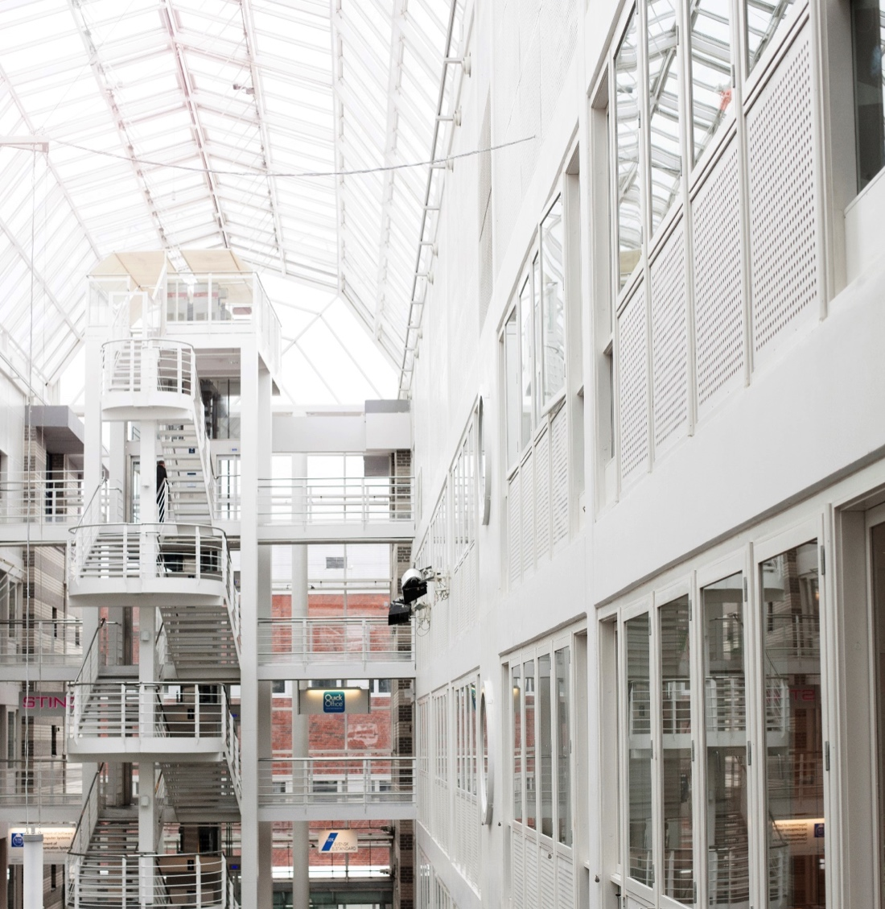

Special Session on
Visually Lossless Video Quality @ HVEI 2017
Kjell Brunnström
ICT
Acreo

Slide 2
Special Session on Visually Lossless Video Quality…
Human Vision and Electronic Imaging 2017 by IS&T at Burlingame, CA, USA, Jan 29 - Feb 2, 2017
Presentations
  Detection of Compression Artifacts on Laboratory, Consumer, and Mobile Displays by Y. Zhang, Y. Yaacob and D. M. Chandler (Today@4.30 pm)
  Business Perspectives on Visually Lossless and Lossy Quality by S. Daly (Tomorrow@10.30 am)
  Subjective assessment and the criteria for visually lossless compression by L. M. Wilcox, R. S. Allison and J. Goel (Today@11.05 am)
  Usage perspectives on visually lossless and lossy quality and Assessment by H. Colett, J. Knopf, P. Corriveau and S.-N. Yang (Today@1.00 pm)
Bonus presentation here
  ”Spatial-Temporal Visible Contrast Energy Predictions of Detection Thresholds” by Al Ahumada (NASA) (Today@11.30 am)
  ” Visually lossless video quality evaluation methodology” by Glenn Van Wallendael (Ghent University - imec) (Today@11.45 am)

Slide 3
Special Session on Visually Lossless Video Quality…
Human Vision and Electronic Imaging 2017 by IS&T at Burlingame, CA, USA, Jan 29 - Feb 2, 2017
Panel discussion
  Damon Chandler, Shizuoka University, Scott Daly, Dolby, Phil Corriveau, Intel, Edward Delp, Purdue University, James Goel, Qualcomm, Laurie Wilcox, York University
Paper
  “Industry and business perspectives on the distinctions between visually lossless and lossy video quality: Mobile and large format displays”

Slide 4
Thank YOU!
Kjell Brunnström
Kjell.brunnstrom@ri.se
ICT
Acreo

