Slide 1

Broadcast and Creating Use Case for Non-Reference
Jeffrey Webb, Principal Streaming Architect
VQEG Madrid, 20/3/18
Premiership Football

Slide 2
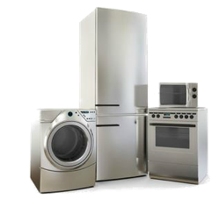
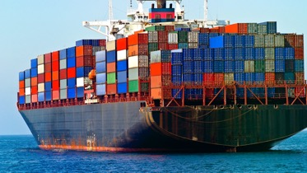
Every journey starts with a single step
Sky is one of the leading commercial TV operators in Europe, operating in six countries with a high value portfolio of premium content. In this presentation we will cover;
Why we are moving our video workflow from appliances to containers?
What are the challenges faced in a modern broadcast environment?
Why the industry needs a non-reference video quality tool?
It’s all about the customer streaming experience
Copyright Sky 2018. All rights reserved. Public.

Slide 3


We needed a new faster approach to deliver channels
Previous live streaming platform delivery timescales (Streaming perspective)
Typical time required to stand up a new live streaming channel = Up to 4 weeks.
  Stream configuration, testing and launch = 3-4 weeks.
Additional costs due to project timescales and risk with manual channel build.
New live streaming platform delivery timescales (Streaming perspective)
Spins up new live channels quickly (Assumes compute available).
Each channel is consistently built using templates.
Channels can be modified quickly by updating templates.
Modular architecture provides flexibility to adapt to future needs.
Supports new streaming capabilities such as Ad-hoc resilient channels.
Our new Software Defined Streaming platform puts us in the fast lane
Copyright Sky 2018. All rights reserved. Public.

Slide 4

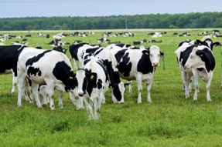
Old versus New
Pets (Appliances): Reference Model
Pets create a strong emotional connection.
We invest a lot of time to nurture and train them.
We get upset when they are ill and take them to the vet to get better.
Cattle (Containers): Non-Reference Model
Farmers are running a business and do not get emotionally attached.
Use new machinery and procedures to cut costs or increase revenue.
When a cow gets ill, it is culled from the farm, as the farmer is focused on the herd.
Streaming DevOps is the merging of two skill sets to optimize the video workflow
Copyright Sky 2018. All rights reserved. Public.

Slide 5


What is Software Defined Streaming (aka SDS)?
A reimagining of live streaming using Streaming DevOps to deliver;
Introduction of Reduced Fault Domain.
Resource planning and capacity planning on a per channel basis.
Continuous Deployment and Continuous Integration (CI/CD) automation pipeline.
Automated video and audio quality monitoring of IP Source versus ABR Ladder.
Centralised monitoring and aggregation reporting using open source tools Elasticsearch, Logstash and Kibana.
All whilst maintaining…
Existing high quality streaming services for client devices.
Copyright Sky 2018. All rights reserved. Public.

Slide 6
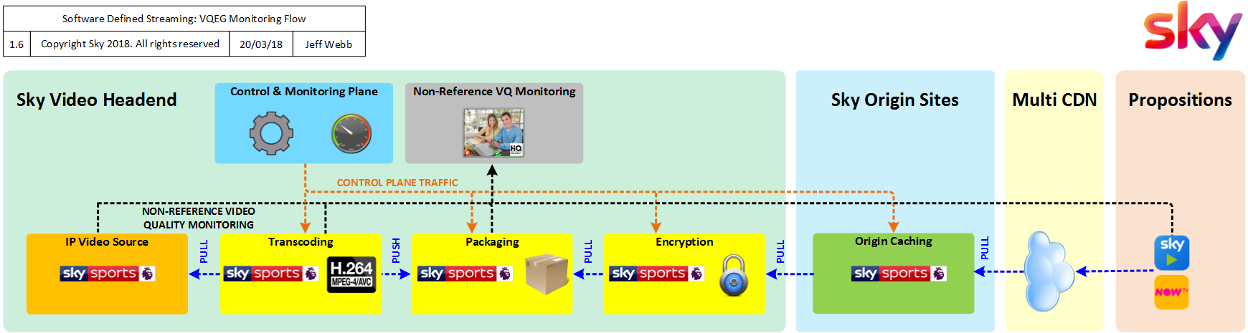
Sky Simplified Linear Video Workflow

Slide 7
Potentially three use cases for linear video workflow
IP contribution (input video source)
Distribution feeds (adaptive bitrate ladder)
Streaming clients (final validation of QoE)

Slide 8
IP contribution use case
Quality of the input video source coming out of our playout chain or from third party.
Applicable to Mezzanine and SDI
Applicable to progressive and interlaced inputs
Applicable to SD, HD, UHD, and perhaps future looking such as HDR
Problem detection and root cause analysis in real time
Possible outcomes should include standardised metrics, and thresholds

Slide 9
Distribution use case
Adaptive bitrate ladder (this is what the customer sees)
Compare the IP source quality versus the adaptive bitrate transcoder outputs as this directly affects the customer experience
For a non-reference model, input sources must measure the VQ as it’s happening and have a small delta with ABR output.
The challenge here is to predict the quality of a video you have not seen before
Extreme cases, billions of dynamic content
How frequently to sample the source to ensure high enough accuracy without impacting stream performance
Other methods to improve accuracy for non-reference models such as self learning models
Computationally suitable for live environments
Possible outcomes should include the mean opinion score, or similar

Slide 10
Streaming clients use case
Everyone has client side analytics tools, focused on buffering, average bitrate and other important metrics.
There is no industry tool available in the market today that tackles client side video quality, especially one that links back to a broadcasters internal system and provides an end to end qualitative score.
Could be difficult but the objective is to pick up issues before (or at the same time as) the customer notices.
There should be lots of other checks in place, so this is a final validation.
This may work better in a partial-reference model where network and device screen characteristics are included in the matrix
Really ambitious, but worth a mention
Possible outcomes should include overall streaming experience metrics

Slide 11

How could the cloud benefit Sky?
SDS is designed for deployment anywhere
Infrastructure agnostic architecture.
The same software stack can be deployed either on or off premise.
Flexible and consistent installation across different geographies.
Ability to support video ingest to the cloud from multiple locations.
Shortens the development cycle by not having to wait for infrastructure.
SDS allows us to rapidly respond to our business needs
Copyright Sky 2018. All rights reserved. Public.

Slide 12


What we have learned so far on our SDS journey?
You have to start with the basics, quality in and quality out
Content is expensive to produce and needs to be treated with care.
Video quality is critical to the customer experience.
Audio quality is very important as our ears are sensitive to poor sound.
You have to be committed (pun intended) to Streaming DevOps
Tight collaboration between streaming engineers and DevOps engineering.
Migration from pets to cattle, required a cultural mind shift change.
Streaming DevOps is a cultural collaboration and brings best of both worlds.
Engineers now have time for research & development to enhance our services.
Synergistic relationship with the whole being greater than the sum of its parts.
You need to be able to see the whole forest and not just the trees.
Copyright Sky 2018. All rights reserved. Public.

Slide 13
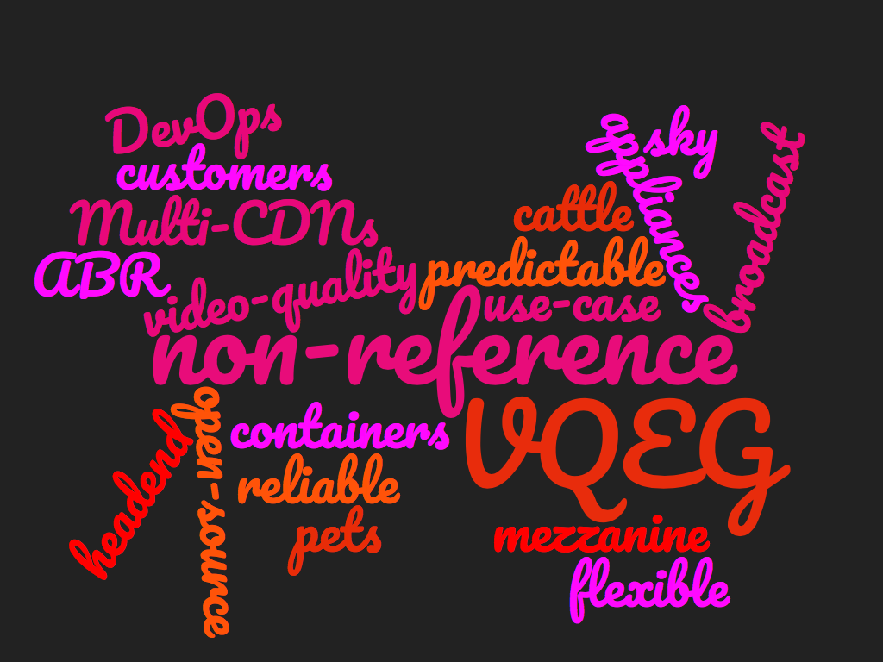
Word thoughts

Slide 14
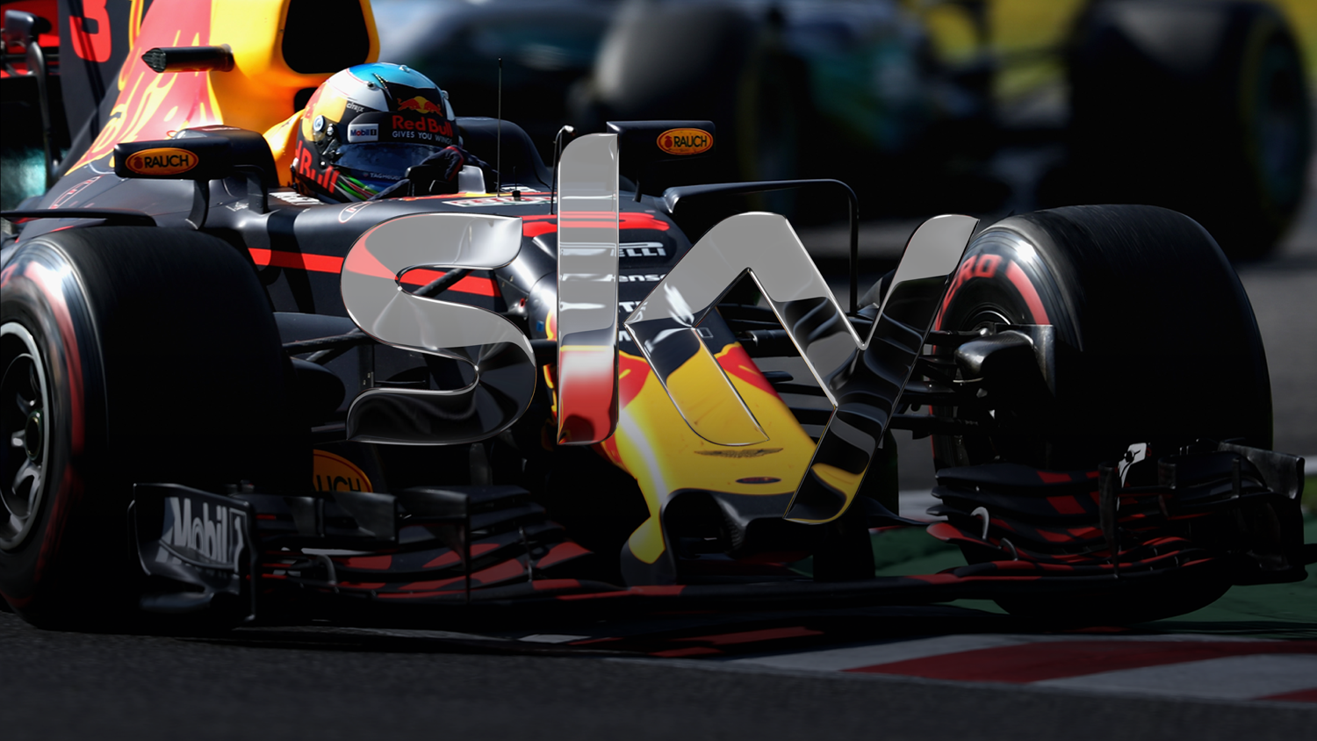
Thank You
Twitter: @SkyUK @JeffWebbUK
Formula 1®

