Slide 1
CGVDS: Cloud Gaming Video DataSet
Saeed Shafiee Sabet
Simula Research Laboratory

Slide 2
Gaming Video DataSets
Gaming recently expanded the associated services, by stepping into live streaming services
Cloud gaming is a delay sensitive service requires special encoding setting
  NVENC, llhq, llhp presets, fixed macroblock size, short key frame inerval
Three Datasets
  GamingVideoDataset (KU-DT/TUB) [1]
  KUGVD (KU)
  CGVDS (DT/TUB-Simula)

Slide 3
Overview of datasets
 | GamingVideoDataset | KUGVD | CGVDS
Influencing Factors | Resolution, Bitrate | Resolution, Bitrate | Resolution, Bitrate, Framerate, GoP, Packet loss
Preset | Veryfast | Veryfast | llhq
Encoding mode | CBR | CBR | CBR
Number of stimuli | 90 | 90 | Over 400
Encoder | FFmpeg, h264 | FFmpeg, h264 | FFmpeg, NvENC (h264)

Slide 4
CGVDS
Six video games selected based on their complexity class [2]
Two large scaled subjective tests have been conducted
  Over 70 participants participated in each (150 together)
  Each stimulus has at least 25 clean ratings (after outlier detection)
Using ffmpeg/NVENC, llhq (Low latency, high quality)
Consists over 400 distorted video sequences
  Resolution, Bitrate, Framerate, GoP, Packet loss

Slide 5
CGVDS
Each participant rated following dimensions
  Video Quality
  Fragmentation
  Unclearness
  Discontinuity
  Noisiness
  Suboptimal Luminosity
Subjective test designed based on ITU-T Rec. P.809 [3]

Slide 6

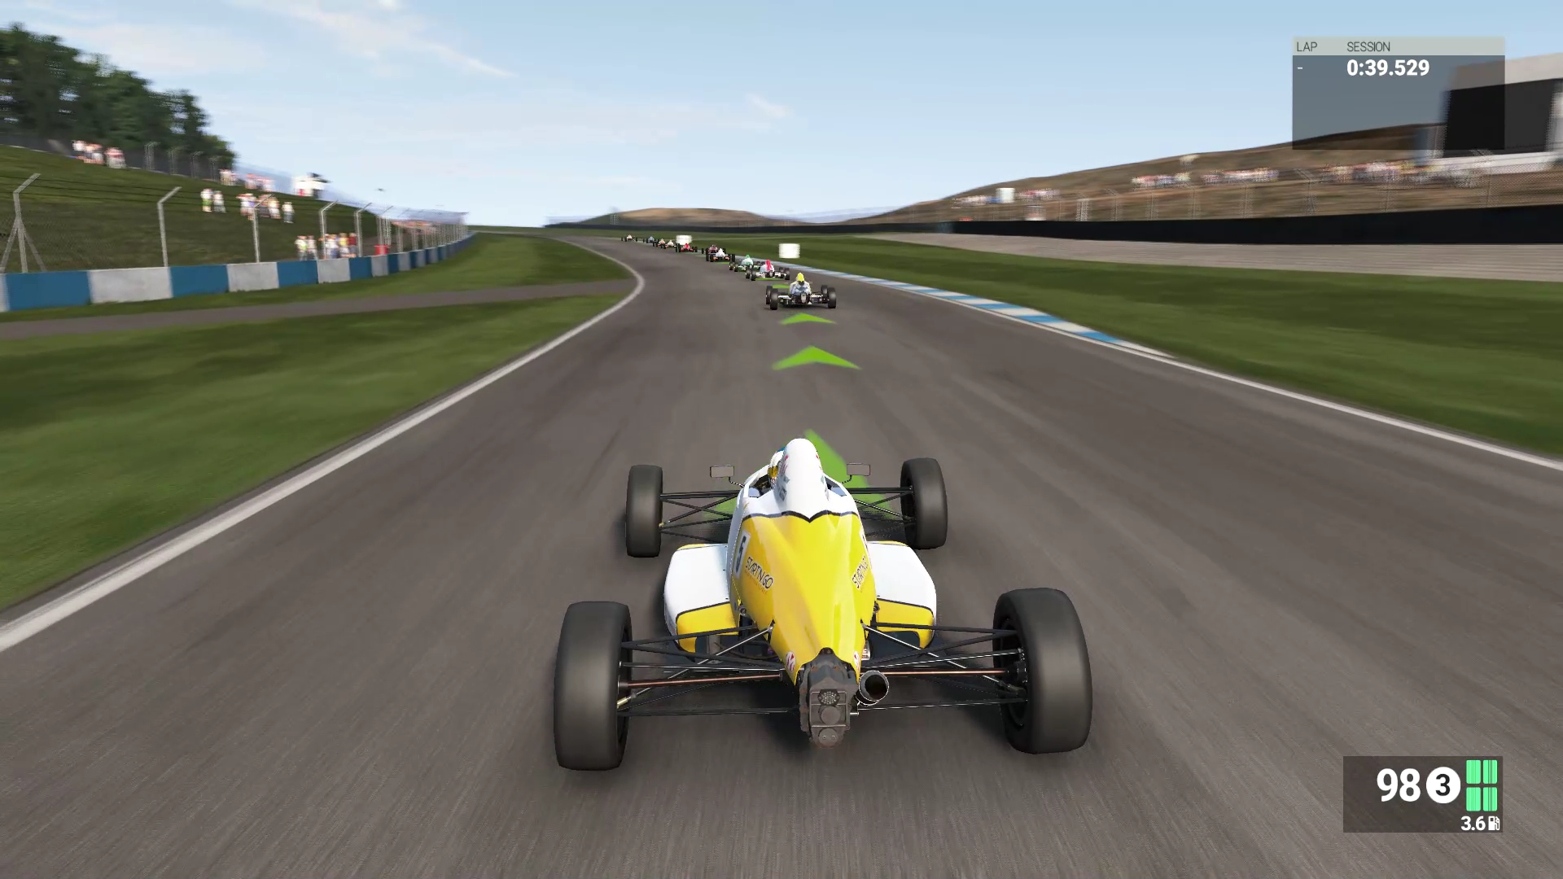
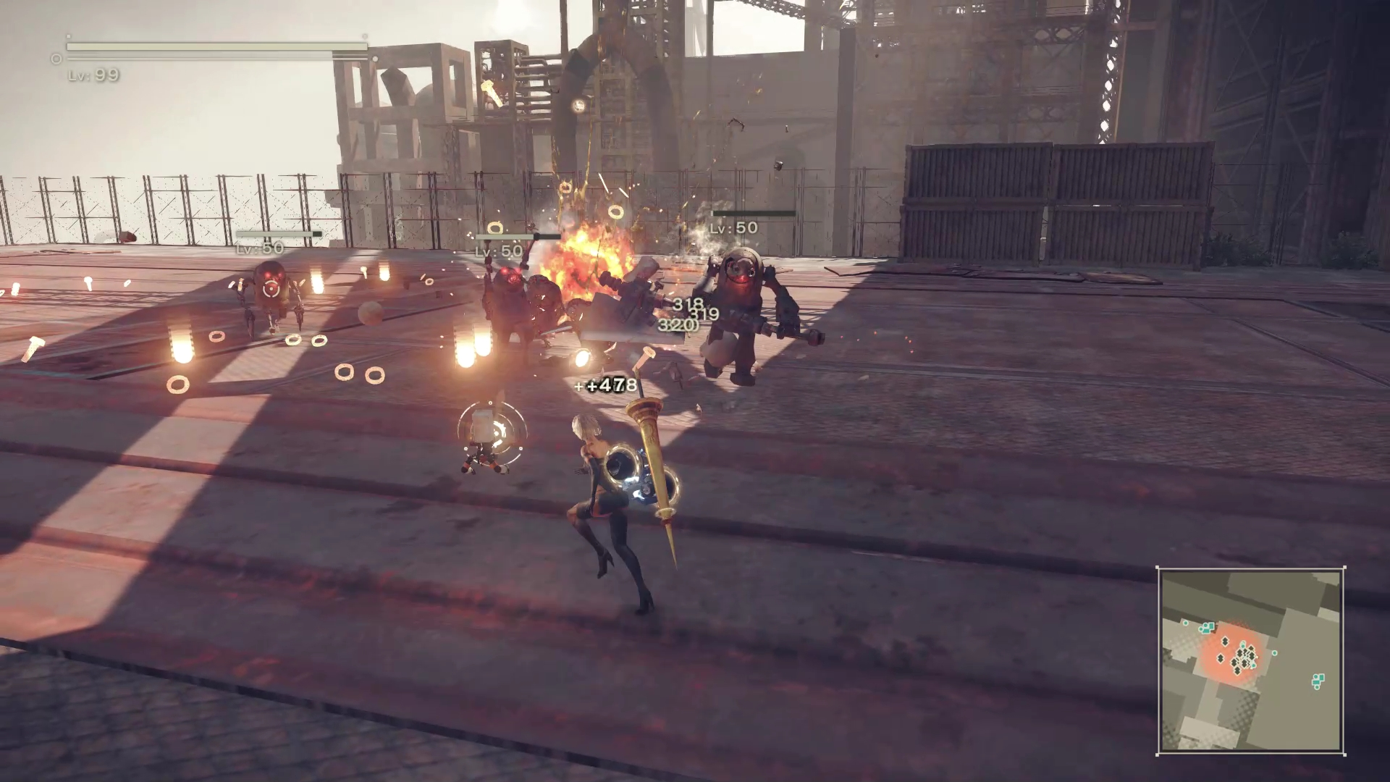
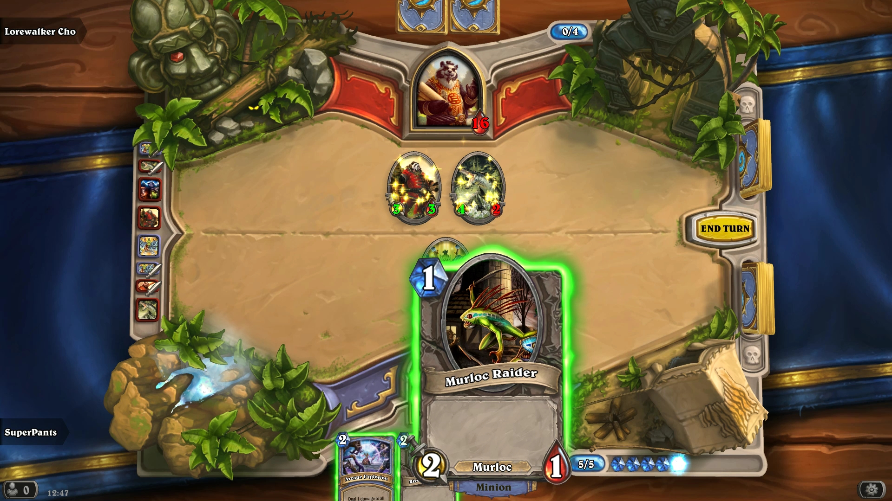
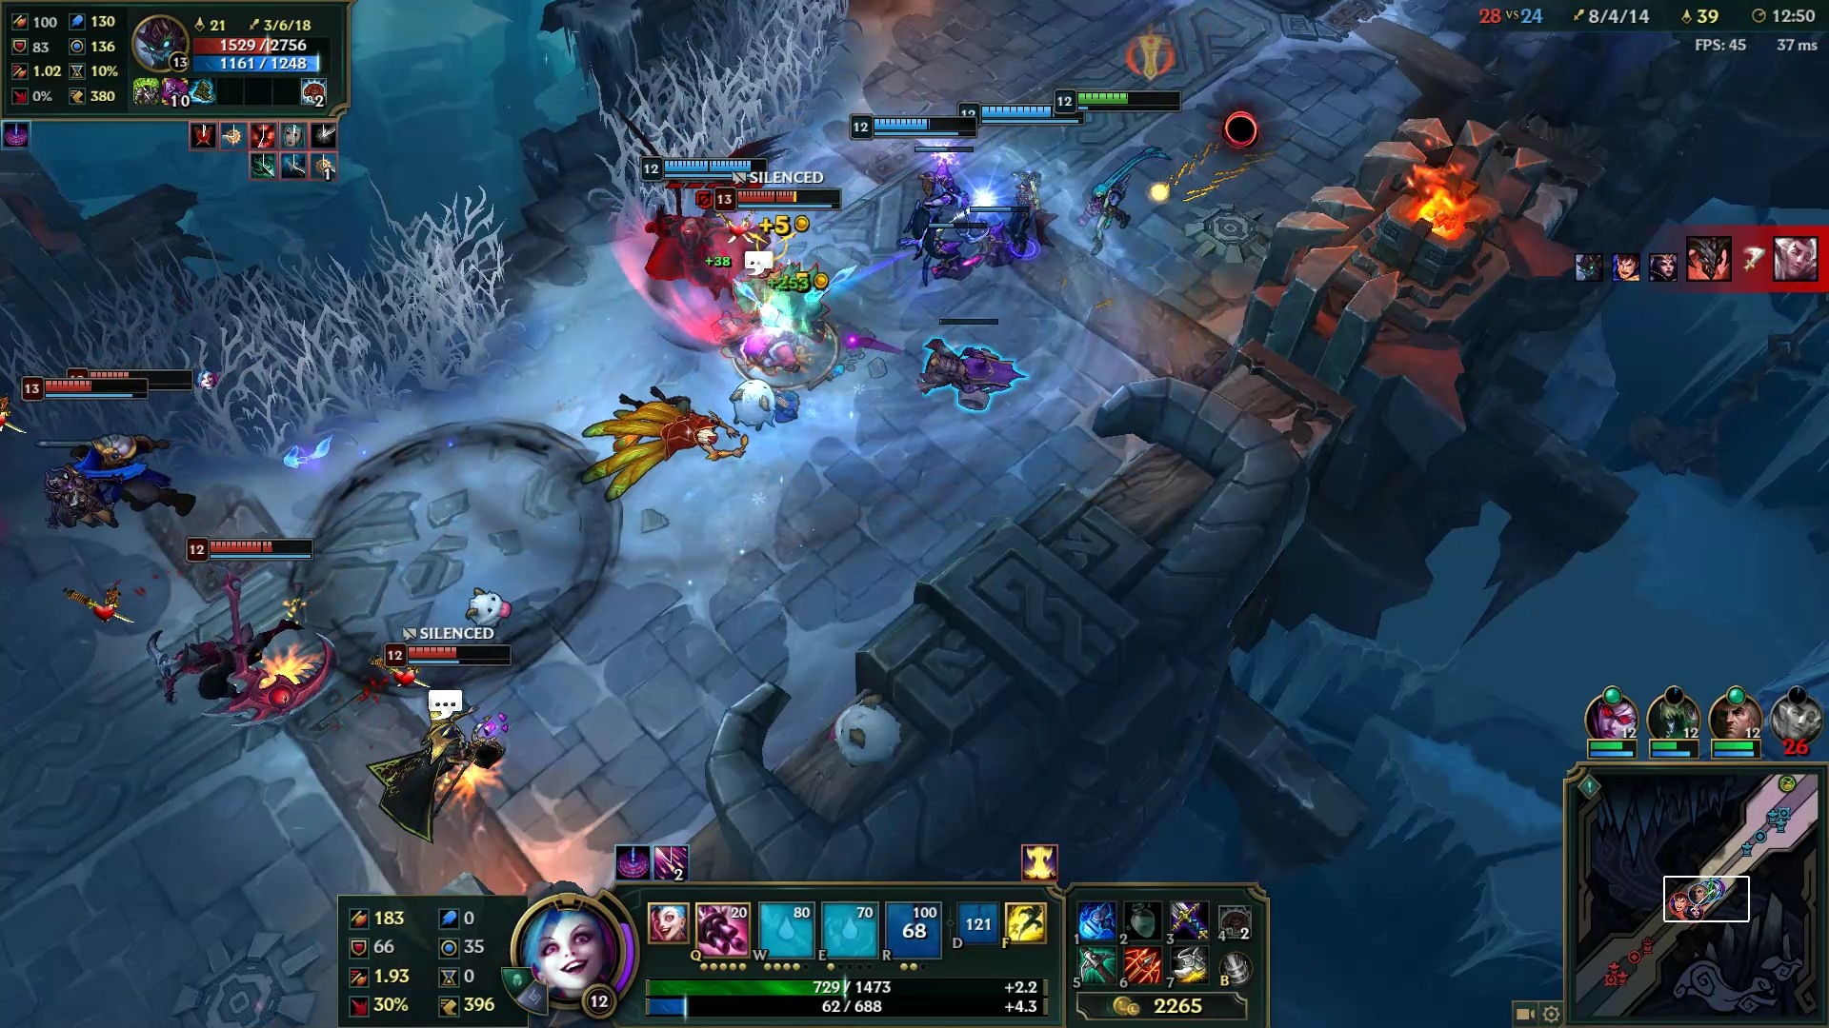
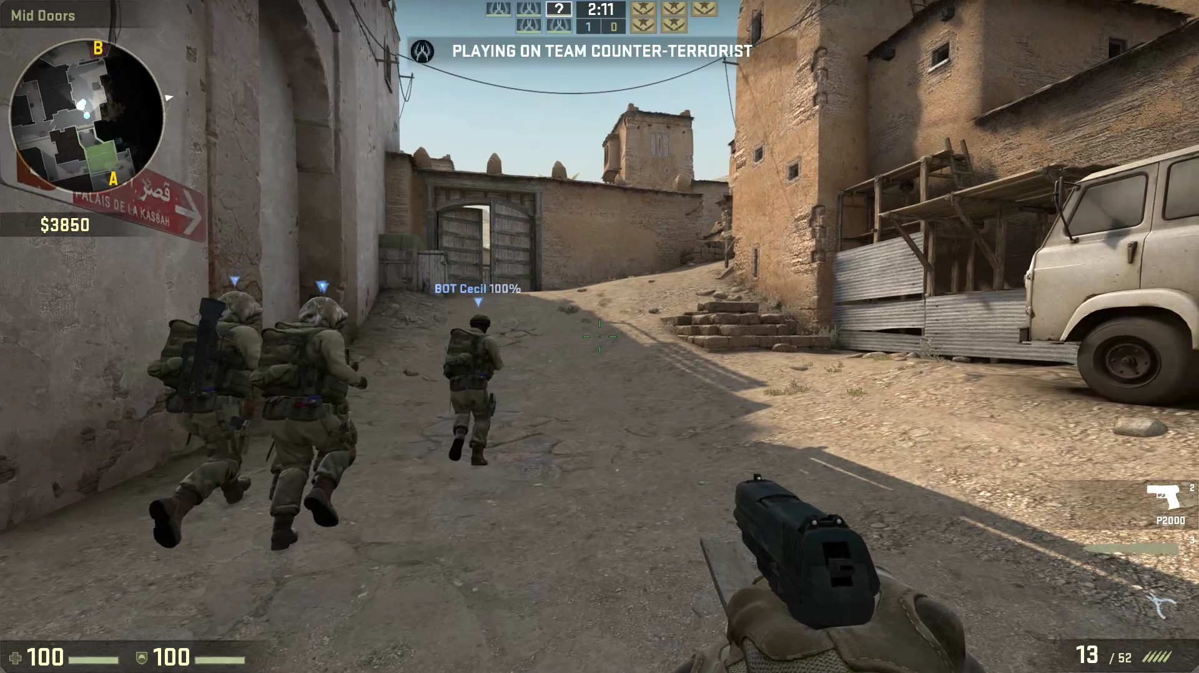
Source Sequence
a) Stick Fight
b)Project Cars
c) Nier: Automata
d) Hearthstone
e) League of Legends
f) Counter-Strike
Notes:
We tried to use videos with different motions and complexity
A and D, have constant background (Omnipresent games)
C and F have so many movements and motions (Complex FPS game)
B and E, are something in between (Global motion)
Saman—Perhaps we can arrange the order based on their complexity

Slide 7
Subjective Test A
Parameter | Value
Duration | 30 sec
Resolution | 1080p, 720p, 480p
Frame Rate | 60, 30, 20
Encoder | FFmpeg- NVENC
Encoding Mode | CBR
Video Compression | Standard H.264, Main 4.0
Preset | llhq (low latency, high quality)
Group of Picture | 2 (seconds)
Packet Loss | 0%
Resolution | Bitrate (kbps)
1080p | 2000, 4000, 10000, 20000, 50000
720p | 1000, 2000, 4000, 50000
480p | 300, 1000, 2000, 4000
Notes:
In total 72 game videos are created
We used 5 parameters for our study (Framerate, Bitrate , Packet Loss, Resolution, Key frame interval)
These 5 parameters were divided into two groups, and bitrate as a factor that has relationship with all the other parameters were used in both groups. (Right?)
For group 1, FR and Resolution stayed constant (30 and 1080) and KFI , PL and BR changed
For group 2, KFI stayed as default and no packet loss were simulated. FR and resolution were changed, and we had different BR for different resolution.
72 Videos for each game

Slide 8
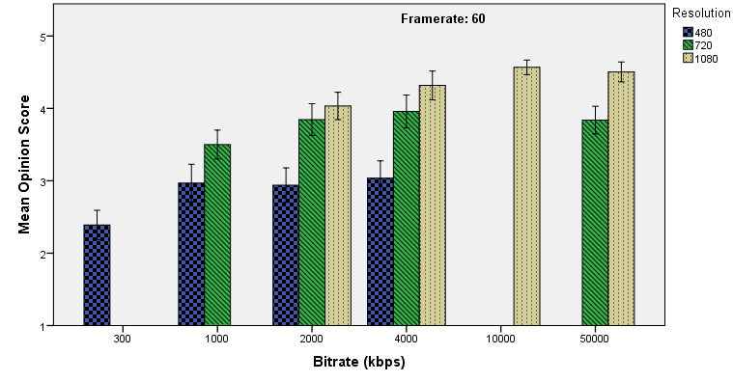
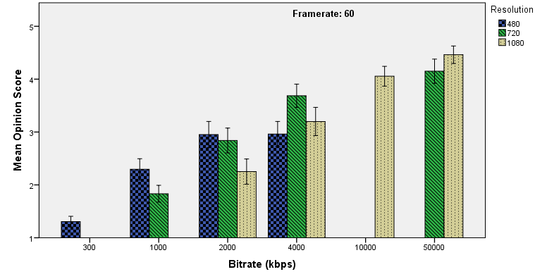
Subjective Test A
Low Complex Class
High Complex Class

Slide 9
Subjective Test A
Low Complex Class videos have better quality in low bitrate
In low complex class quality is almost saturated on 4000kbps.
Increasing bitrate after this point does not increase the quality anymore.
Low Complex Class
High Complex Class

Slide 10
Subjective Test B
Parameter | Value
Duration | 30 sec
Resolution | 1080p, 720p, 480p
Frame Rate | 60
Encoder | FFmpeg- NVENC
Encoding Mode | CBR
Video Compression | Standard H.264, Main 4.0
Preset | llhq (low latency, high quality)
Group of Picture | 0.5, 1, 2 (seconds)
Packet Loss | 0%, 0.2%, 0.5%, 1%
Resolution | Bitrate (kbps)
1080p | 2000, 4000, 10000, 20000, 50000
720p | 1000, 2000, 4000, 50000
480p | 300, 1000, 2000, 4000
Notes:
In total 72 game videos are created
We used 5 parameters for our study (Framerate, Bitrate , Packet Loss, Resolution, Key frame interval)
These 5 parameters were divided into two groups, and bitrate as a factor that has relationship with all the other parameters were used in both groups. (Right?)
For group 1, FR and Resolution stayed constant (30 and 1080) and KFI , PL and BR changed
For group 2, KFI stayed as default and no packet loss were simulated. FR and resolution were changed, and we had different BR for different resolution.
72 Videos for each game

Slide 11
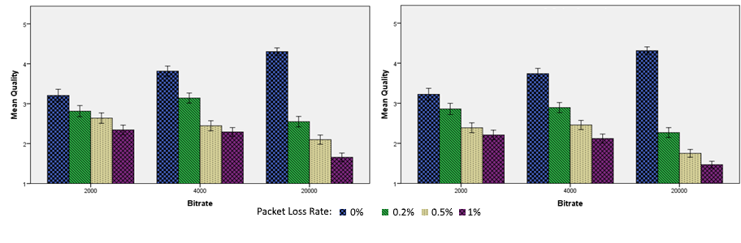
Subjective Test B
GoP: 0.5 sec
GoP: 2 sec

Slide 12
Subjective Test B
Effect of Packet Loss is stronger on higher bitrates
Smaller GoP slightly could mitigate the effect of packet loss on video quality
GoP: 0.5 sec
GoP: 2 sec

Slide 13
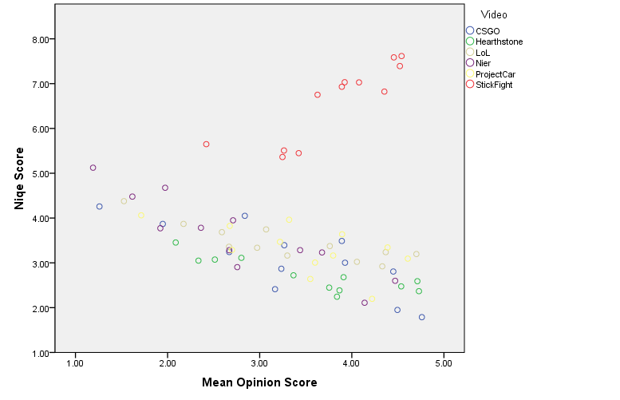
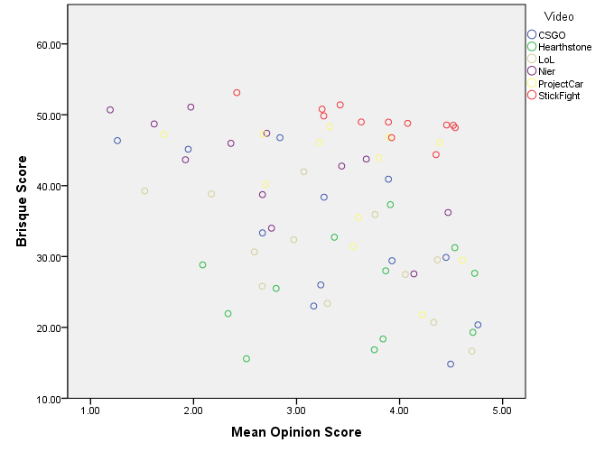
Performance of NR metrics
Only compression artifcat, (no packet loss or low framerate)

Slide 14
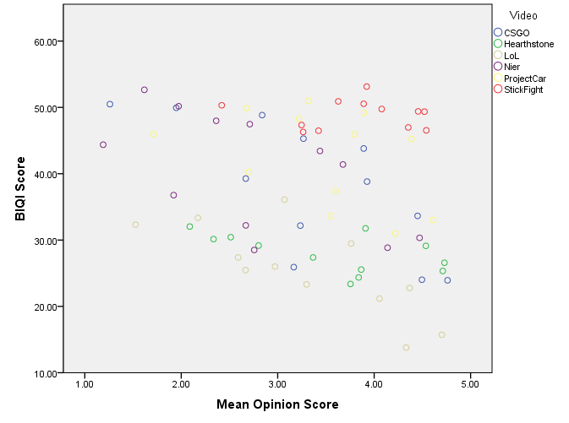
Performance of NR metrics
Niqe performs well for complex video games
If the game design is a simple 2D design, Niqe as naturalness index would not perform well
BIQI and Brisque do not perform well for game content

Slide 15
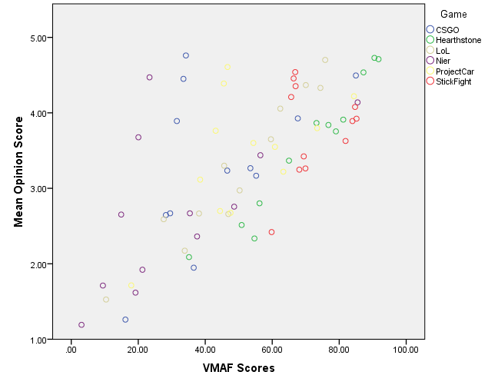
Performance of VAMF
Only tested with the first dataset
Perform well in general but not with high complex data
Pearson Correlation: 0.69

Slide 16
Conclusion
A dataset with 432 videos is created.
In total over 150 participants, participated in our studies.
Each video is rated by 25 participants
The dataset will be released very soon

Slide 17
Reference
[1]. Barman, et al. "GamingVideoSET: A Dataset for Gaming Video Streaming Applications," 2018 16th NetGames conference, Amsterdam, 2018, pp. 1-6.
[2]. Zadtootaghaj, Saman, et al. "A classification of video games based on game characteristics linked to video coding complexity." 2018 16th Annual Workshop on Network and Systems Support for Games (NetGames). IEEE, 2018.
[3]. Schiffner, Falk, and Sebastian Möller. "Diving Into Perceptual Space: Quality Relevant Dimensions for Video Telephony." Quality and Usability Lab–Technische Universität Berlin, Berlin(2016).
[4]. S. Schmidt, S. Zadtootaghaj, S. Möller, F. Metzger, M. Hirth, and M. Suznjevic, “Subjective Evaluation Methods for Gaming Quality (P.GAME),” CH-Geneva, 2018.

Slide 18
Thank You!

