Slide 1





Statistical quality of experience analysis: on planning the sample size and statistical significance testing
Kjell Brunnström and Marcus Barkowsky
RISE ICT
Acreo

Slide 2

Planning number of test subjects
How can we plan in QoE experiments so that we can find the effect we would like to see?
Brunnström, K. and M. Barkowsky, Statistical quality of experience analysis: on planning the sample size and statistical significance testing. Journal of Electronic Imaging, 2018. 27(5): p. 11.

Slide 3
Introduction
Type I error: to claim that there is an effect while there is none
  The risk depends on confidence level, typically α = 0.05 (5%)
Type II error: to miss an effect if it is there
  Larger risk if we safeguard more against Type I error
  The risk to miss an effect if is there (β = 0.20)
  This gives 4 times higher risk for Type II than Type I, which is common

Slide 4
Introduction
Power (more common to use)
  The probability to correctly conclude that there is an effect if it is there (1 - β = 0.80)
We need to balance the experiments between Power and Type I error
Factor influencing are expected effect size, number of samples and significance level

Slide 5
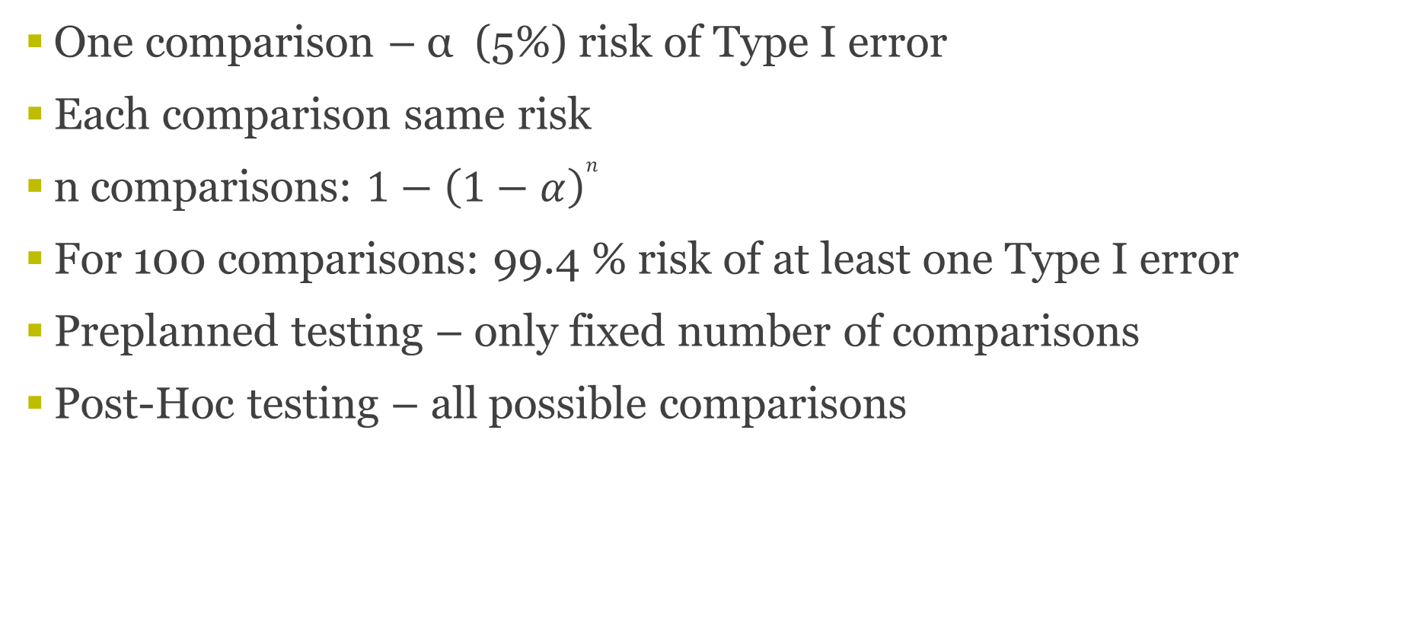
Introduction – Multiple comparisons
One comparison – α (5%) risk of Type I error
Each comparison same risk
n comparisons: $1−{\left(1−α\right)}^{n}$
For 100 comparisons: 99.4 % risk of at least one Type I error
Preplanned testing – only fixed number of comparisons
Post-Hoc testing – all possible comparisons

Slide 6
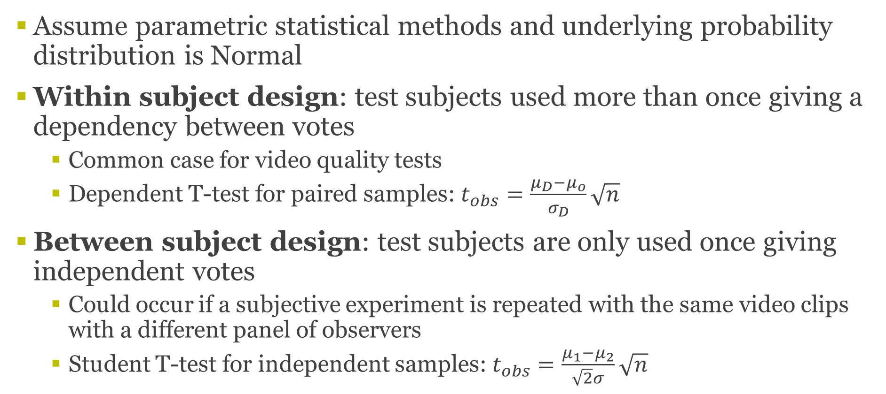
Method
Assume parametric statistical methods and underlying probability distribution is Normal
Within subject design: test subjects used more than once giving a dependency between votes
  Common case for video quality tests
  Dependent T-test for paired samples: $t_{obs}=\frac{μ_{D}−μ_{o}}{σ_{D}}\sqrt{n}$
Between subject design: test subjects are only used once giving independent votes
  Could occur if a subjective experiment is repeated with the same video clips with a different panel of observers
  Student T-test for independent samples:$t_{obs}=\frac{μ_{1}−μ_{2}}{\sqrt{2}σ}\sqrt{n}$

Slide 7
Method: Simulate influence
Number of video clips in experiment: n_PVS = 100
Assume pre-planned gives 100 comparisons
Post-hoc gives 100*99/2 = 4950
Method to compensate for multiple comparisons: Bonferroni (α/n)
Bonferroni significance levels:
  0.05 (1 comparison)
  0.0005 (100 comparisons)
  0.000011 (4950 comparisons)

Slide 8
Method: Simulate influence
Compute probability of significance i.e. p-value of the two T-tests
Interesting difference MOS = 0.5 and 1.0 on five graded scale
We have used σ = 0.8 (Typical experimental value e.g. VQEG HDTV)
Planning the number of test subjects based on power of 0.8 i.e. β = 0.20, α = 0.05, β/α = 4

Slide 9
Estimation of sample size for power 0.8, MOS difference 1.0 and standard deviation 0.8
27 subjects
4950 comparisons
α = 0.000011
18 subjects
100 comparisons
α = 0.0005
1 comparisons
α = 0.05
8 subjects

Slide 10
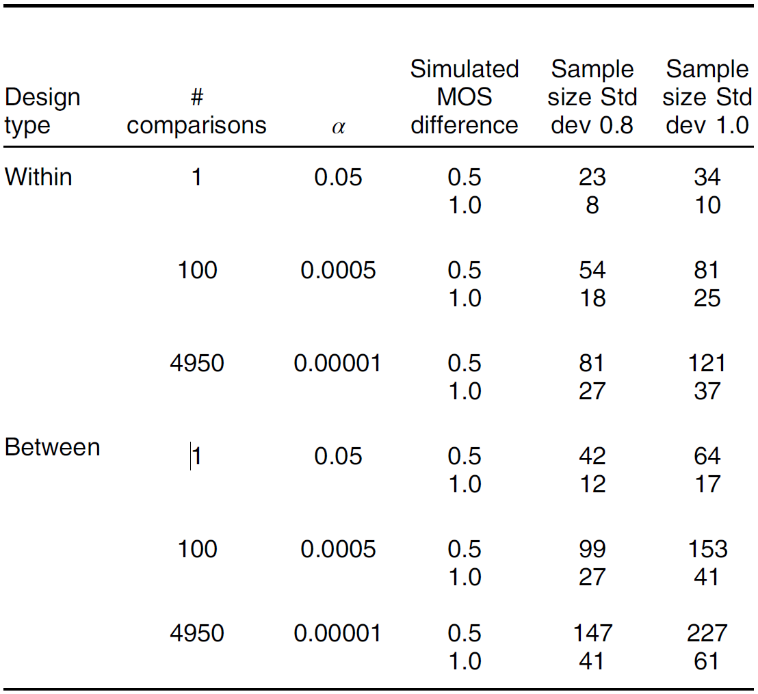
The number test subjects a power of 0.8

Slide 11
Comparisons of object models
The previous arguments relevant for object model comparison
Looking for statistically signficant differences
Let’s assume comparison of 10 objective models
Performance metric Person correlation

Slide 12
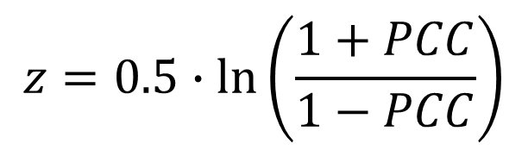
Person Correlation (PCC)
$$z=0.5∙\ln\left(\frac{1+PCC}{1−PCC}\right)$$
ITU-T Rec. P.1401
Make PCC Normally distributed
  (Fisher z transformation)
Student T-test
Depends on difference and number of fitted points

Slide 13
Influence on correlation
> 0.92 significant for one comparison
1 comp
9 comp
45 comp

Slide 14
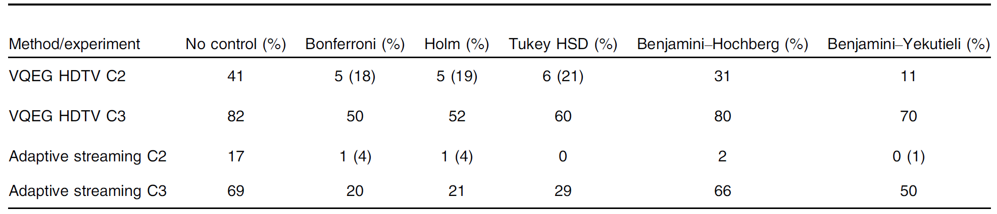
Effect of method for controlling Type-I error
Many methods have been proposed in the litterature.
Bonferroni is simple, but usually accused for beeing too conservative
We compared a few methods

Slide 15
Conclusions
Multiple comparisons should be considered and compensated for in planning and analysis of subjective QoE experiments as well as in comparison of objective quality methods.
The number of test subjects currently recommended are too low considering this (possibly with the exception of P.913)

Slide 16
ITU input
We have (RISE, Ericsson and TU Ilmenau) prepared in input to ITU SG12
We propose to ammend P.1401 with text on multiple comparison
We propose to harmonize the text in BT.500, P.910 and P.913, when it comes to number of test subjects. Basically using P.913 as a starting point, but separating two cases.
  No pre-planned number of comparison => 27 controlled env. and 37 in public env.
  Pre-planned number of comparison (<100) => 18 and 25

Slide 17
Thank you!
Kjell Brunnström
kjell.brunnstrom@ri.se
RISE Acreo

