Slide 1
NR Metric Confidence Interval Estimation Using Classification Errors
Margaret H Pinson
NTIA/ITS
mpinson@ntia.doc.gov
+1 303-497-3579

Slide 2
Goals
Confidence interval (CI) for NR metrics
One value computed from many subjective datasets
  Different subjective scales
  Lab study, field study, crowdsourcing
  Number of subjects may be misleading
  Individual ratings may not be available
Cannot put datasets onto a common scale
Added value: understand NR metric performance

Slide 3
Classification Errors
Objective Differences
 |  | Objective Decision
 |  | Better | Equivalent | Worse
Subjective Decision | Better | correct ranking | false tie | false ranking
 | Equivalent | false differentiate | correct tie | false differentiate
 | Worse | false ranking | false tie | correct ranking
Subjective Differences
ΔS
ΔM
ΔM = f(ΔS, MOS_{i}, M_{i})

Slide 4
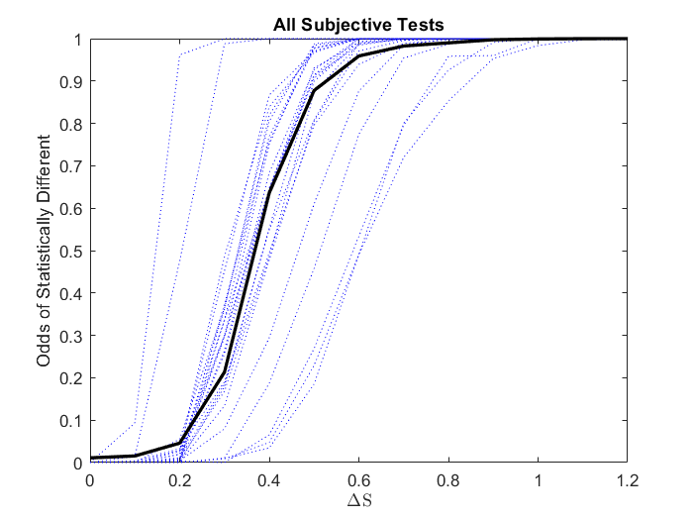
Choosing ΔS
For each subjective test
Given ΔS
  All pairs of MOSs
  Student’s t-test
  Compute fraction pairs significantly different
Blue = one subjective test
Black = all data pooled

Slide 5
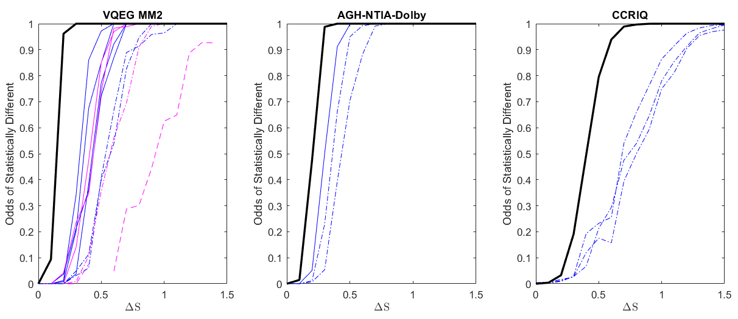
Multiple Lab Studies
Number of Subjects & Rating Task Difficulty
Compression only, N = 213
Compression only, N = 71
Camera capture, N = 53

Slide 6
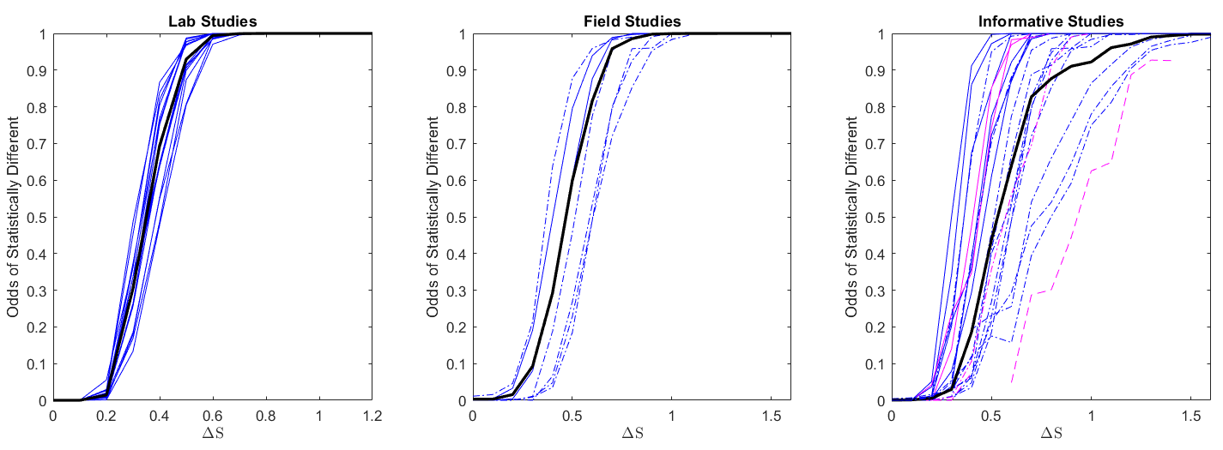
Test Design → ΔS
ΔS = 0.5
ΔS = 0.7
ΔS = 1.0

Slide 7
“The Influence of Subjects and Environment on Audiovisual Subjective Tests: An International Study”
Choose number of subjects that can distinguish 73% of PVS pairs
  15 to 19 subjects
Agree = 73%
Ambiguous = 13%
  Range is [10% .. 16%]
Disagree < 0.03%
  8 subjects
 |  | Objective Decision
 |  | Better | Equivalent | Worse
Subjective Decision | Better | correct ranking | false tie | false ranking
 | Equivalent | false differentiate | correct tie | false differentiate
 | Worse | false ranking | false tie | correct ranking
 |  | Subjective Test #2
 |  | Better | Equivalent | Worse
Subjective Test #1 | Better | agree | ambiguous | disagree
 | Equivalent | ambiguous | agree | ambiguous
 | Worse | disagree | ambiguous | agree

Slide 8
Classification Errors
Objective Differences
ΔS = 0.5
False tie ≤ 1%
False differentiate ≤ 13%
subjective testing thresholds
Subjective Differences
ΔS
 |  | Objective Decision
 |  | Better | Equivalent | Worse
Subjective Decision | Better | correct ranking | false tie | false ranking
 | Equivalent | false differentiate | correct tie | false differentiate
 | Worse | false ranking | false tie | correct ranking
ΔM

Slide 9
Algorithm
All media pairs (A, B), where
A and B are within the same dataset
ACR MOS, 5-level scale
subjective data (MOS_{A}, MOS_{B})
Compare (MOS_{A}-MOS_{B}) to ΔS
objective data (O_{A}, O_{B})
Compare (O_{A}-O_{B}) to ΔM
Calculate if A is better than, worse than, or equivalent to B
choose ΔM
Choose smallest ΔM where:
Calculate if A is better than, worse than, or equivalent to B
For each ΔM, calculate odds of each classification error
False ranking ≤ 1%
False differentiate ≤ 13%

Slide 10
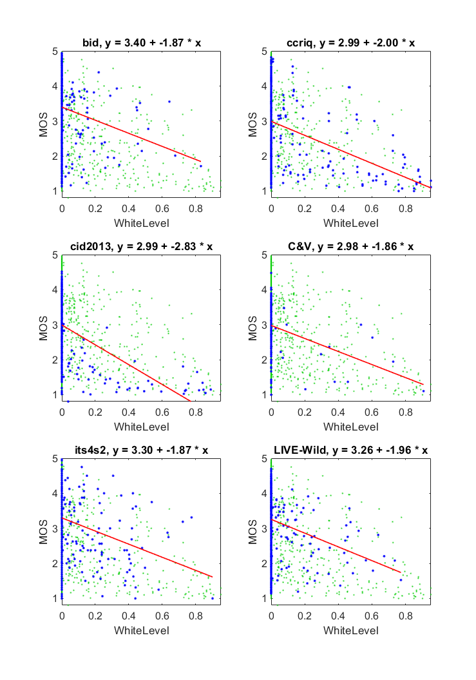
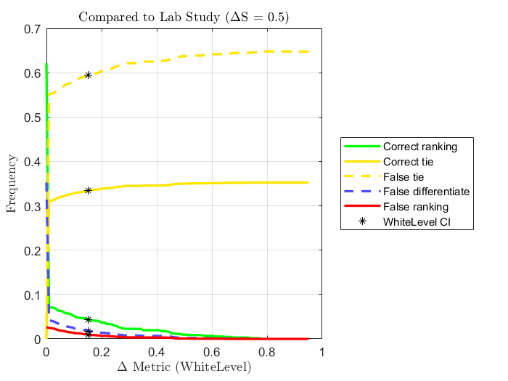
Example #1. Root Cause Analysis, ≈0.28 Correlation
CI = 0.15
Correct decision = 4%
Full range [0 .. 0.95]
≈6 CIs
 |  | Objective Decision
 |  | Better | Equivalent | Worse
Subjective Decision | Better | correct ranking | false tie | false ranking
 | Equivalent | false differentiate | correct tie | false differentiate
 | Worse | false ranking | false tie | correct ranking

Slide 11
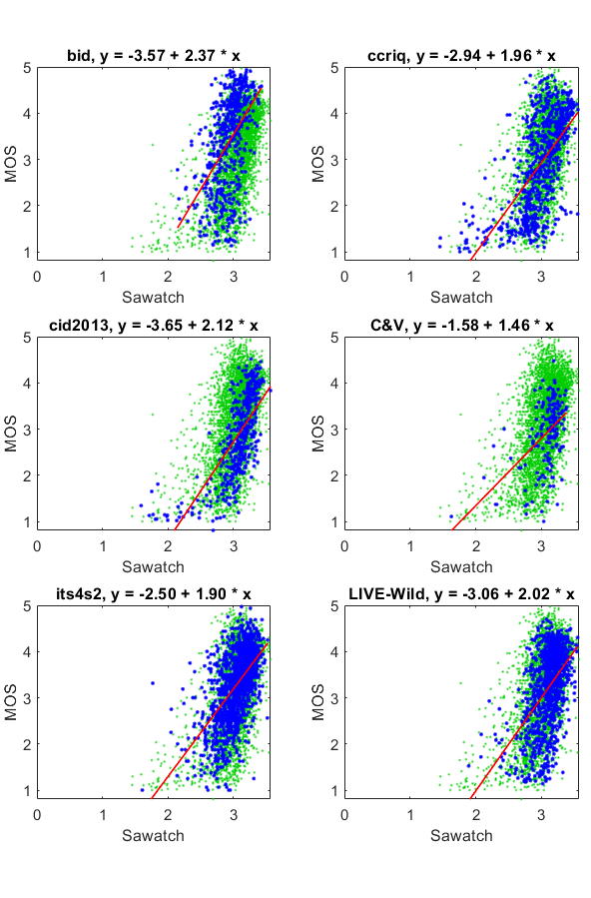
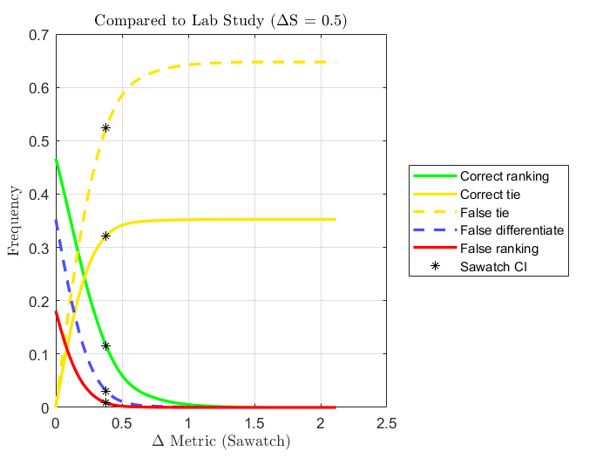
Example #2. MOS , ≈0.57 Correlation
CI = 0.38
Correct decision = 12%
Full range [1.45 .. 3.57]
≈6 CIs
 |  | Objective Decision
 |  | Better | Equivalent | Worse
Subjective Decision | Better | correct ranking | false tie | false ranking
 | Equivalent | false differentiate | correct tie | false differentiate
 | Worse | false ranking | false tie | correct ranking

Slide 12
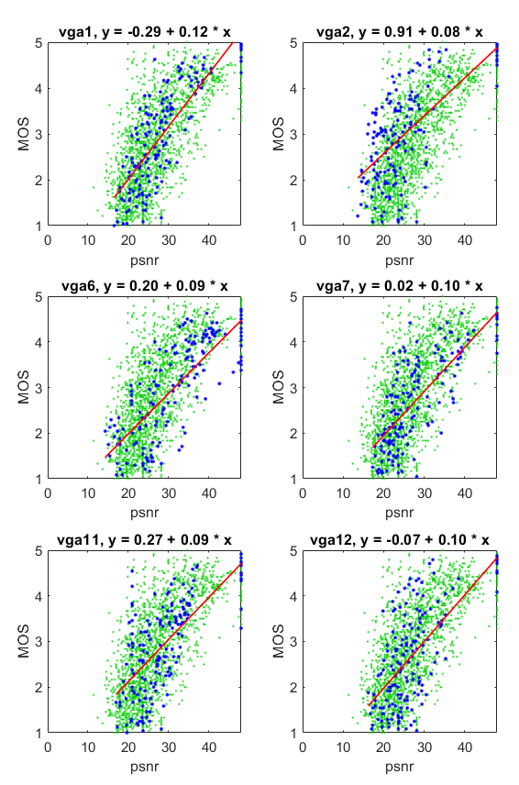
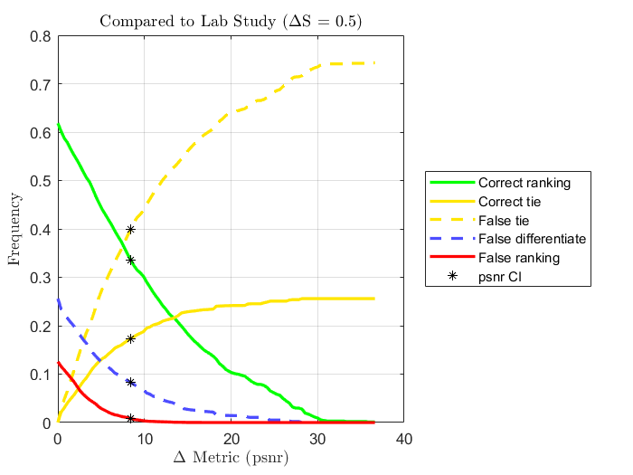
Example #3. PSNR, ≈0.77 Correlation
CI = 8.42
Correct decision = 34%
Full range [11.4..48.0]
≈4 CIs
 |  | Objective Decision
 |  | Better | Equivalent | Worse
Subjective Decision | Better | correct ranking | false tie | false ranking
 | Equivalent | false differentiate | correct tie | false differentiate
 | Worse | false ranking | false tie | correct ranking
13 datasets from VQEG Multimedia

Slide 13
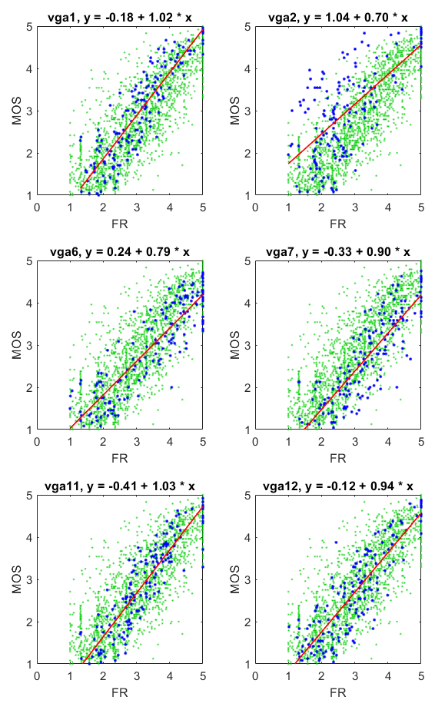
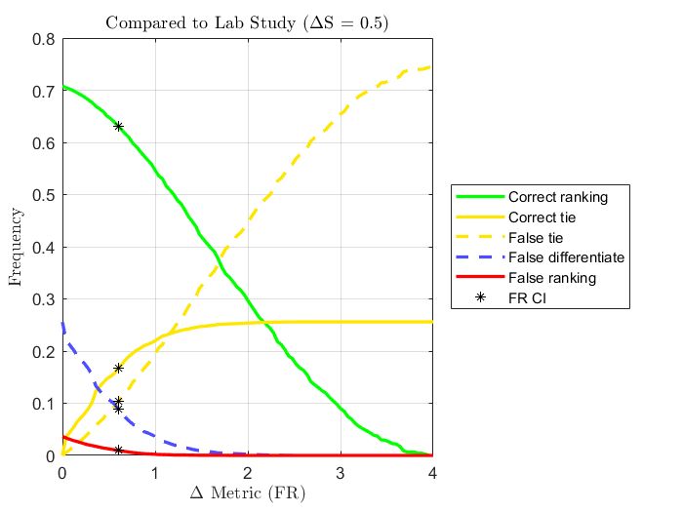
Example #4. FR Metric, ≈0.93 Correlation
CI = 0.60
Correct decision = 63%
Full range [1.0 .. 5.0]
≈7 CIs
 |  | Objective Decision
 |  | Better | Equivalent | Worse
Subjective Decision | Better | correct ranking | false tie | false ranking
 | Equivalent | false differentiate | correct tie | false differentiate
 | Worse | false ranking | false tie | correct ranking
13 datasets from VQEG Multimedia

Slide 14
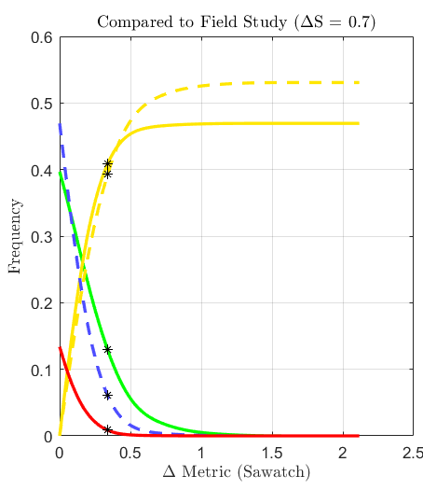
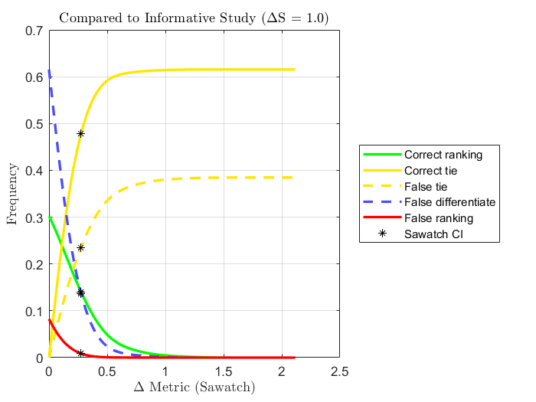
Example #2. MOS, ≈ 0.57 Correlation
Study Type Comparison
CI = 0.38
Correct decision = 12%
CI = 0.34
Correct decision = 13%
CI = 0.28
Correct decision = 14%

Slide 15
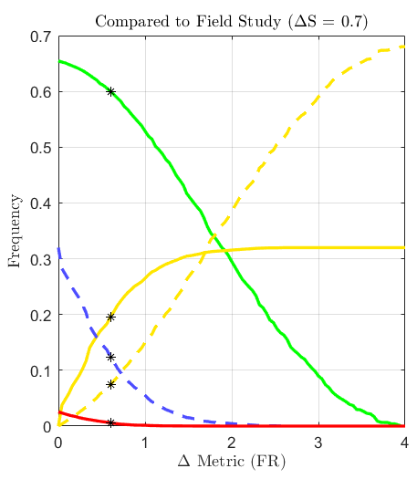
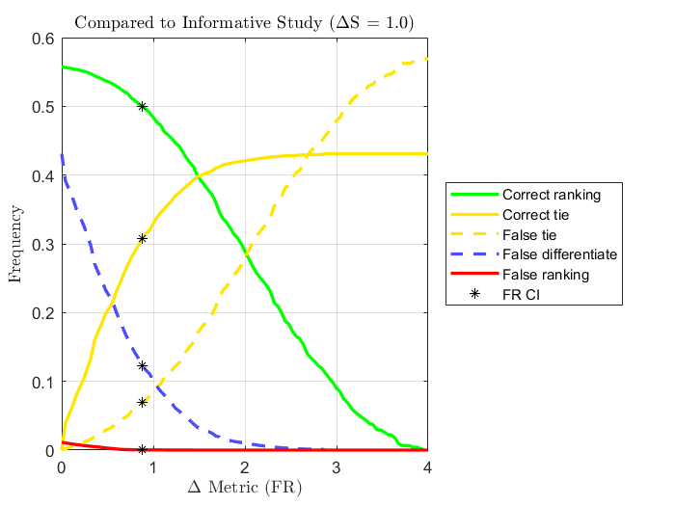
Example #4. FR, ≈0.93 Correlation
Study Type Comparison
CI = 0.6
Correct decision = 63%
CI = 0.6
Correct decision = 60%
CI = 0.88
Correct decision = 50%

Slide 16
Confidence Interval Estimation Using Classification Errors
Conclusion
Options
ΔS from subjective datasets
  ΔS = 0.5 for lab study
  ΔS = 0.7 for field study
  ΔS = 1.0 for informative study
ΔM (CI) by comparing conclusions
  Compare to lab study (ΔS = 0.5)
  Limit false ranking to ≤ 1%
  Limit false differentiate to ≤ 13%
Report classification error frequency
  Easier for novices than classical statistics
Manually choose alternate CI
Report CI for different applications
  Camera capture, compression,
  transmission errors, …
Use “correct ranking” to analyze metric performance
  0% to ≈73%
  Just noticeable difference (JND) data solution

