Slide 1




Comparison of Subjective Methods for Quality Assessment of 3D Graphics in Virtual Reality
Yana Nehmé¹ Jean-Philippe Farrugia ¹ Florent Dupont¹
Patrick Le Callet² Guillaume Lavoué¹
Laboratoire des Sciences du Numérique de Nantes
2
1

Slide 2
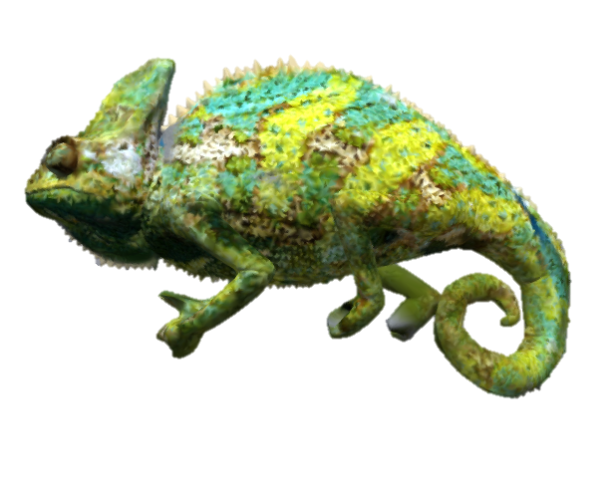
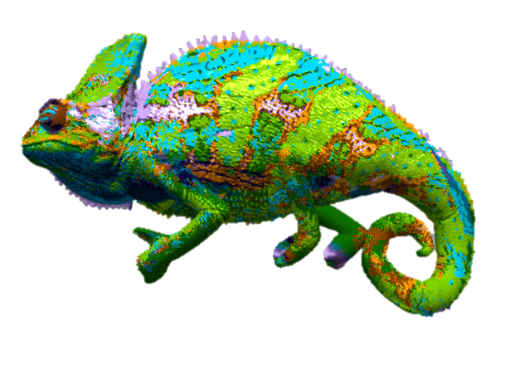
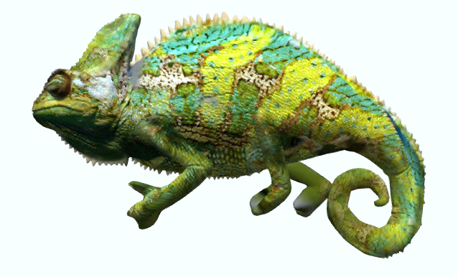
Introduction
Complex 3 scenes are visualized on HMD, smartphones, via the network ...
To avoid latency or rendering issues, there is a critical need to compress and simplify these 3D models.
Reference model
Simplification
Quantization
      impact the visual quality!
      Evaluating the visual quality is the most convenient way to drive these processing operations.
      To evaluate the visual quality, we resort to subjective quality assessment tests.

Slide 3
Subjective quality assessment tests
A group of human subjects rates the quality of a set of distorted objects.
Numerous methodologies for subjective quality assessment exist in the field of image processing: ACR, DSIS, PC, SAMVIQ … [ITU BT.500-13]

Slide 4


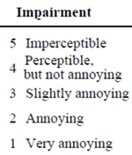
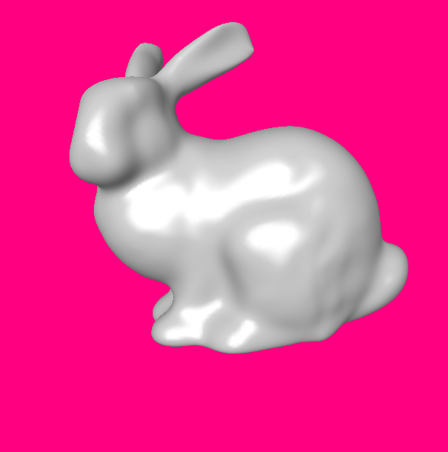
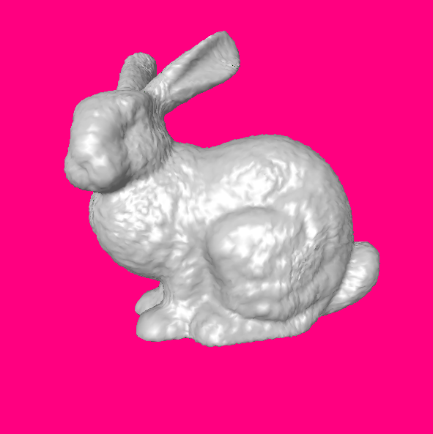
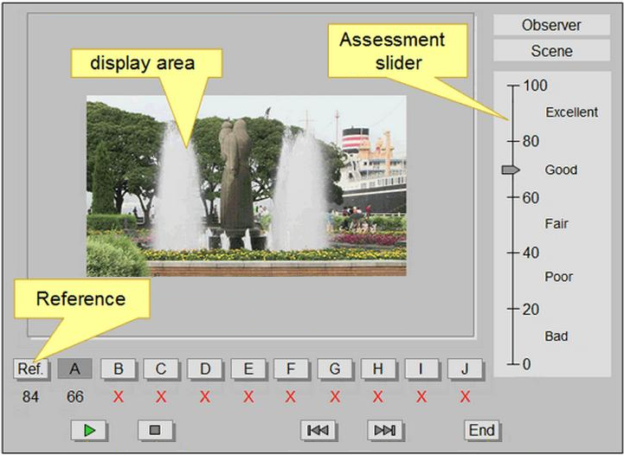
Subjective quality assessment tests
Distorted model
Reference
Distorted model
Absolute Category Rating (ACR) method
Double Stimulus Impairment Scale (DSIS) method
Subjective Assessment Methodology for Video Quality (SAMVIQ)

Slide 5








Related work
Countless subjective tests for assessing image/video quality exist in the literature.
Several works compare the performance of the methodologies, mostly for natural image or video content.
NONE
 | Images / videos | 360° videos | 3D graphics
Screen
Virtual reality
  ACR vs. SAMVIQ [Péchard et al. 2008]
  ACR vs. Double stimulus vs. PC vs. Similarity jugements [Mantiuck et al. 2012]
  M-ACR vs. DSIS – Oculus Rift [Singala et al. 2018]

Slide 6
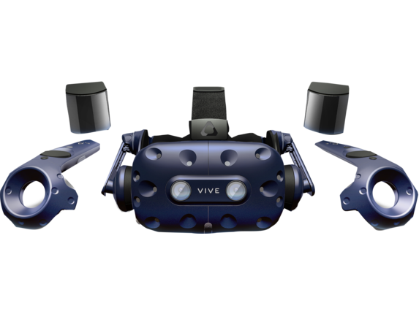
Our contributions
Bring methods that are standard in the field of natural images/videos in the field of computer graphics.
  Compare ACR-HR vs. DSIS vs. SAMVIQ for assessing the quality of colored 3D graphics.
    Stability , accuracy, consistency …
    Required number of observers
  The experiment is conducted in virtual reality.
1- Are these methods valid/accurate to evaluate the perceived quality of 3D graphics data ?
2- Is the presence of a reference necessary, due to the lack of human prior knowledge on 3D graphics compared to natural images/videos?
HTC Vive Pro headset

Slide 7
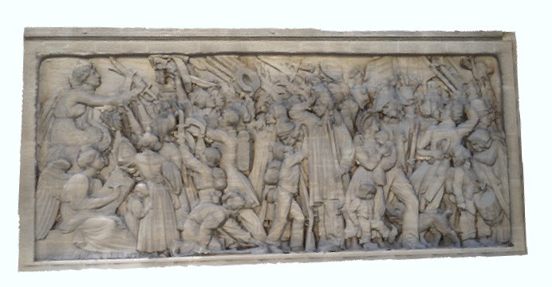
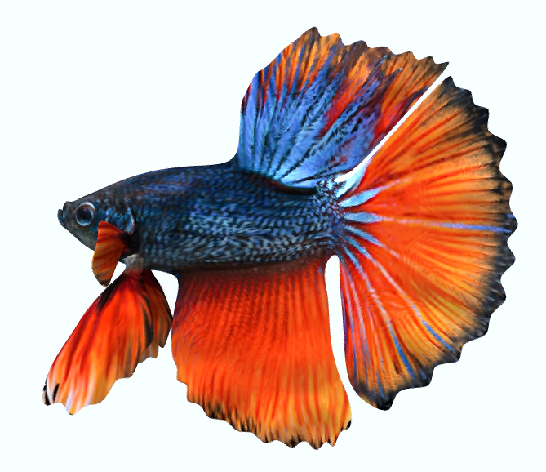

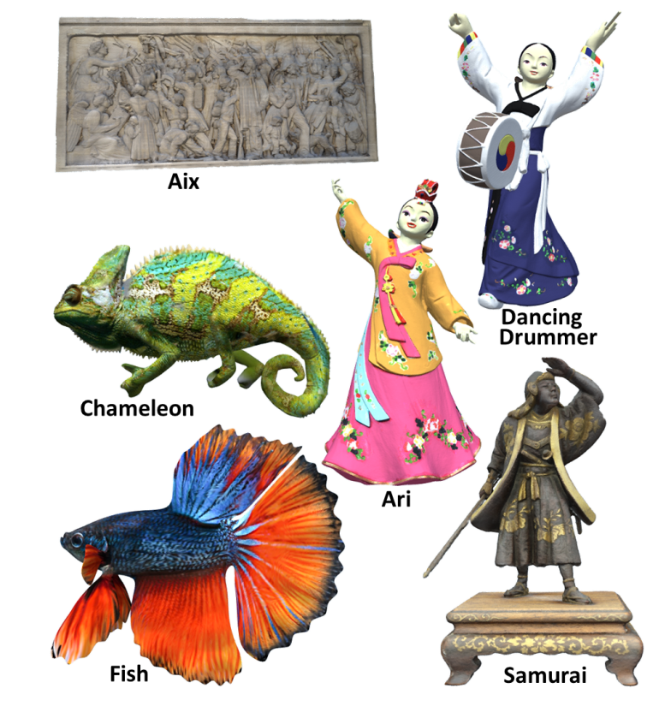
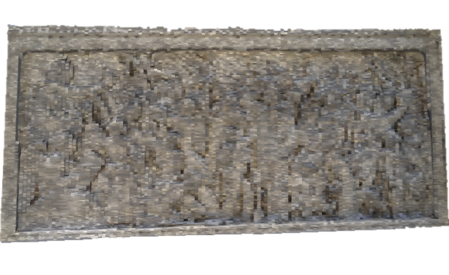
Subjective Experiment
Dataset of high-quality colored 3D models
      5 high resolution meshes (250k to 600k vertices)
      4 types of distortions
      4 strengths of distortion
  ➔ 80 test stimuli
Rendering and
      Distance_{stimuli-observer} : 3 m
      Dynamics stimuli: slow rotation
      Model’s size: 36.87ᵒ of visual angle
Geometric quantization
Color-aware simplification
Reference
interaction:
        Limited interaction: head motion
Distorted model
Reference
Distorted model

Slide 8
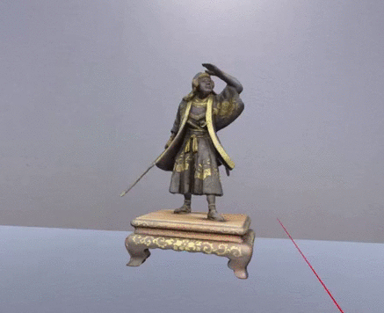
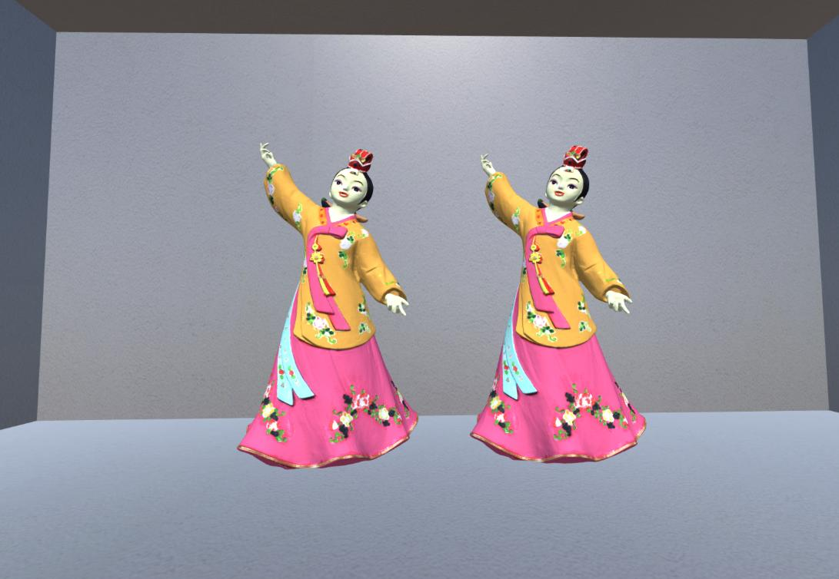
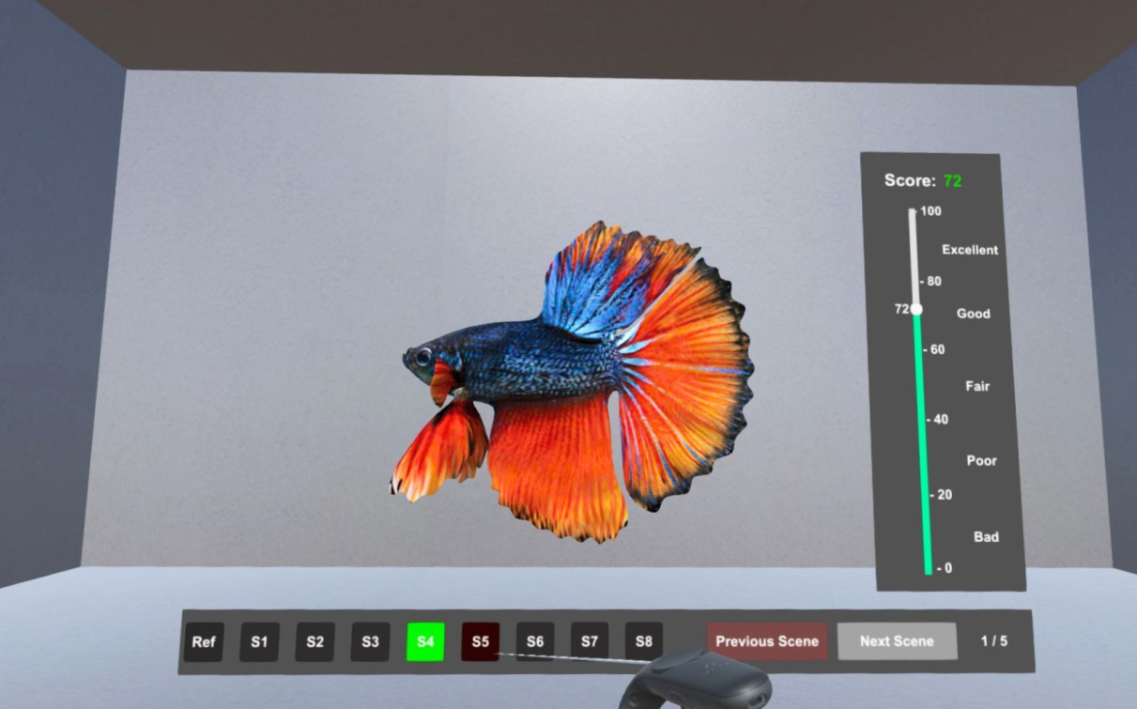
Snapshots of the experimental environment
Distorted model or HR
Reference
Distorted model
ACR - HR
DSIS
SAMVIQ

Slide 9
Experimental procedure
Experiment 1: ACR-HR vs. DSIS
  Purpose: Determine whether the presence of an explicit reference is necessary to improve the accuracy of the method.
    G1: 15 subjects - did ACR-HR then DSIS
    G2: 15 subjects - did DSIS then ACR-HR
Experiment 2: SAMVIQ
  Purpose: Determine which method is the best to assess the quality of 3D graphic models.
    17 subjects
Subjects were students and professionals, aged between 18 and 45 (median 23)
ACR-HR | DSIS | SAMVIQ
18 min | 23 min | 20-30 min * 2 sessions

Slide 10
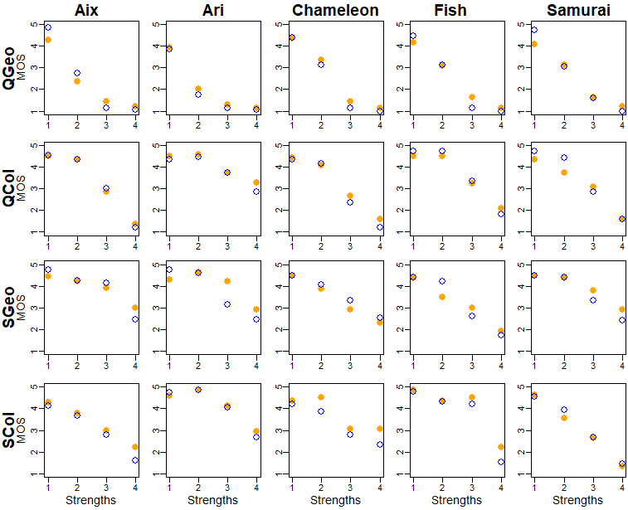
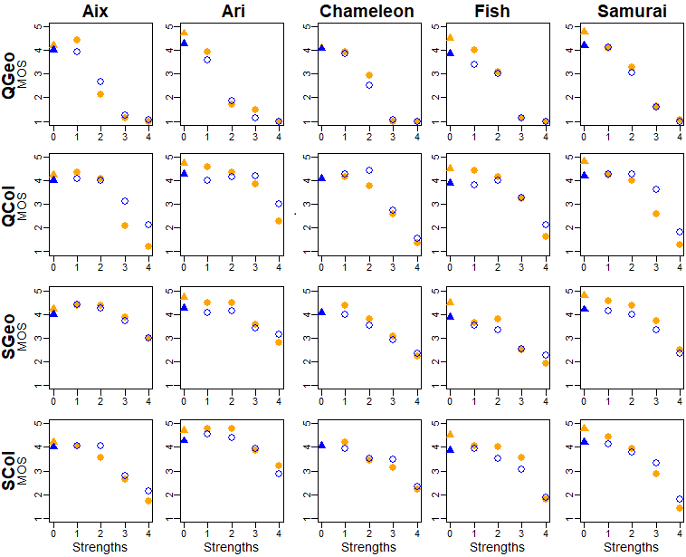
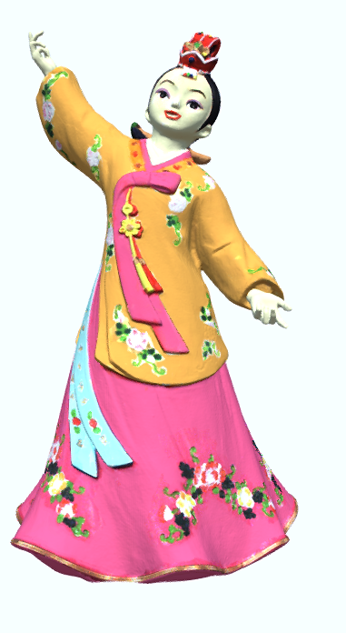
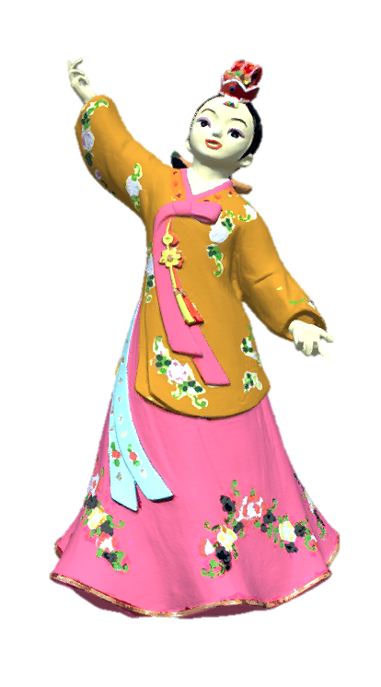
Exp 1: Mean Opinion Score (MOS)
Color quantization
Geometric quantization
Color quantization
○ MOS of G1
● MOS of G2
G1: did ACR-HR 1st
then DSIS
G2: did DSIS 1st
then ACR-HR
Color-ignorant simplification
Color-aware simplification
Reference
Distorted model
DSIS sessions
ACR-HR sessions

Slide 11
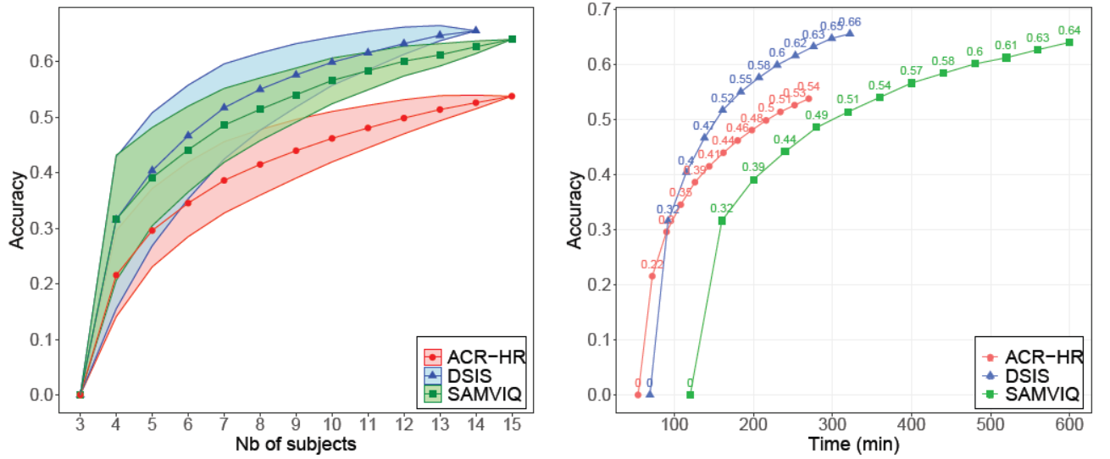
Accuracy and time effort
DSIS is slightly more accurate than SAMVIQ.
DSIS is the most time-efficient method.

Slide 12
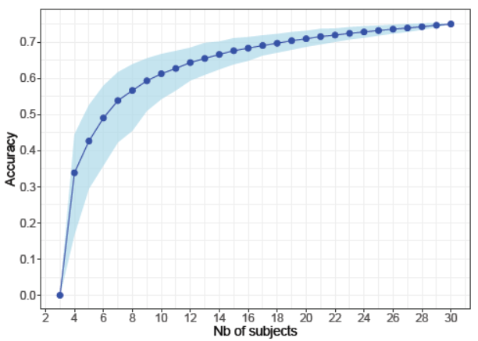
Conclusion & Recommendations
We designed 2 psycho-visual experiments that compares 3 methodologies: ACR-HR, DSIS, SAMVIQ.
        3D graphics
        VR environment
        With and without explicit reference
The presence of an explicit reference is necessary to improve the accuracy and the stability of the method.
DSIS seems to be the most suitable
method to assess the 3D graphics quality.
Recommended number of observers
for the DSIS method: 24 subjects.

Slide 13
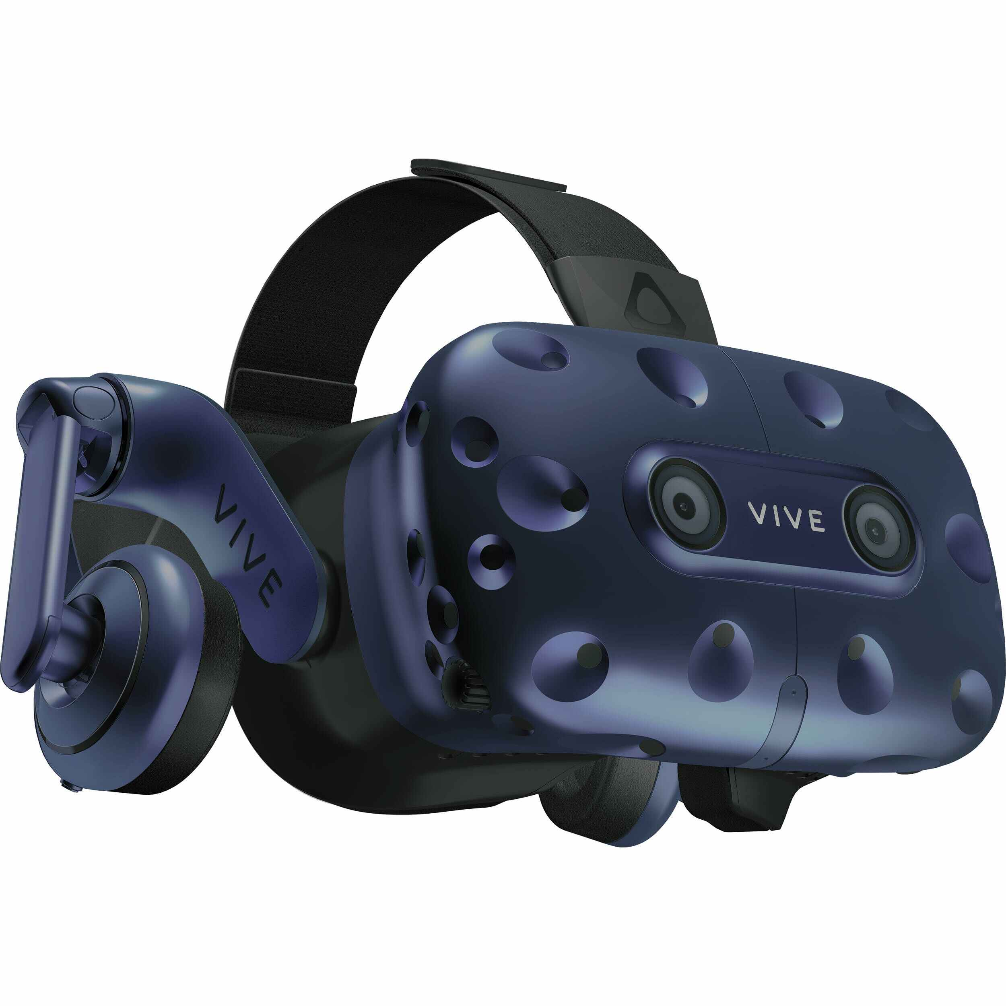
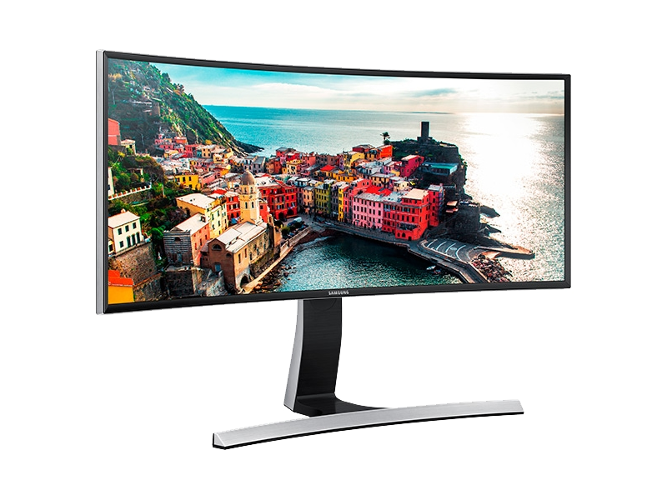
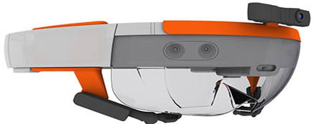
What next?
This study makes the first step toward standardizing a methodology for assessing the quality of 3D graphics in VR.
    Evaluating the impact of the display devices (2D screen, VR/MR headset) on the perceived quality of 3D graphics.
Screen
HTC Vive Pro
Microsoft HoloLens
Microsoft HoloLens

Slide 14

Thank you for your attention.
This work was supported by French National Research Agency as part of ANR-PISCo project (ANR-17-CE33-0005). https://projet.liris.cnrs.fr/pisco/
Yana Nehmé, Jean-Philippe Farrugia, Florent Dupont, Patrick LeCallet, and Guillaume Lavoué. 2019. Comparison of subjective methods, with and without explicit reference, for quality assessment of 3D graphics. In ACM Symposium on Applied Perception 2019 (SAP '19). https://doi.org/10.1145/3343036.3352493
Yana Nehmé, Jean-Philippe Farrugia, Florent Dupont, Patrick LeCallet, and Guillaume Lavoué. 2020. Comparison of Subjective Methods for Quality Assessment of 3DGraphics in Virtual Reality. In ACM Transactions on Applied Perception (TAP ‘20).

Slide 15
Bibliography
    [ITU BT.500-13] ITU-R BT.500-13. 2012. Methodology for the subjective assessment of the quality of television pictures BT Series Broadcasting service. International Telecommunication Union.
    [Péchard et al. 2008] Stéphane Péchard, Romuald Pépion, Patrick Le Callet. 2008. Suitable methodology in subjective video quality assessment: a resolution dependent paradigm. International Workshop on Image Media Quality and its Applications, IMQA2008.
    [Mantiuck et al. 2012] Rafał K. Mantiuk, Anna Tomaszewska, and Radosław Mantiuk. 2012. Comparison of Four Subjective Methods for Image Quality Assessment. Computer Graphics Forum 31, 8, 2478–2491.
    [Singala et al. 2018] Ashutosh Singla, Werner Robitza, and Alexander Raake. 2018. Comparison of Subjective Quality Evaluation Methods for Omnidirectional Videos with DSIS and Modified ACR. Electronic Imaging 2018, 14.

