Slide 1
Introduction to 5G
Margaret Pinson
mpinson@ntia.gov

Slide 2
Cellphone Communications Protocols
Third Generation Partnership Project (3GPP)
  Develop protocols for cellphones
  7 standards developing organizations (SDOs): ARIB, ATIS, CCSA, ETSI, TSDSI, TTA, & TTC
  Established 1998
International Telecommunications Union (ITU)
3G
  Flip phone
  Voice & text messaging
4G LTE
  Smartphone
  Voice & text messaging & internet access
5G
  Opportunity for innovation

Slide 3
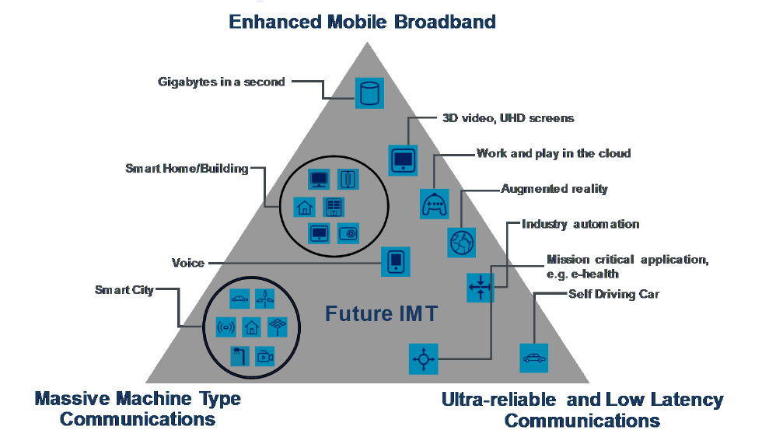
Standalone 5G vs Non-Standalone 5G
Non-Standalone 5G (NSA)
  4G network enhanced with support for 5G phones
  Enables enhanced mobile broadband
  (e.g., higher bandwidth video streaming)
  Most “5G” advertised in 2021 is NSA
Standalone 5G (SA)
  Pure 5G
  Enhanced mobile broadband
  Internet of things (IoT)
  Ultra-reliable and low latency communications(URLLC)
5G adds flexibility to optimize network for
specific end-user requirements
  Diverging wireless spectrum utilization options
From an ITU Recommendation

Slide 4
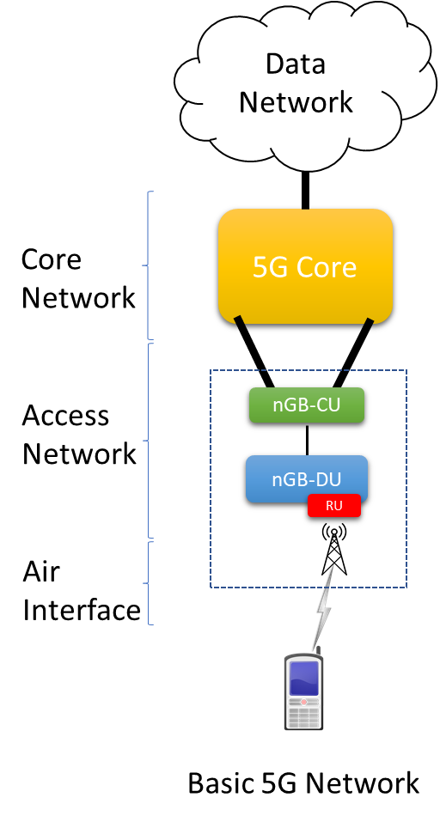
3GPP Components
Data network
  Internet, another phone provider, …
Core network (Core)
Radio access network (RAN)
  Network of base stations: gNB (“G node B”)
  Centralized unit (CU)
  Distributed unit (DU)
  Radio unit (RU)
User equipment (UE) / smartphone
5G RAN architecture focus
  Mobile network operators (MNOs)
  End-to-end service for millions of customers
  Often proprietary and monolithic
few
gNB-CU
gNB-DU
RU
many

Slide 5
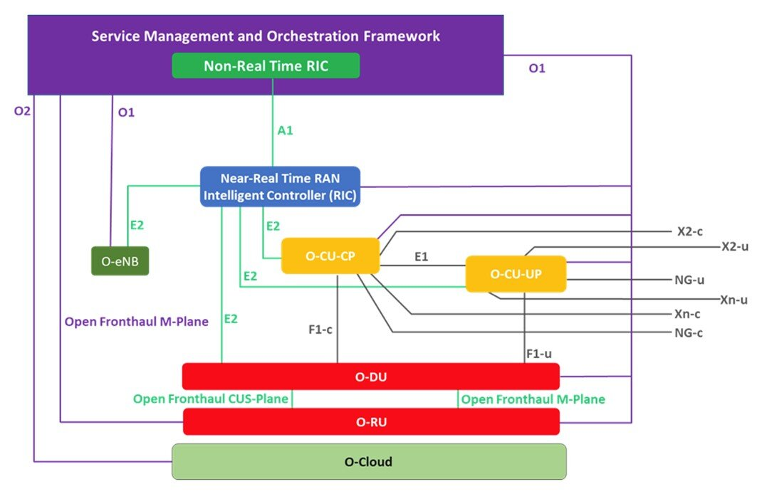
O-RAN Alliance
Industry organization
  MNOs, vendors, and academic institutions
  Established February 2018
Goals
  Extend RAN standards
  More intelligent, open, virtualized, and fully interoperable mobile networks
Interface to radio unit (RU)
  May enable new vendors, encourage innovation
Interface to RAN Intelligent Controller (RIC)
  Prioritize network resources
  Highway (mobile, rapidly change cells)
  Warehouse (IoT)
  VR/AR (low latency, mobile edge computing)
https://www.o-ran.org/blog/2021/6/23/o-ran-alliance-introduces-33-new-specifications-released-since-march-2021

Slide 6
How Much Faster?
Maximum Theoretical Improvement*
Actual Improvement
Situation | “Bars” | 4G | 5G
Peak downlink | 5 | 3 Gb/s | 20 Gb/s
Peak uplink | 5 | 1.5 Gb/s | 10 Gb/s
Cell edge downlink | 1 | < 1 Mb/s | 100 Mb/s
Cell edge uplink | 1 | < 100 Kb/s | 50 Mb/s
Probably much lower than sales hype
  Late 4G enhancements originally intended for 5G
  5G NSA very different from 5G SA
Too many unknown factors
  Spectrum allocation
  Propagation environment, clutter
  Network configuration
  Multiple-input multiple-output (MIMO) antenna
  Virtualization & softwarization
  → contemporary software tools and practices
  White box hardware → hardware upgrades
  Continuous integration (CI) and continuous delivery (CD)
*These statistics came from a 5G course from Award Solutions.

Slide 7
Public vs Private 5G Networks
Public Network
Private Network (New!)
Mobile network operator (MNO)
  Millions of subscribers
  Your smartphone
Spectrum allocation
  In U.S., MNOs purchase spectrum from FCC
Same 5G air interface technology, etc.
Dedicated to a single organization
  Business in remote location with poor coverage
  Manufacturing plant with autonomous vehicles and remotely controlled machinery
Deployment options
  Dependent network, provided by MNO
  Independent network, built by the organization
Spectrum
  Own, lease, sub-lease from MNO, unlicensed, Citizen Broadband Radio Service (CBRS)
Reduce or eliminate network errors

Slide 8
Multi-Access Edge Computing (MEC) and 5G
What Is MEC
Example Applications
Access to cloud-based computing & storage
  Pre-existing (not part of 5G)
  Take advantage of 5G speed, bandwidth, ULL
5G MEC may be closer to the user’s device
MEC enables new types of devices
  Not just smartphones
  Low power consumption
  Minimal local computing resources
  Local camera → MEC analysis → local or remote response
Medical training
  AR (MEC replaces local computer)
  Fully automated training, or…
  Remote expert watches AR stream, advises
First responder training for limited budgets
  AR (MEC replaces local computer)
  Group tactics
  Sudden events simultaneous on all AR devices
Manufacturing plant with automated vehicles
  Camera → MEC computer vision →…
  URLLC 5G wireless connection

Slide 9
Questions?

