Slide 1




Spammer Detection on Pairwise Comparison Experiments
Comparison of two PoE Scenarios
Ali Ak, Patrick Le Callet
VQEG – 10 May 2022
Related Publications:
[1] On Spammer Detection In Crowdsourcing Pairwise Comparison Tasks: Case Study On Two Multimedia QoE Assessment Scenarios, Ali Ak, Mona Abid, Matthieu Perreira Da Silva, Patrick Le Callet, ICME 2021
[2] Reliability of Crowdsourcing for Subjective Quality Evaluation of Tone Mapping Operators, Abhishek Goswami, Ali Ak, Wolf Hauser, Patrick Le Callet, Frederic Dufaux, MMSP 2021
This work has received funding from the European Union's Horizon 2020 research and innovation programme under the Marie Sklodowska-Curie Grant Agreement No. 765911 (RealVision)

Slide 2
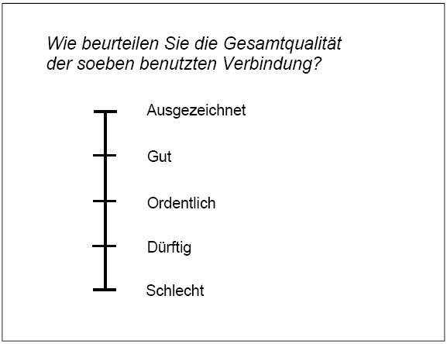
Rating vs Ranking
Rating
Ranking
A
A
B
5
4
3
2
1
Excellent
Good
Fair
Poor
Bad
Which one do you prefer?
Notes:
So by asking to compare the two experience, we can simplify the task and eliminate the issues arise with the rating methods.
Of course PoE has its own drawbacks too. Exponentially increasing number of pairs to compare

Slide 3
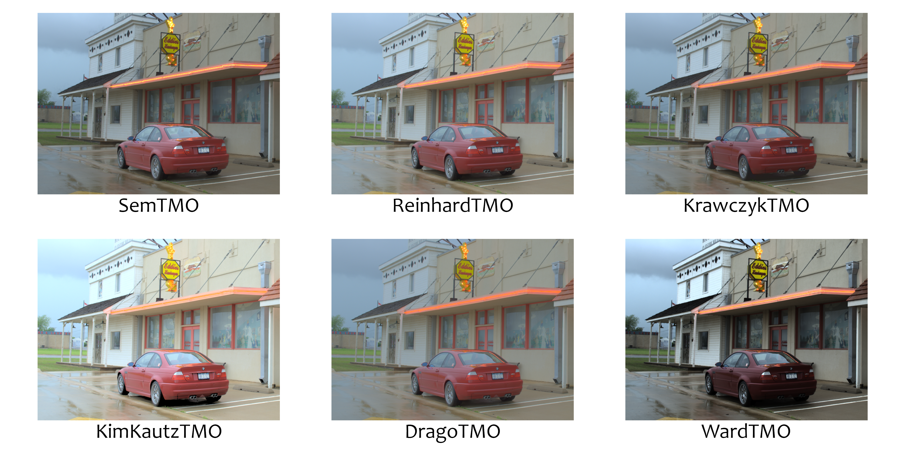
Pairwise comparison: two-alternative forced choice (2AFC)
Simplified task
High discriminative power
Required number of observers may increase exponentially
Outlier/spammer detection tools are not well established on the standards
Notes:
So by asking to compare the two experience, we can simplify the task and eliminate the issues arise with the rating methods.
Of course PoE has its own drawbacks too. Exponentially increasing number of pairs to compare

Slide 4
Aim and Challenges
Understanding the impact of the subjectivity of the Preference of Experience scenario on the spammer detection
Challenges:
Binary nature of pairwise comparison data
Defining spammer behavior
Notes:
So by asking to compare the two experience, we can simplify the task and eliminate the issues arise with the rating methods.
Of course PoE has its own drawbacks too. Exponentially increasing number of pairs to compare

Slide 5
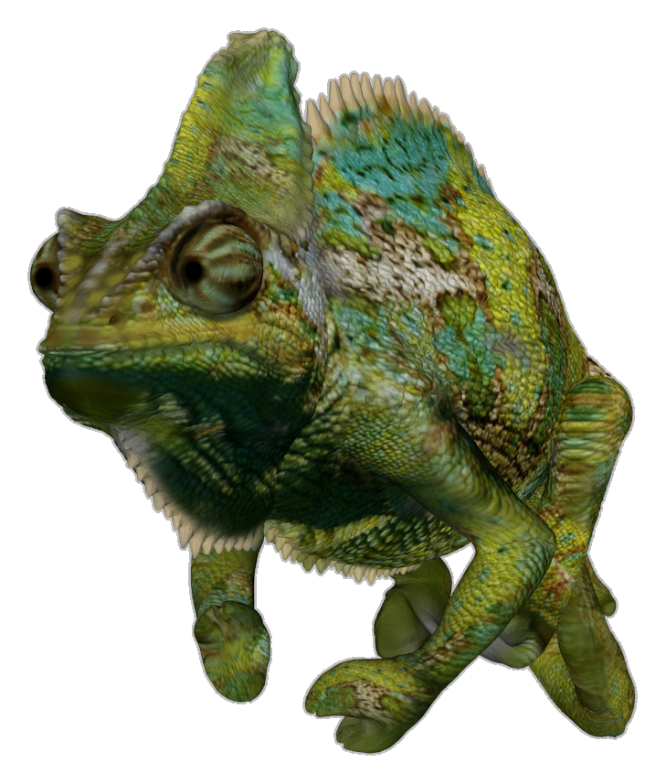
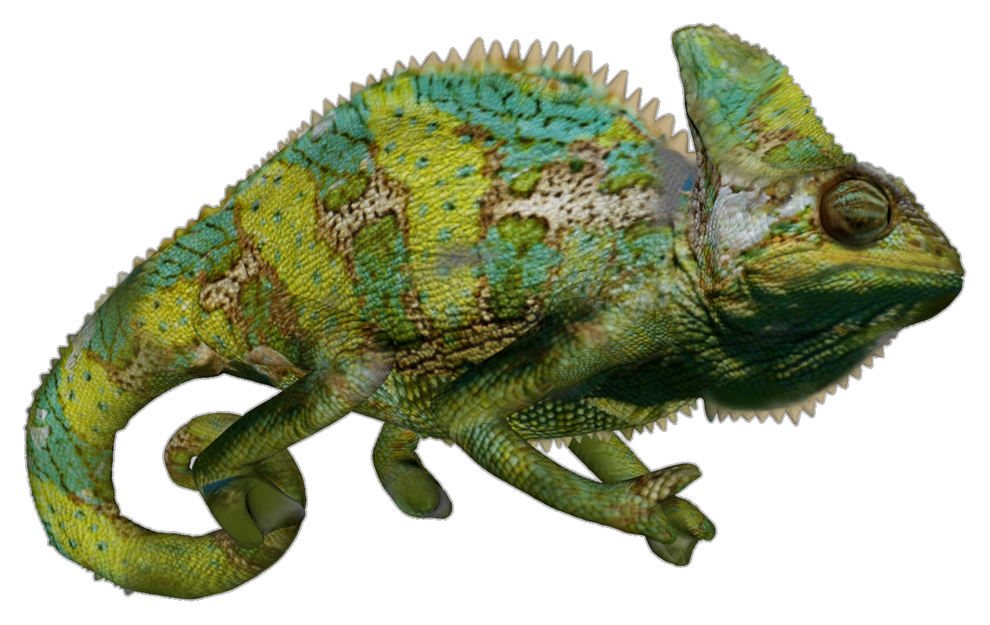


Introducing the PoE scenarios
View Preference
Tonemapped Image Quality
SRC: 21 high resolution 3D Meshes
HRC: rendered under 4 viewpoints
126 pairs to compare in total
100 observers per pair, 200 in total
SRC: 20 High Dynamic Range (HDR) images
HRC: 4 Tone Mapping Operators (TMO)
120 pairs to compare in total
100 observers per pair, 400 total
Notes:
So by asking to compare the two experience, we can simplify the task and eliminate the issues arise with the rating methods.
Of course PoE has its own drawbacks too. Exponentially increasing number of pairs to compare

Slide 6
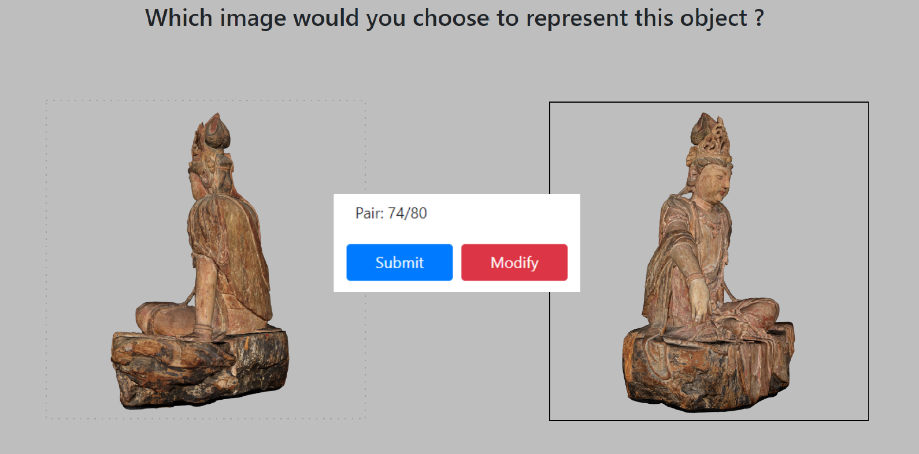
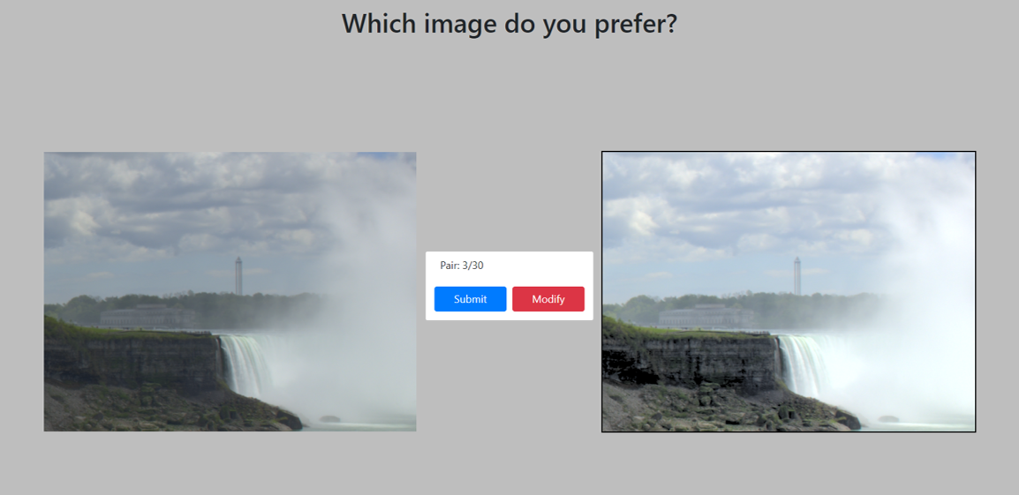
Introducing the PoE scenarios
View Preference (Exp-VP)
Tonemapped Image Quality (Exp-TMO)
Notes:
So by asking to compare the two experience, we can simplify the task and eliminate the issues arise with the rating methods.
Of course PoE has its own drawbacks too. Exponentially increasing number of pairs to compare

Slide 7
Introducing the binary similarity measures
Cohen’s Kappa Coefficient
Measures the inter-observer agreement for a given set of classifications
Can work with binary data as well as categorical data
Values are in range [-1, 1] where higher values indicate a higher agreement
Rogers-Tanimoto (RT) Dissimilarity
Measures the distance between two binary arrays
Can be accomponied with a weight vector to adjust the impact of each stimuli.
Values are in range [0, 1] where lower values indicate a higher agreement
Notes:
So by asking to compare the two experience, we can simplify the task and eliminate the issues arise with the rating methods.
Of course PoE has its own drawbacks too. Exponentially increasing number of pairs to compare

Slide 8
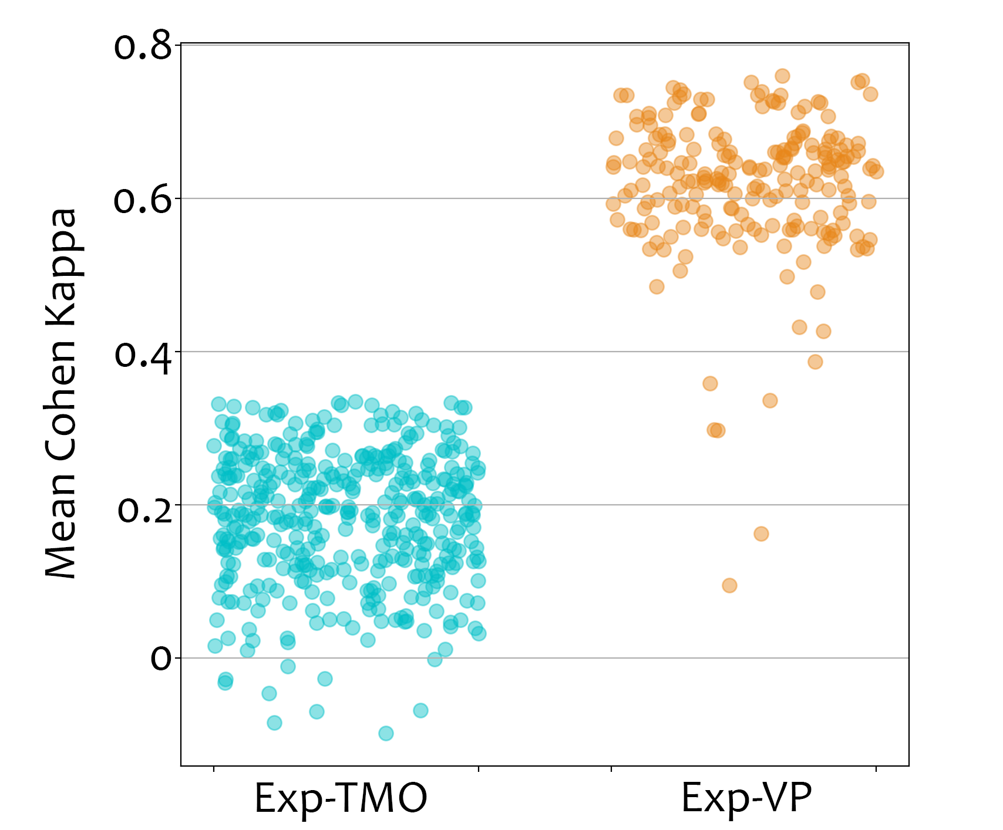
Comparison of the two PoE scenarios
Notes:
So by asking to compare the two experience, we can simplify the task and eliminate the issues arise with the rating methods.
Of course PoE has its own drawbacks too. Exponentially increasing number of pairs to compare

Slide 9
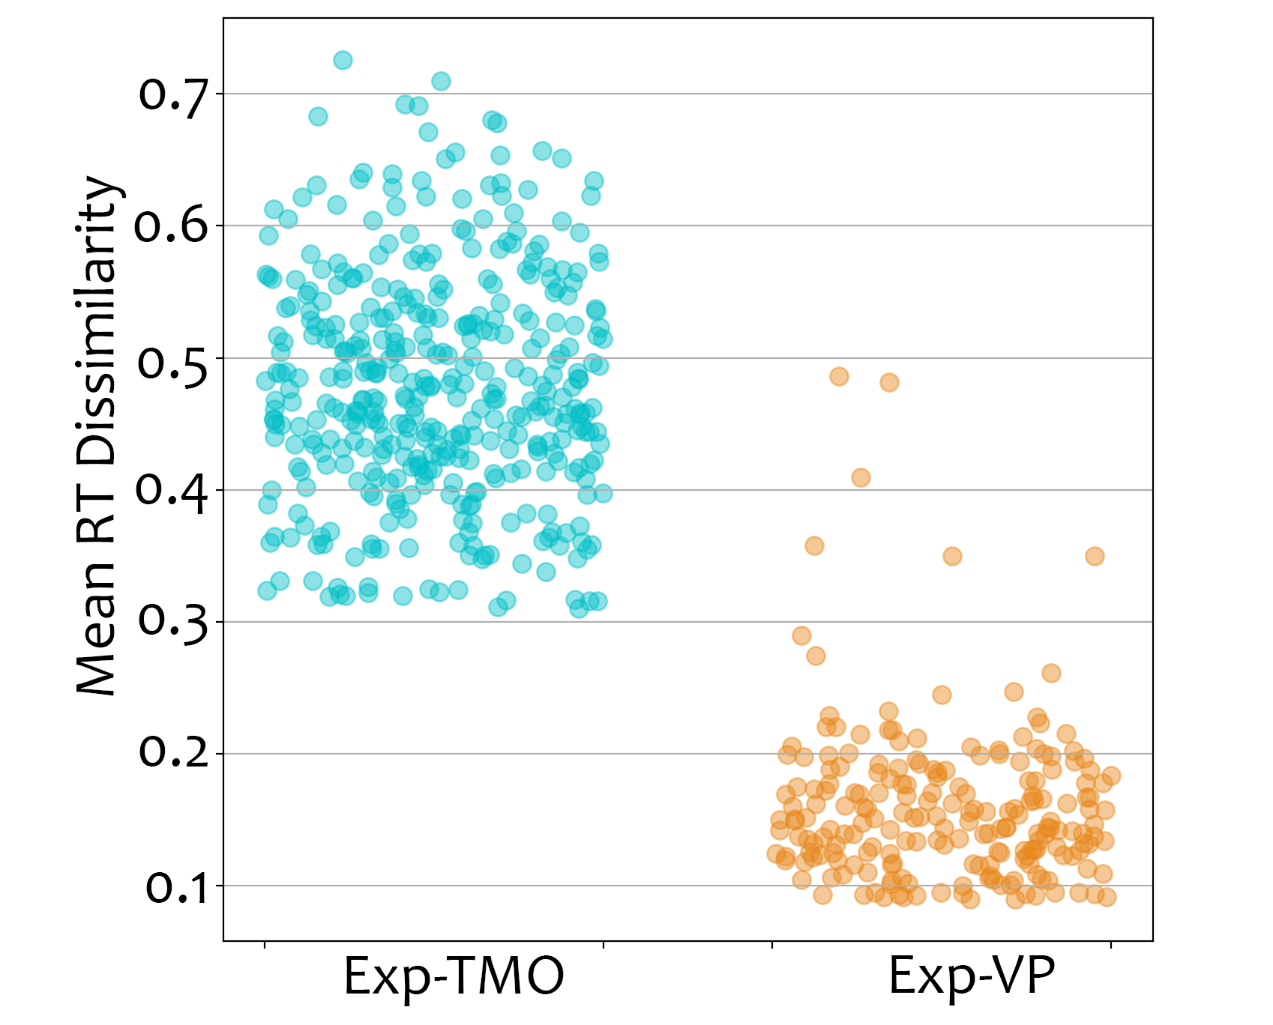
Comparison of the two PoE scenarios
Notes:
So by asking to compare the two experience, we can simplify the task and eliminate the issues arise with the rating methods.
Of course PoE has its own drawbacks too. Exponentially increasing number of pairs to compare

Slide 10
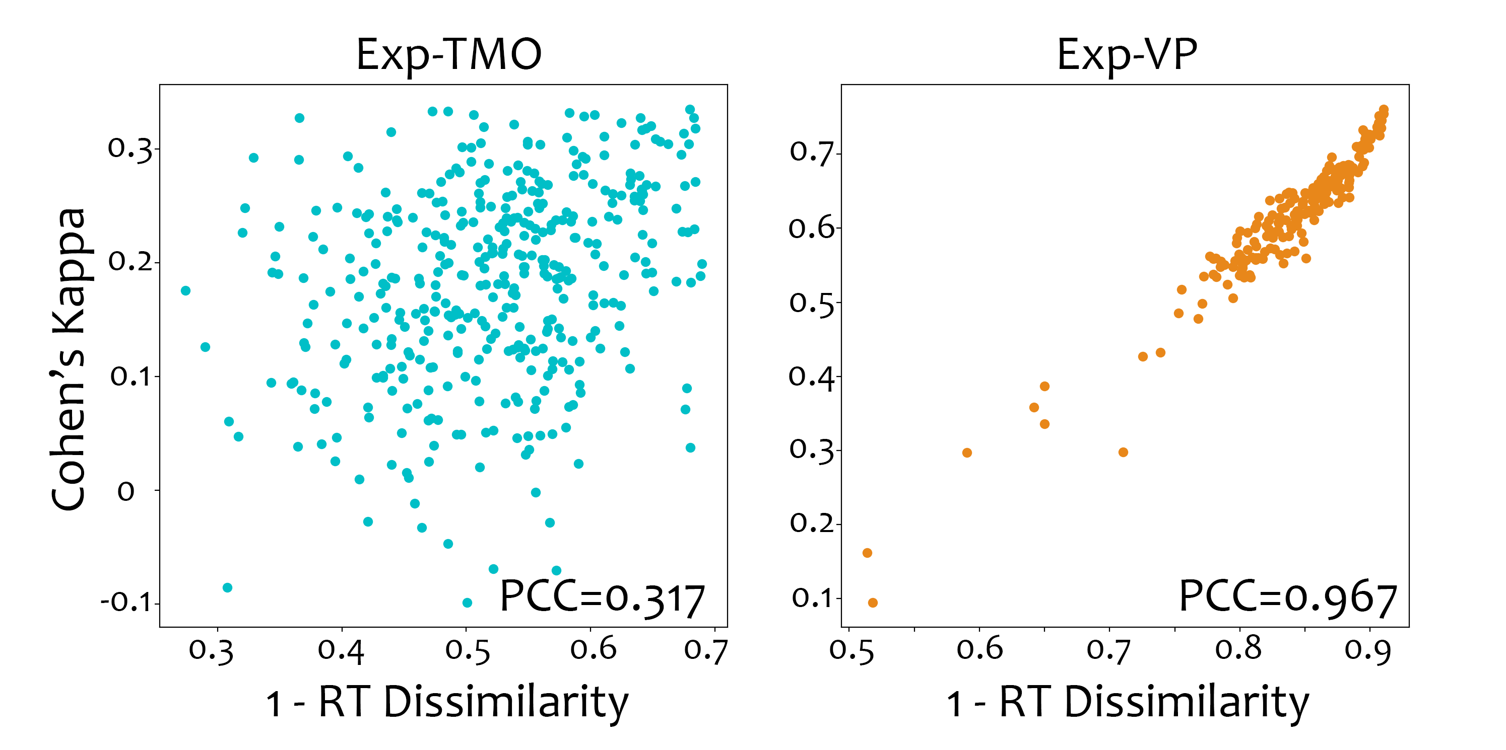
Correlation between Cohen’s Kappa and RT dissimilarity
Notes:
So by asking to compare the two experience, we can simplify the task and eliminate the issues arise with the rating methods.
Of course PoE has its own drawbacks too. Exponentially increasing number of pairs to compare

Slide 11
Defining spammer behavior
Consistently giving unacceptable responses to the QoE task
Reasons for spammer behaviors:
  Lack of attention
  Maximizing financial gains
  Misunderstandings
Notes:
So by asking to compare the two experience, we can simplify the task and eliminate the issues arise with the rating methods.
Of course PoE has its own drawbacks too. Exponentially increasing number of pairs to compare

Slide 12
Synthetic spammer profiles
Random voter: Randomly voting on A or B
Lack of attention, maximizing financial gains
Repeater: Voting based on image position, e.g. left, right
Lack of attention, maximizing financial gains
Inverted voter: Voting on the opposite of his/her pairwise preference.
Misunderstanding the task
Mixed: Combination of the behaviors above.
Notes:
So by asking to compare the two experience, we can simplify the task and eliminate the issues arise with the rating methods.
Of course PoE has its own drawbacks too. Exponentially increasing number of pairs to compare

Slide 13
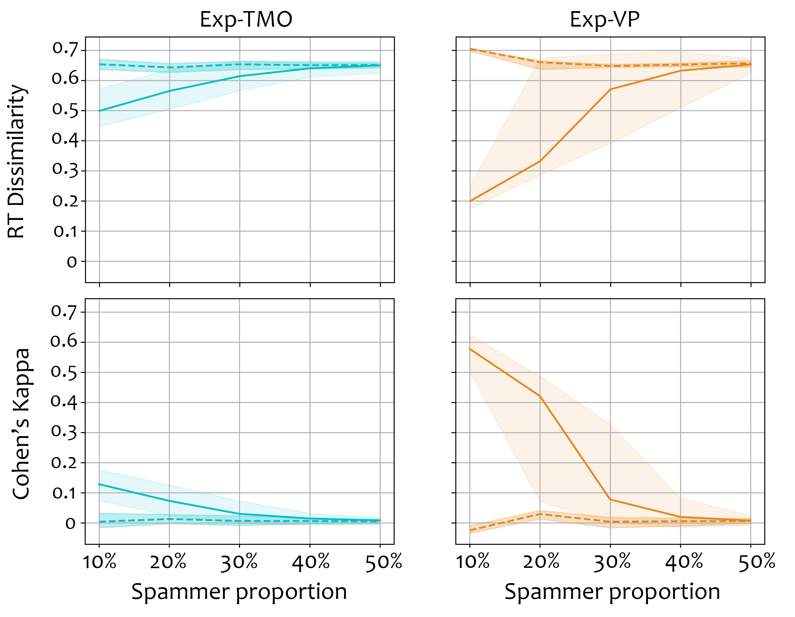
Influence of spammer proportion
Fixed spammer behavior intensity of %80 i.e. 80% generated spammer vote combined with 20% real observer vote
Mean values and 75% percentile ranges are plotted on the figure.
Solid lines – Real observers
Dashed lines – Synthetic spammers
Notes:
So by asking to compare the two experience, we can simplify the task and eliminate the issues arise with the rating methods.
Of course PoE has its own drawbacks too. Exponentially increasing number of pairs to compare

Slide 14
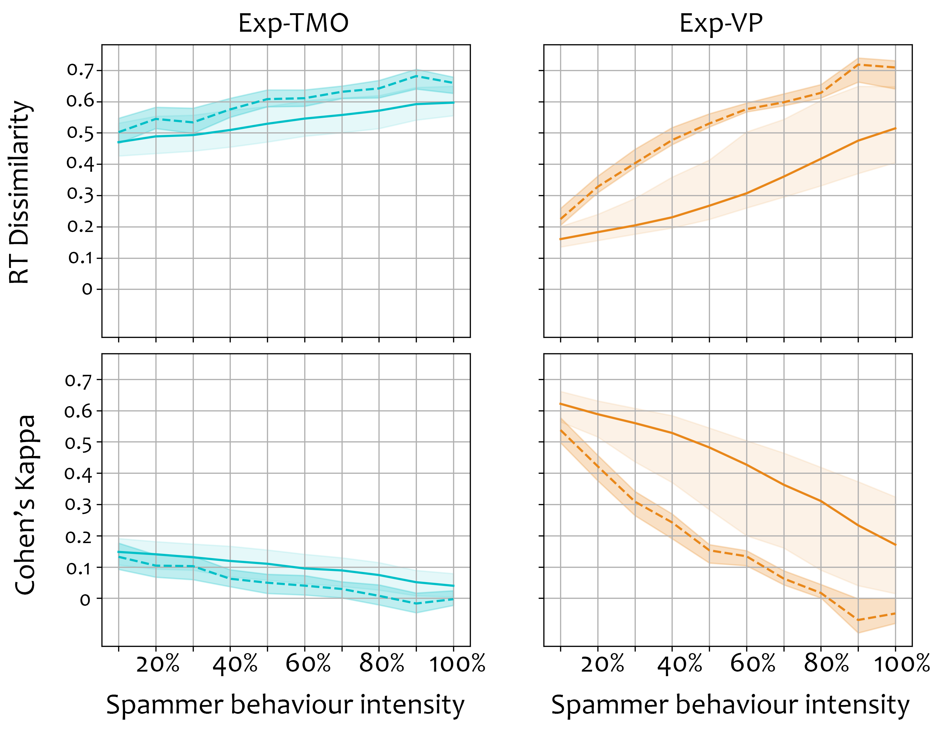
Influence of spammer behavior intensity
Fixed spammer proportion of %20
Mean values and 75% percentile ranges are plotted on the figure.
Solid lines – Real observers
Dashed lines – Synthetic spammers
Notes:
So by asking to compare the two experience, we can simplify the task and eliminate the issues arise with the rating methods.
Of course PoE has its own drawbacks too. Exponentially increasing number of pairs to compare

Slide 15
Conclusion
Subjectivity of the QoE scenario plays an important role on observer agreement
Using a universal threshold of agreement is not possible and should be adjusted for each experiment
30% to 40% spammer proportions makes the spammers and reliable observers indistinguishable in terms of mean measures.
Simply using the mean agreement is not sufficient to identify spammers!
  (Future/recent work)
Notes:
So by asking to compare the two experience, we can simplify the task and eliminate the issues arise with the rating methods.
Of course PoE has its own drawbacks too. Exponentially increasing number of pairs to compare

Slide 16
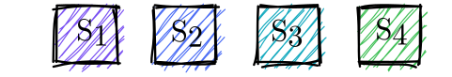
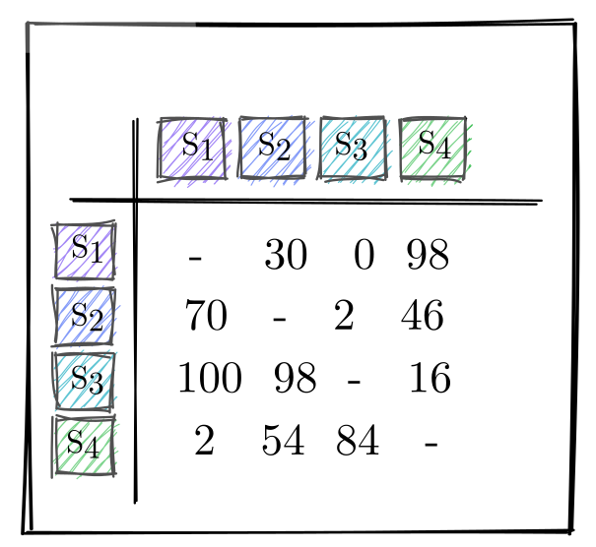
Pair Comparison Matrix
Pair Comparison Matrix
Notes:
So by asking to compare the two experience, we can simplify the task and eliminate the issues arise with the rating methods.
Of course PoE has its own drawbacks too. Exponentially increasing number of pairs to compare

Slide 17
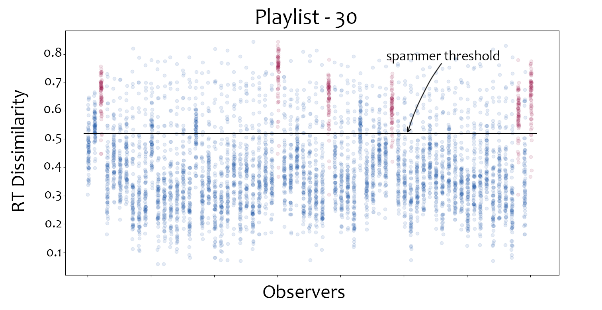
RT dissimilarities of each observer with the rest of the observers
Notes:
So by asking to compare the two experience, we can simplify the task and eliminate the issues arise with the rating methods.
Of course PoE has its own drawbacks too. Exponentially increasing number of pairs to compare

Slide 18
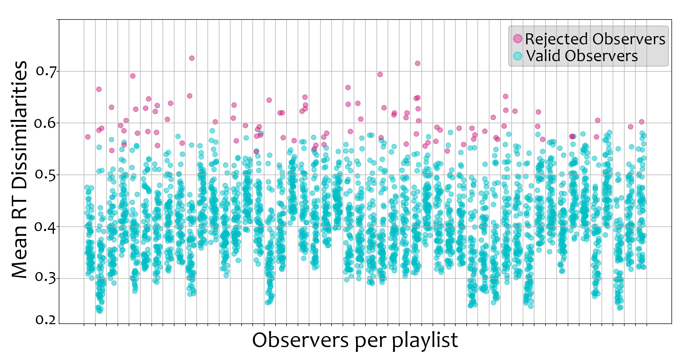
Rejected observers on the large scale dataset
Notes:
So by asking to compare the two experience, we can simplify the task and eliminate the issues arise with the rating methods.
Of course PoE has its own drawbacks too. Exponentially increasing number of pairs to compare

